Slide 1
Lesson 1: Animal Health
Grades
3rd – 5th
Making Cows Smile

Slide 2
Part 1
Introduction

Slide 3
Introduction
Dairy farming is a way of life to over 40,000 farm families in the United States.
Dairy farmers have a very important job to do.
They work with many people to take good care of their animals. We depend on those animals to produce milk to keep us healthy.

Slide 4
Learning Objectives
Students will list at least three ways farmers care for their cows.
Students will name people who help the dairy farmer care for their animals.
Students will list the skills, education, and responsibilities of being a veterinarian.

Slide 5
Essential Vocabulary
Bulk Tank – a special container used to cool and store milk on the dairy farm until it is picked up to be processed
Bull – a male calf or cow
Calf – a baby cow
Cud – something produced after a cow eats her food
Dairy Cow – a farm animal who is female and produces milk for us to drink
Heifer – a female calf or teen-aged cow
Milker – the unit that removes the milk from the cow’s udder
Total Mixed Ration – the special mix of feed that a cow eats to meet her specific dietary needs
Udder – the part of a cow’s body which produces and stores milk

Slide 6
Careers with Meanings
Dairy Farmer – a person who takes care of cows and provides milk for us to drink
Herd Manager (i.e. Herdsman) – a farm employee who has special training in cow health
Nutritionist – someone who has special training in balancing a mixture of feed to keep cows healthy
Veterinarian - an animal doctor who gives regular medical care to the animals

Slide 7
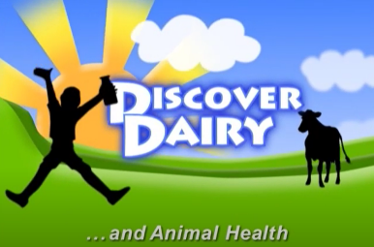
Activating Strategy
Let’s discover how the health and care of dairy cows are important to the farmer by watching the video, Discover Dairy and Animal Care.

Slide 8
Part 2
Main Areas of Cow Care

Slide 9
Introduction
Just like our parents do many things to take care of us, dairy farmers do many things to take good care of their animals. The animals on a dairy farm that give milk are called cows. Baby cows are called calves, and a female calf is called a heifer.

Slide 10
A Dairy Farmer’s Main Responsibilities
Providing their animals with a place to live
Keeping their animals healthy
Providing their animals with a nutritious diet
Providing safe milk and dairy products for us

Slide 11
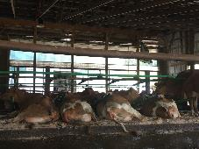
Providing Animals with Place to Live
Each dairy farmer chooses a style of home for the animals with the top priority being cow comfort.
Most cows live in barns together with separate beds called stalls. These stalls are kept dry and warm for cows to rest well.
Stalls even have water mattresses on them!
Stalls are bedded with different types of material such as sawdust, sand, straw, newspaper, and even dried manure.

Slide 12
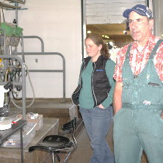
Keeping their Animals Healthy
Cows receive regular medical check-ups from an animal doctor called a veterinarian.
Veterinarians help farmers vaccinate their cows and have proper medications when cows are sick.
Cows are vaccinated to protect them from diseases.
Dairy Herd Managers are farm employees who have special training in cow health care and take care of cows everyday on the farm.

Slide 13
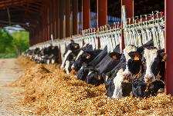
Providing Animals with Nutritious Diets
Cows eat 90 pounds of food a day — that’s like 360 hamburgers!
Cows drink 50 gallons of water a day – that is a bathtub full of water!
Cows eat a special mix of feed called a total mixed ration or TMR. TMR includes corn, wheat, grass, hay, and grain mixed with nutrients and minerals and is customized for each cow.
The farmer works with a nutritionist, someone who has specialized training in balancing feed rations, to prepare a ration with a carefully formulated mix of nutrients and minerals to keep the cows healthy.

Slide 14
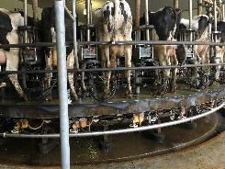
Providing Safe Food for Us
Cows are milked two or three times a day on dairy farms.
Cows like to be milked; it does not hurt them.
Routine milking keeps the cows healthy and happy.
It only takes 3 – 7 minutes for a cow to be milked.
Cows produce 60 – 120 pounds of milk a day; that is seven to fifteen gallons of milk!
The dairy farmer uses special equipment called a milker to remove the milk from the cow’s udder and send it into a cooling area called a bulk tank.

Slide 15
Closure
We discussed what dairy farmers do everyday to take care of their cows. Tell the class one way that dairy farmers are responsible for the care of their cows.

Slide 16
Part 3
Career Spotlight: Veterinarian

Slide 17
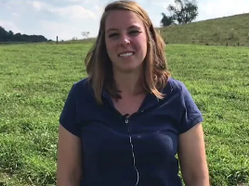
Career Spotlight: Veterinarian
Let’s learn more about a career in dairy and agriculture. We will hear from a veterinarian in this video, Ag Careers Veterinarian.

Slide 18
Responsibilities of Veterinarians
Travel to the farm for regular visits as well as emergency calls
Prescribe and administer medications and vaccinations to all types of animals
Draw blood for testing and diagnose illness and disease
Perform surgeries
Operate medical equipment like X-ray machines and ultrasound technology
Advise on ways to prevent occurrence or spread of diseases
Adhere to standard safety protocols and maintain a clean, sterile environment

Slide 19
Education to be a Veterinarian
Bachelor’s Degree in Animal Nutrition, Animal Science, Biology, Chemistry, Zoology or other related major (required, before doctoral program acceptance)
Doctorate of Veterinary Medicine (required)
Certifications for Therapy, Ophthalmology, Anesthesiology, or Neurology can be considered (optional)

Slide 20
Closure
Dairy farmers depend on veterinarians to help them take care of their cows.
Tell us one way that veterinarians help dairy cows.
Are you interested in being a veterinarian when you grow up?

Slide 21
Part 4
Activity

Slide 22
Introduction
Today we discussed the important job dairy farmers do everyday to take care of their cows. They work with many people to take good care of their animals, so we have milk to keep us healthy. Let’s complete a fun activity to see what you learned.

Slide 23
Activity
Take some time to complete this activity.

Slide 24
Lesson Closure
Today you learned about what dairy farmers do every day to take care of their cows and that they work with many people to take good care of their animals, so we have milk to keep us healthy. Tell us one person farmers work with and what that person does to help the farmer and his or her cows.

Slide 25
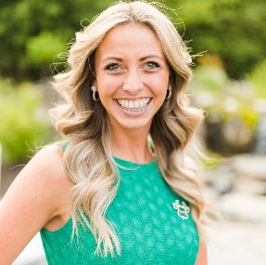
Brittany Snyder Call: 717-788-0297 Email: bsnyder@centerfordairyexcellence.org
Notes:
You can feel free to follow me, but I highly encourage you to go and follow: Discover Dairy, Dairy Leaders of Tomorrow, Dairy Excellence Foundation and Center for Dairy Excellence
-following will help you see important information to share.
Before I wrap up, I dropping a few different links in the chat box one more time for you. A link to this presentation, a link to the key messages discussed earlier, the link to the quiz you need to complete and a link to a schedule with links and details about joining me throughout the week for the other programs.
And again, if you have questions or comments you want to share either about this webinar or about the dairy industry after this webinar is over, please feel free to text or call 717-585-0875 and we will get back to you as soon as possible with answers.
Thank you everyone for joining me today and I look forward to seeing you again tomorrow!

