Slide 1
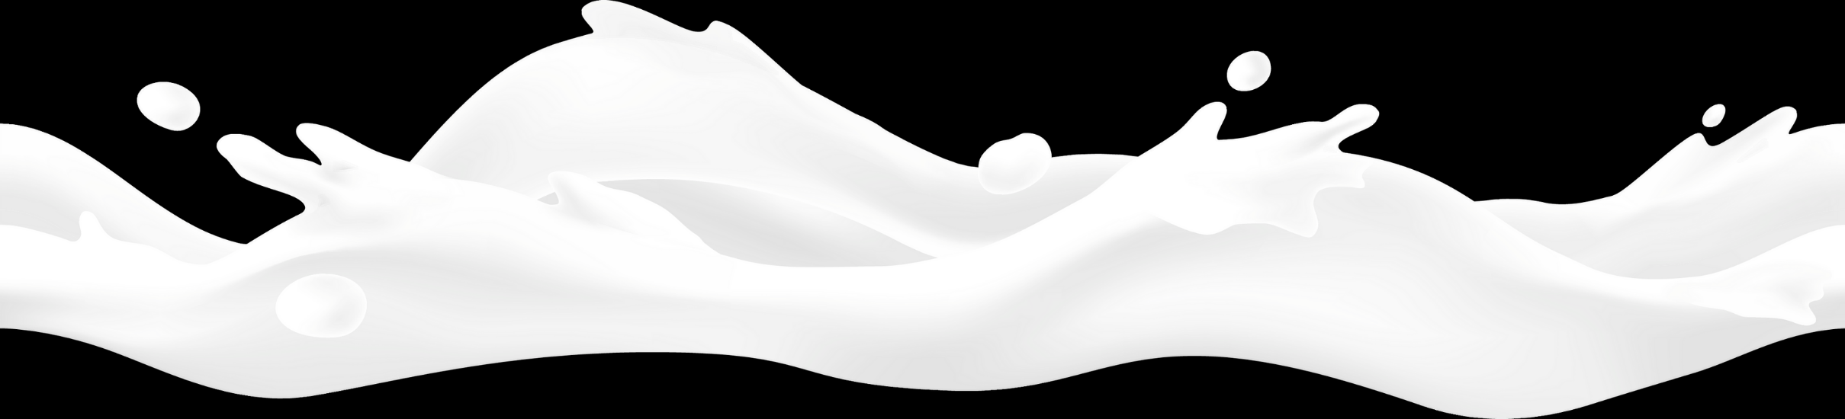

LESSON 2
Milk Quality and Safety
Keeping Milk Fresh

Slide 2


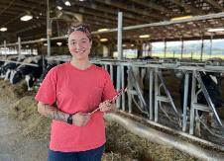
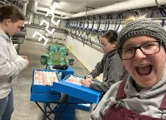
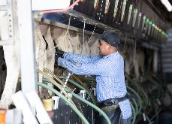
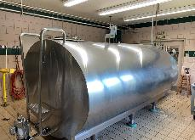
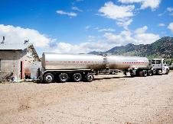
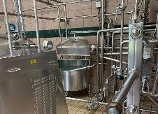
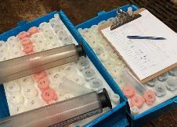
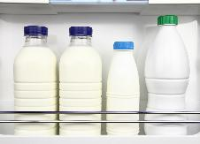
Introduction
HOW DOES MILK GET FROM THE COW TO THE CONSUMER?
We will learn the steps taken to make sure milk is safe and a quality food from the time it leaves the cow to when it is bought in the store to when you drink it or eat foods made with it.

Slide 3
Essential Vocabulary
DAIRY DEFINITIONS
Inspector: a person who checks dairy barns, cows, and equipment to make sure they are kept clean and safe.
Milk Tank: a special container where milk is cooled to under 40°F and stored until picked up and taken to the processing plant.
Milking Equipment: the unit used to gently remove the milk from the cow’s udder.
Pasteurization: the process of heating milk to at least 145°F for a short period of time which makes sure milk and dairy foods are safe to drink and eat.
Processing Plant: the place where milk is pasteurized and bottled for fluid milk or made into dairy foods.
Sanitize: To clean something making sure any dirt or harmful deposits are removed.
Teats: the projections on the bottom of the udder with openings for the milk to leave the udder.
Udder: the part of a cow’s body which makes and holds milk

Slide 4
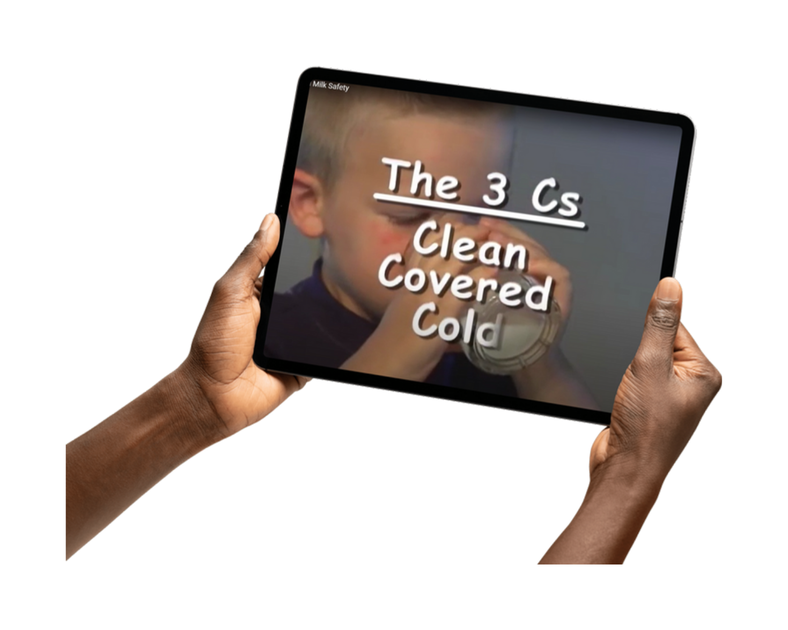

Activating Strategy
DISCOVER DAIRY AND MILK SAFETY
Let’s discover how milk is kept clean and safe when it leaves the cow to when we enjoy it.

Slide 5
Keeping Milk Fresh and Safe
INTRODUCTION
Have you ever thought about how much milk from the cow becomes dairy products that we eat?
There are 8 important steps that go into making sure milk and the dairy foods we buy are safe and wholesome.

Slide 6
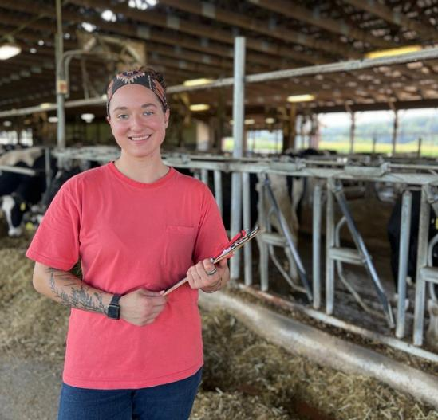
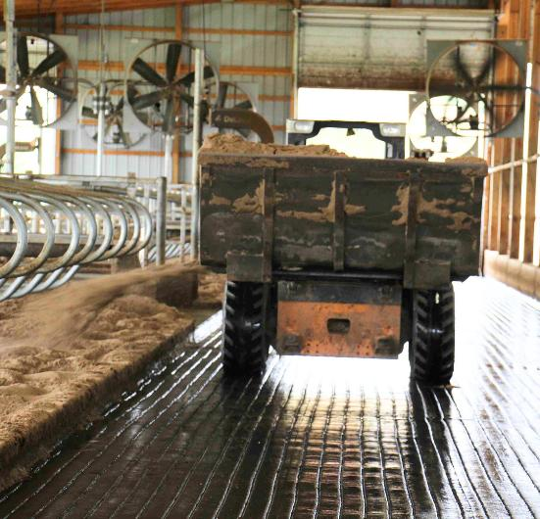
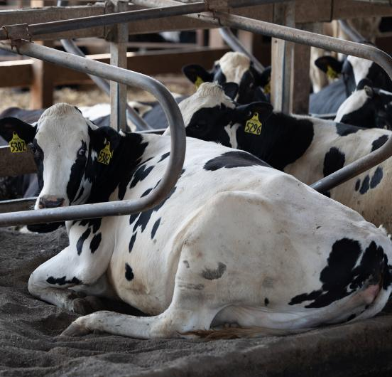
Keeping Milk Fresh and Safe
STEP 1: HEALTHY COWS AND CLEAN BARNS
A farmer’s job is to keep the cows healthy and the barns clean.
Cows must be clean, comfortable, and well cared for.
Barns must be clean and well kept.
Healthy cows produce quality milk.

Slide 7

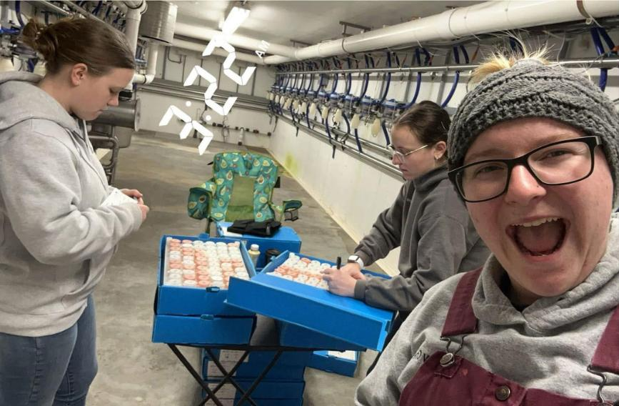
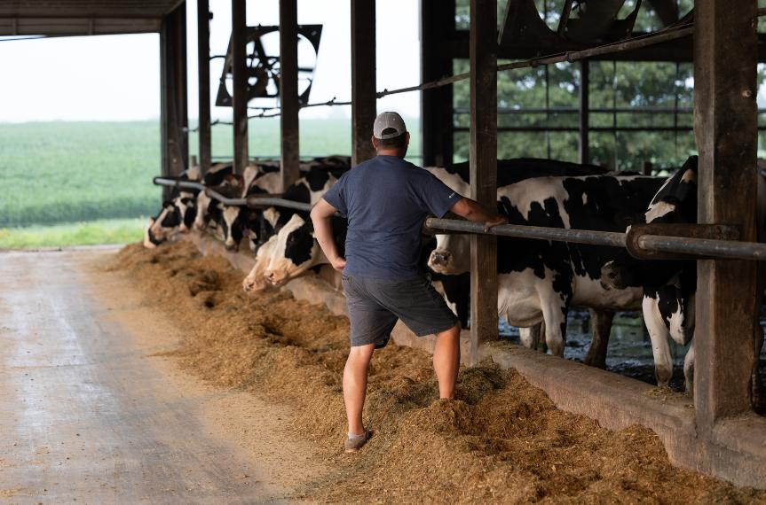
Keeping Milk Fresh and Safe
STEP 2: INSPECTIONS
Cows are milked two or three times every day.
Dairy farmers are regularly checked by milk inspectors.
Milk inspectors make sure the barn, cows, and milking equipment are clean.

Slide 8
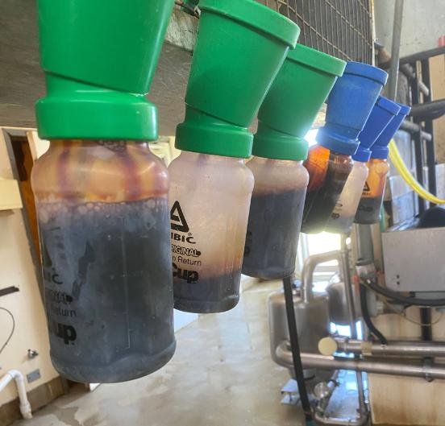
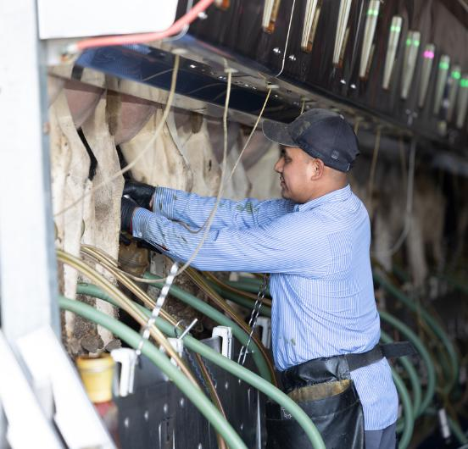
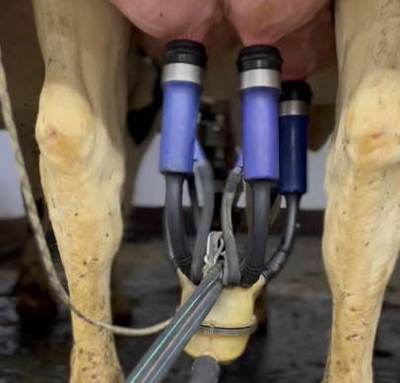
Keeping Milk Fresh and Safe
STEP 3: THE MILKING PROCESS
Before milking, the cow’s udder is cleaned to make sure the milk stays clean.
The milking equipment gently squeezes the milk out of the udder through the teats.
The milking process takes about 5 to 8 minutes.
Cows like to be milked.

Slide 9
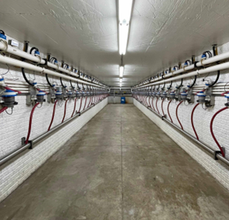
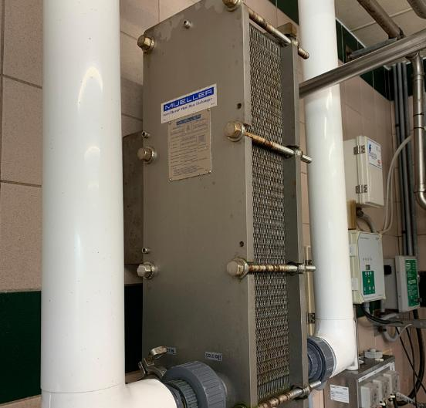
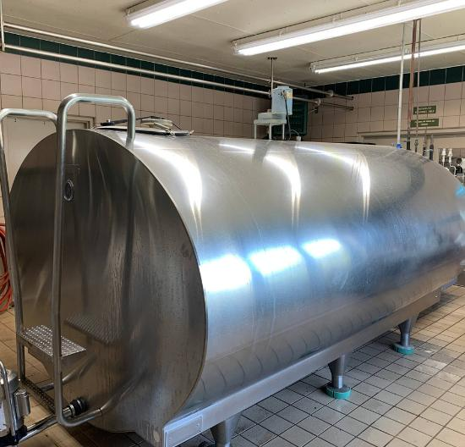
Keeping Milk Fresh and Safe
STEP 4: COOLING THE MILK
Milk flows through clean pipelines to the large milk tank.
The milk runs through a plate cooler to lower the temperature quicker.
Milk is cooled quickly to under 40°F to keep it fresh.

Slide 10
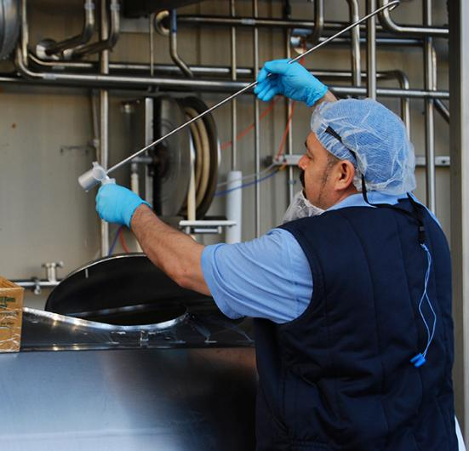
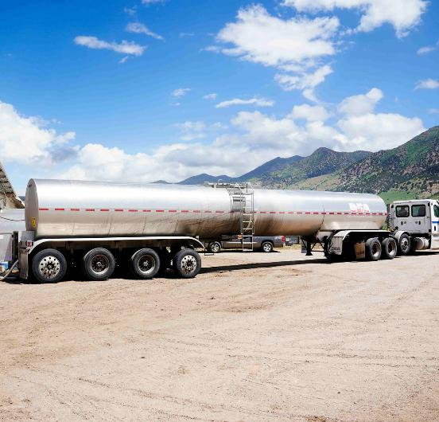
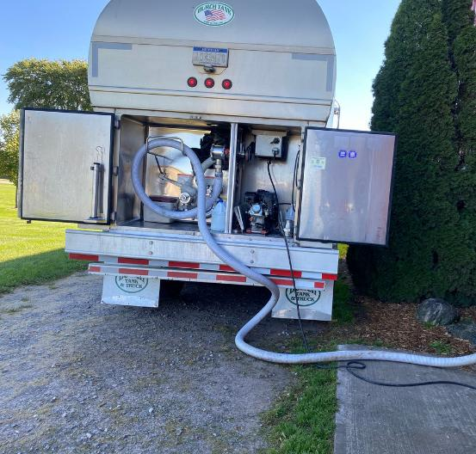
Keeping Milk Fresh and Safe
STEP 5: “MOO”VING THE MILK
Milk is picked up by refrigerated trucks every one or two days.
Milk trucks take the milk from the farm to the milk processing plant.
Most of the milk gets to the processing plant in less than two days from coming out of the cow.

Slide 11
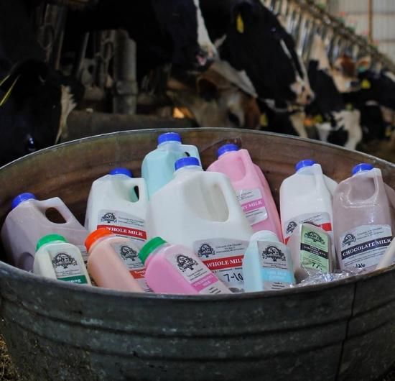
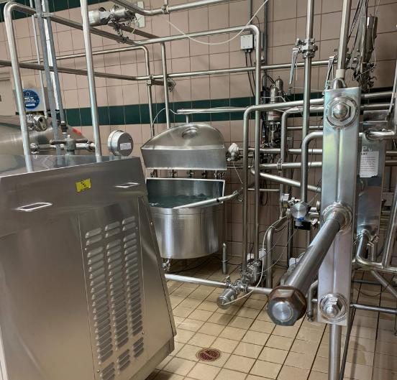
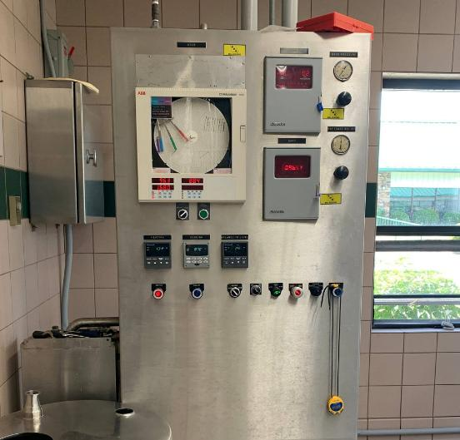
Keeping Milk Fresh and Safe
STEP 6: PASTEURIZATION
Pasteurization is a very important step to milk safety. It kills possible germs and bacteria.
Pasteurization is the process of heating milk to high temperatures for a short period of time.
The milk is heated to at least 145° for a few minutes.
Pasteurization ensures milk and dairy foods are safe to drink and eat.

Slide 12
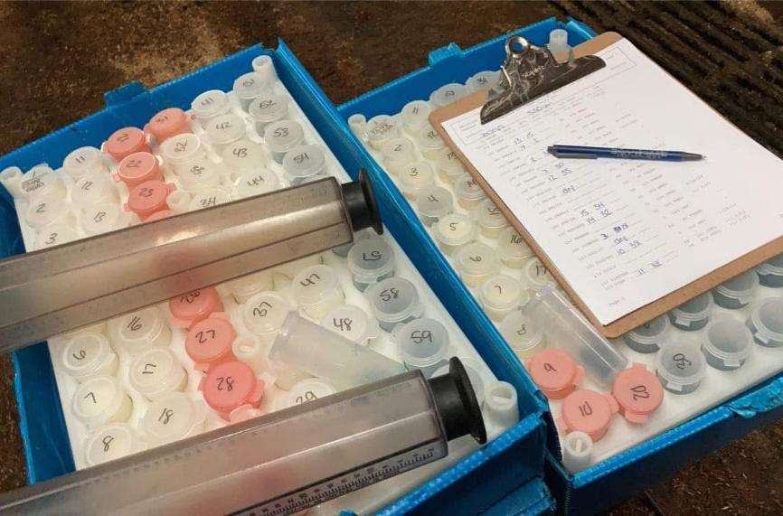
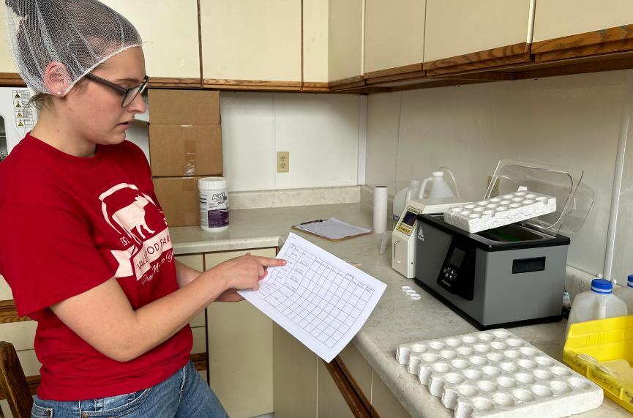
Keeping Milk Fresh and Safe
STEP 7: MORE TESTING
Milk is tested and retested up to 17 times during its trip from the farm to the grocery store.
Cows are milked two or three times every day.
Quality and safety are key. If the milk does not meet safety standards, it is thrown away.

Slide 13



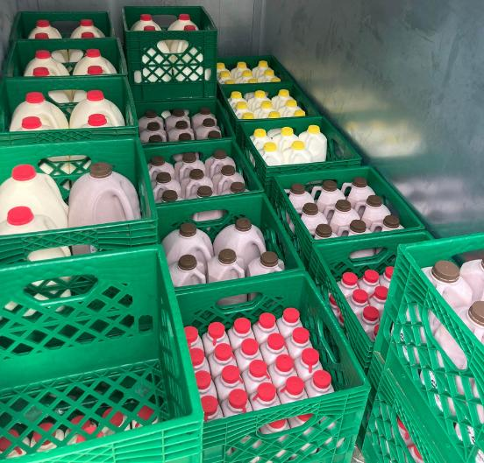
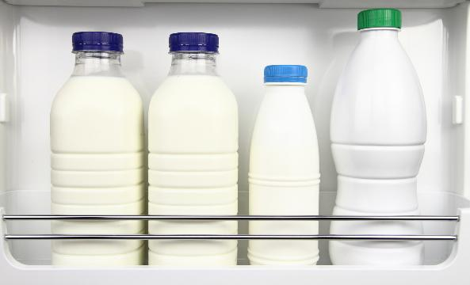
Keeping Milk Fresh and Safe
STEP 8: OUR JOB - THE 3 C’S
Keep milk cold.
Keep milk covered.
Keep milk clean.
Once we get milk and dairy foods home, it is up to us to keep it safe and pure.

Slide 14
From Moo to You: The Journey of Milk
CLOSURE
Tell us how you can do your job to make sure your milk is safe.

Slide 15
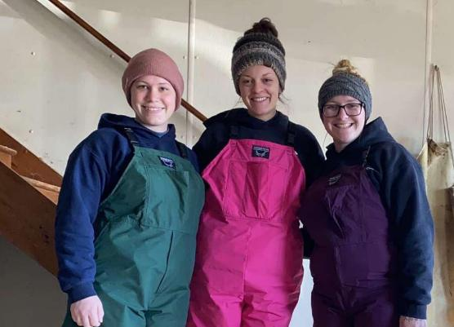
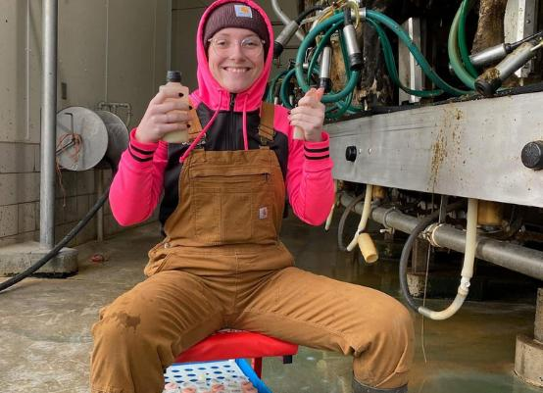
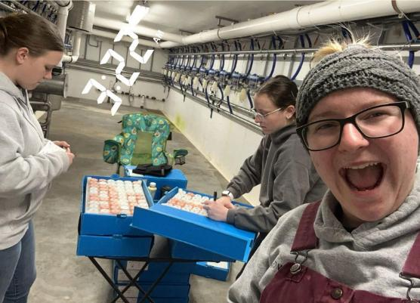
Career Spotlight: USDA Milk Inspector
INTRODUCTION
Milk inspectors are an important part when providing a healthy dairy product. They ensure every farmer is supplying safe, clean milk.

Slide 16

Career Spotlight: USDA Milk Inspector
ACTIVATING STRATEGY
Let’s discover the career of a milk inspector.

Slide 17
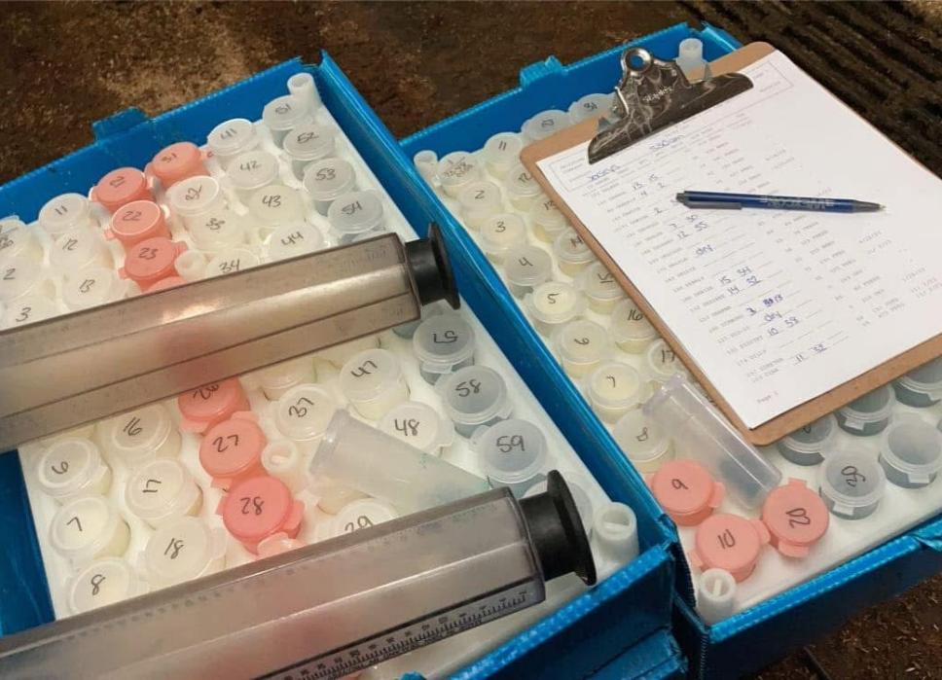
Career Spotlight: USDA Milk Inspector
MILK INSPECTOR RESPONSIBILITIES
1. Inspect dairy farms to make sure they obey various regulatory and food safety requirements
2. Collect and take samples to the lab for testing
3. Issue licenses to dairy producers
4. Write down and record violations
5. Give recommendations for farm improvements
6. Complete full reports that detail the conditions at the dairy farms

Slide 18
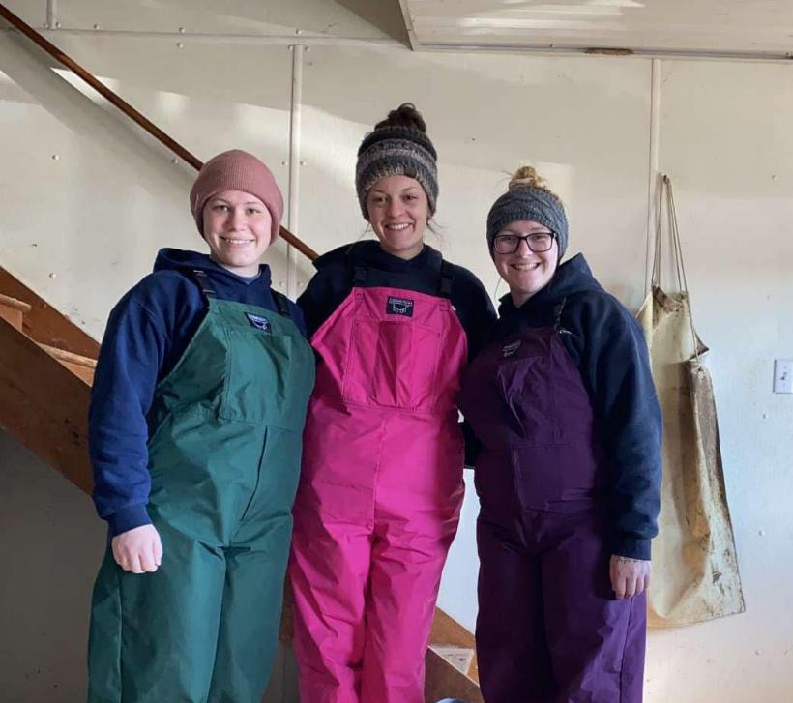
Career Spotlight: USDA Milk Inspector
WHO IS THE MILK INSPECTOR
REQUIRED EDUDATION: Milk inspectors need a bachelor’s degree in Animal Science, Agriculture Business, or other related majors.
The milk inspector provides a fresh set of eyes on many different dairy farms multiple times a year. They enjoy working with dairy farmers and are important members of dairy’s health and safety team.
They are needed to make sure milk and dairy foods are safe and help to produce high quality foods to drink and eat.

Slide 19
Career Spotlight: USDA Milk Inspector
CLOSURE
  Tell us one way that milk inspectors make sure our milk is fresh and safe.
  Are you interested in being a milk inspector when you grow up?

Slide 20
Milk Color Explosion Lab
INTRODUCTION
Today we discussed the steps taken to make sure milk is fresh and safe to drink. Milk is tested up to 17 times during this process.
Let’s complete a fun lab to model testing milk with a twist that will give us colorful results.

Slide 21
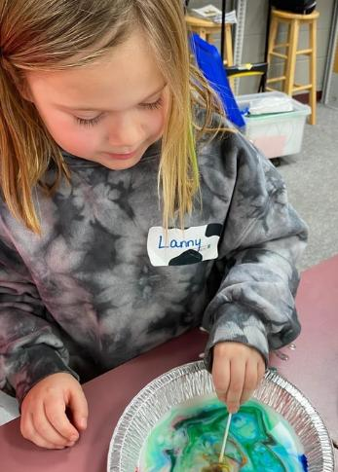
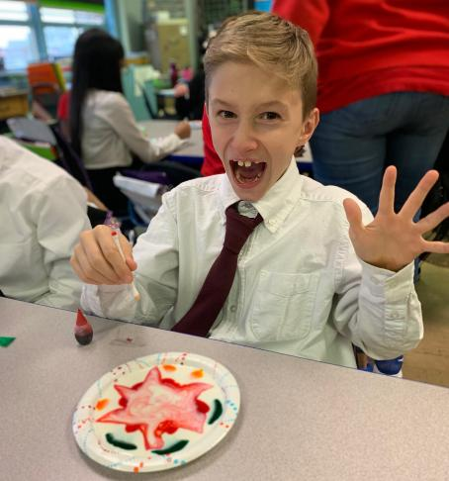
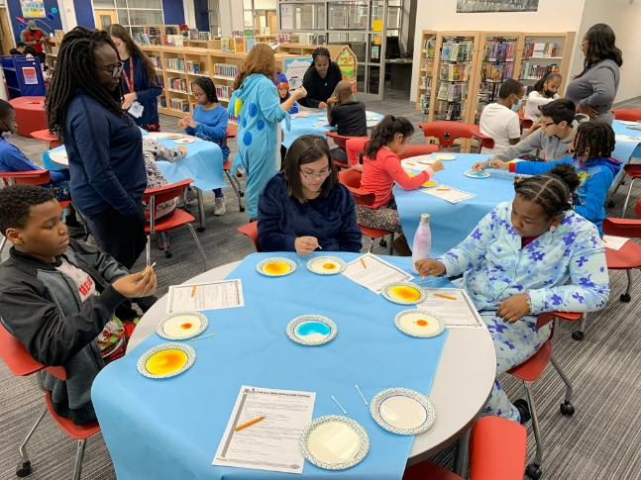
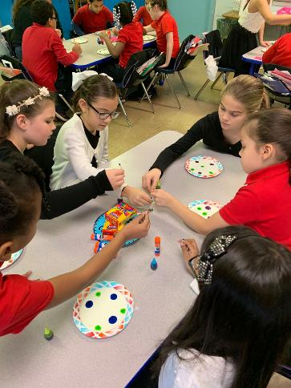
Milk Color Explosion Lab
RESULTS
Why did the food coloring in your whole milk “explode”?

Slide 22
Closure
Share one thing you learned today about “Keeping Milk Fresh”.

