Slide 1
Lesson 1: Animal Health
Grades
6th – 8th
Making Cows Smile

Slide 2
Part 1
Introduction

Slide 3
Introduction
Dairy farming is a way of life to over 40,000 farm families in the United States. Dairy farmers have a very important job to do.
A healthy, well-cared-for cow will give more milk. The way farmers care for their cows and how they feed them has helped to increase the amount of milk cows give over the past 50 years.
In this lesson, you will learn how dairy farmers work with others to make sure that their cows’ diet is balanced and nutritious to keep the cows healthy and happy.

Slide 4
Learning Objectives
Students will read a nutrition label correctly.
Students will create a nutritious snack balanced with specific requirements.
Students will list the responsibilities and education of a nutritionist.

Slide 5
Essential Vocabulary
Calorie – the amount of energy in food
Cud – partially digested food that a cow chews again
Dairy Cow – a farm animal who is female, has had a baby, and produces milk for us to drink
Diet – the kinds of food that people and animals eat regularly
Nutrient – a substance that is necessary for life and growth
Nutritionist – someone who has special training in balancing a mixture of feed to keep cows healthy
Total Mixed Ration – the special mix of feed that a cow eats to meet her specific dietary needs

Slide 6
Activating Strategy
Let’s discover how the health and care of dairy cows are important to the farmer by watching the video, Discover Dairy and Animal Care.

Slide 7
Part 2
Nutrition Lab

Slide 8
Introduction
A healthy, well-cared-for cow will give more milk. The way farmers care for their cows and how they feed them has helped to increase the amount of milk cows give over the past 50 years. Just like our diets, a cow’s diet must be balanced.
In this lab, you will simulate how farmers use a large feeding scale and mixer to balance and weigh each feed to meet the cow’s precise nutrient needs. You will use measuring cups and nutritional labels to make a snack of a spinach salad and orange juice that contains the required nutrients.

Slide 9
Nutrition Lab
Make sure you have the needed materials for this lab.
As you work through the lab, make sure to complete the information on the Nutrition Lab Sheet.
Feel free to ask questions and seek help as needed.

Slide 10
Closure
Today you simulated how farmers balance and weigh each feed to meet the cow’s precise nutrient needs by making a snack of a spinach salad and orange juice that contained the needed amounts of nutrients.
How do you think adding 6 more foods to your salad would change your experiment?

Slide 11
Part 3
Career Spotlight: Nutritionist

Slide 12
Introduction
When we went over key vocabulary, we had a definition for a nutritionist. A nutritionist is someone who has special training in balancing a mixture of feed to keep cows healthy.
Let’s explore more about the career of a Nutritionist.

Slide 13
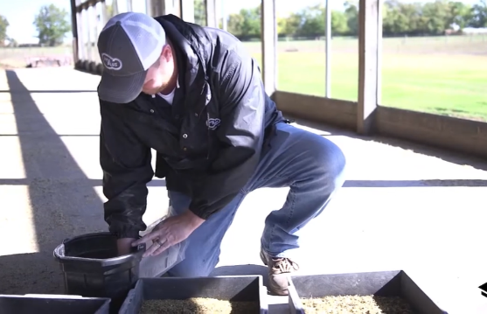
Career Spotlight: Nutritionist
Let’s learn more about a career in dairy and agriculture. We will hear from a nutritionist in this video, Animal Nutritionist.

Slide 14
Responsibilities of Nutritionists
Communicate with existing clients
Locate and recruit potential customers
Ensure that the nutritional needs of their animals are satisfied
Create feed formulas that maximize the growth of their customers' livestock

Slide 15
Education to be a Nutritionist
Bachelor’s Degree in Agriculture Science, Animal Science, Animal Nutrition, or related fields (Required)

Slide 16
Closure
Dairy farmers depend on nutritionists to help them take care of their cows.
Tell us one way that nutritionists help dairy cows.
Are you interested in being a nutritionist when you grow up?

Slide 17
Part 4
Kahoot Activity

Slide 18
Introduction
Today we discussed the important job dairy farmers do everyday to take care of their cows. They work with nutritionists to ensure cows have a balanced and nutritious diet, so we have milk to keep us healthy. Let’s complete a Kahoot review to see what you learned.

Slide 19
It’s time to play….
How to Play
Click the Kahoot box above
Type in the pin number provided for you and click “ENTER”
Wait for everyone to join the game
When the game begins, select the answers you think are correct as fast as you can. As you answer questions, you will earn points
The top three winners will be highlighted on the screen

Slide 20
Lesson Closure
Today you learned about the way farmers care for their cows and how they feed them. Just like our diets, a cow’s diet must be balanced.
In this lesson, you learned how dairy farmers work with a nutritionist to make sure that their cows’ diet is balanced and nutritious to keep the cows healthy and happy.

Slide 21
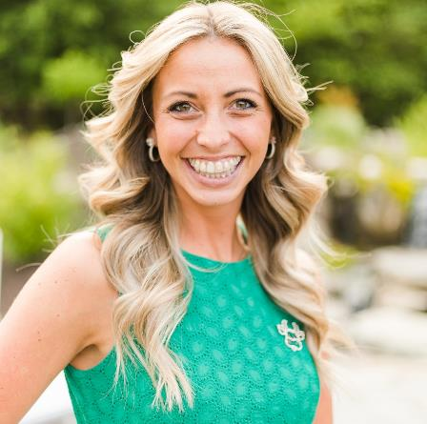
Brittany Snyder Text/Call: 717-788-0297 Email: bsnyder@centerfordairyexcellence.org
Notes:
You can feel free to follow me, but I highly encourage you to go and follow: Discover Dairy, Dairy Leaders of Tomorrow, Dairy Excellence Foundation and Center for Dairy Excellence
-following will help you see important information to share.
Before I wrap up, I dropping a few different links in the chat box one more time for you. A link to this presentation, a link to the key messages discussed earlier, the link to the quiz you need to complete and a link to a schedule with links and details about joining me throughout the week for the other programs.
And again, if you have questions or comments you want to share either about this webinar or about the dairy industry after this webinar is over, please feel free to text or call 717-585-0875 and we will get back to you as soon as possible with answers.
Thank you everyone for joining me today and I look forward to seeing you again tomorrow!

