Slide 1


LESSON 2
Milk Quality and Safety
Keeping Milk Fresh

Slide 2

Introduction
MILK IS THE MOST REGULATED AND SAFEST FOOD AVAILABLE TO YOU.
It is also used to make a variety of dairy products such as cheese, yogurt, ice cream, and butter. Milk is tested for quality and safety at the farm level, in route to the dairy processing plant, and at several points during processing. It is tested to make sure it does not contain any harmful contaminants and is safe to drink.
In this lesson, you will learn about the various safety and sanitation procedures milk undergoes throughout the processing stages. You will also learn about the processing of foods made from milk.

Slide 3
Essential Vocabulary
DAIRY DEFINITIONS
Dairy Products: foods made from milk
Fortification: the process of adding vitamins, such as Vitamins A and D, to milk before bottling it
Homogenization: the process of breaking up the fat globules in milk so cream does not separate in the milk
Pasteurization: the process of heating milk to high temperatures for a short amount of time to kill bacteria
Processing Plant: the place where milk undergoes procedures to ensure safety and bottled or made into dairy products
Sanitation: the process of cleaning something to ensure any dirt or harmful residues are removed
Standardization: the process of removing all the fat from the milk

Slide 4


Activating Strategy
DISCOVER DAIRY AND MILK SAFETY & QUALITY
Let’s discover how milk is tested to ensure its safety and quality.

Slide 5
Keeping Milk Fresh
INTRODUCTION
Have you ever thought about how milk from the cow becomes dairy products that we eat?
Let’s look at the processes milk undergoes to make sure it is safe to drink and use in making dairy products.

Slide 6
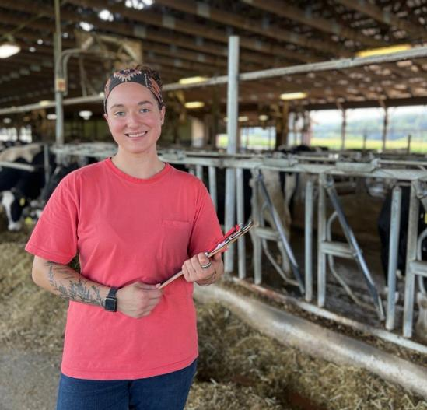
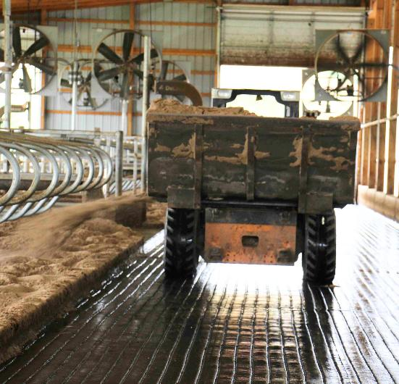
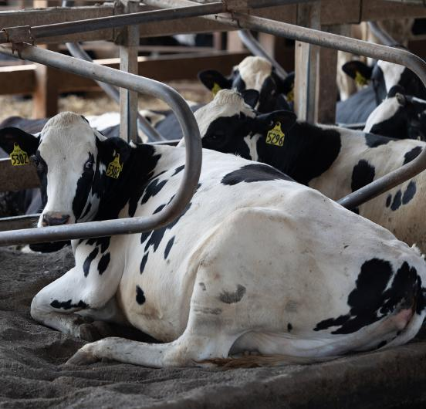
Keeping Milk Fresh
FARMERS TAKE CARE OF THE COWS
A farmer’s job is to keep the cows healthy and the barns clean.
Cows must be clean, comfortable, and well cared for.
Barns must be clean and well kept.
Healthy cows produce quality milk.

Slide 7
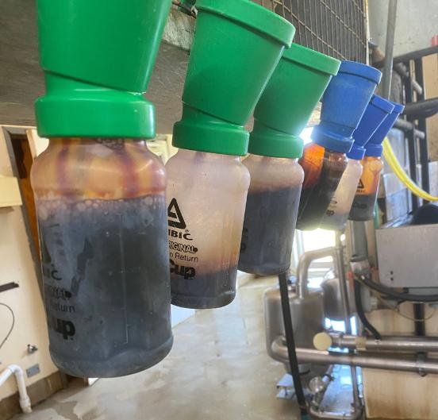
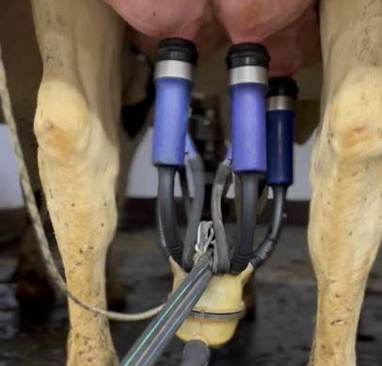
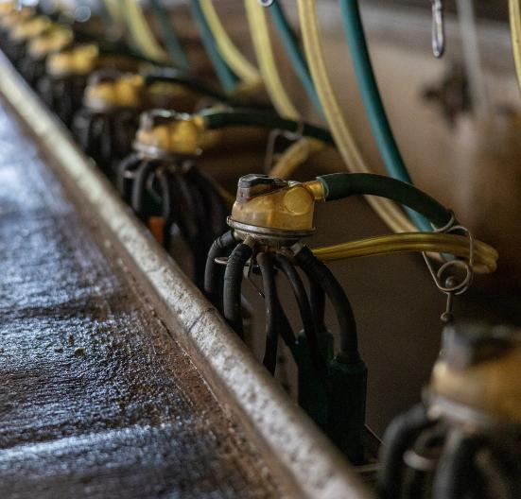
Keeping Milk Fresh
SANITATION
Before milking, the cow’s udder is cleaned to make sure the milk stays clean.
Milk is never touched by human hands to ensure safety.
All equipment and tanks are sanitized regularly.
From the cows to the equipment, everything is sanitized to remove any harmful residues.

Slide 8
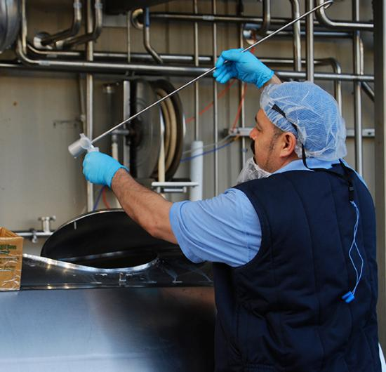
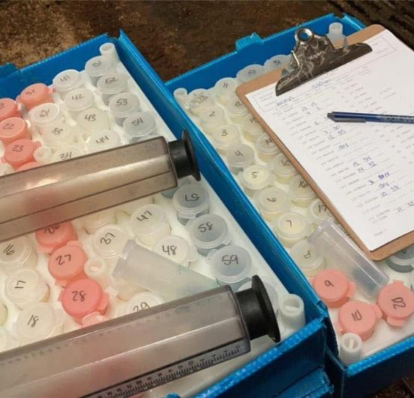
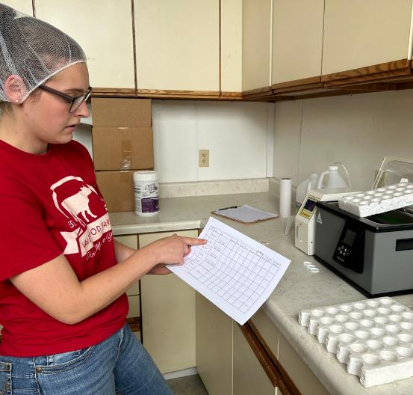
Keeping Milk Fresh
MILK TESTING
Milk is tested many times during its trip from the farm to the grocery store.
Every load of milk shipped from every dairy farm in the U.S. is tested for safety up to 17 times!
Milk that does not meet safety standards is thrown away.

Slide 9
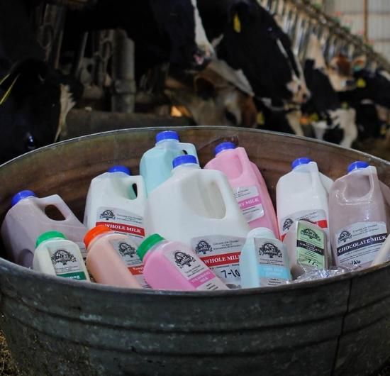
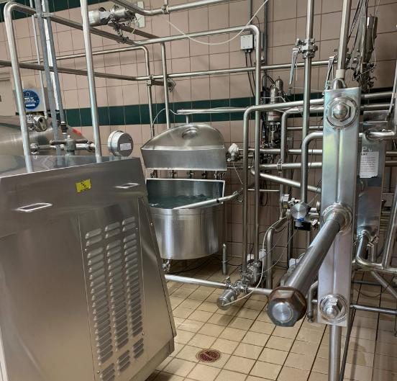
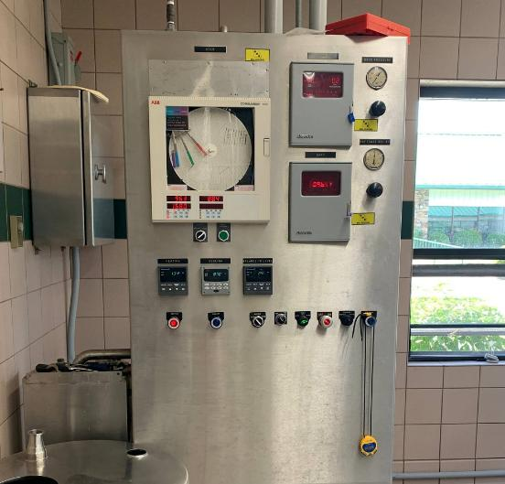
Keeping Milk Fresh
PASTEURIZATION
Pasteurization is a very important step to milk safety. It kills possible germs and bacteria.
Pasteurization is the process of heating milk to high temperatures for a short period of time.
The milk is heated to at least 161.5° for a few minutes.
Pasteurization ensures milk and dairy foods are safe to drink and eat.

Slide 10
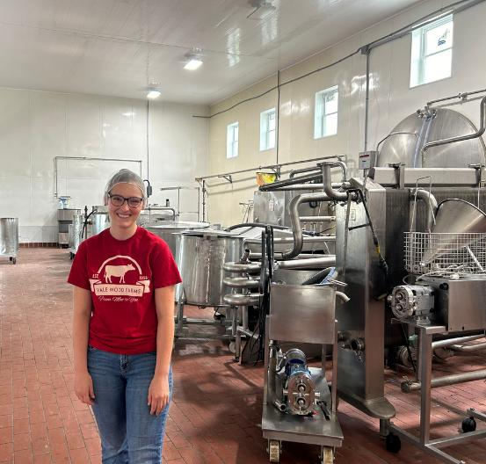
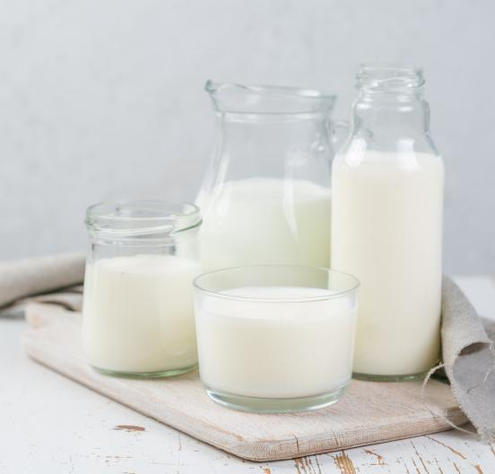
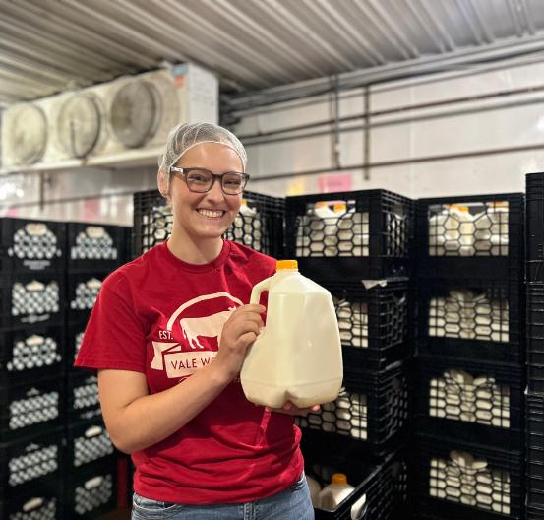
Keeping Milk Fresh
STANDARDIZATION
Standardization is the process of removing all the fat or cream from the milk at the processing plant.
Fat is then added back later to create the various types (is. 1%, 2%, and whole) of milk.
This milk is referred to as skim milk or fat-free milk.

Slide 11
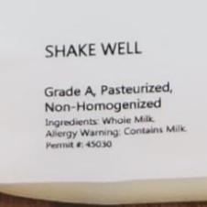
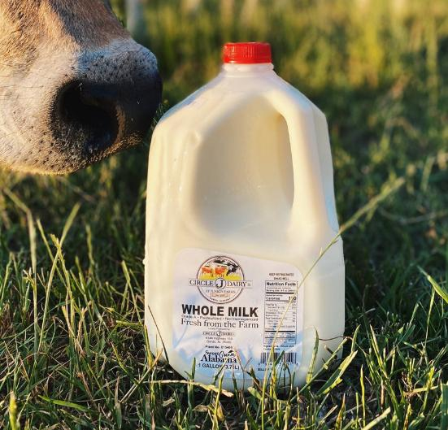
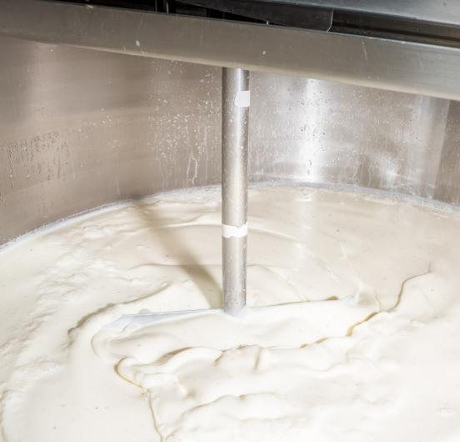
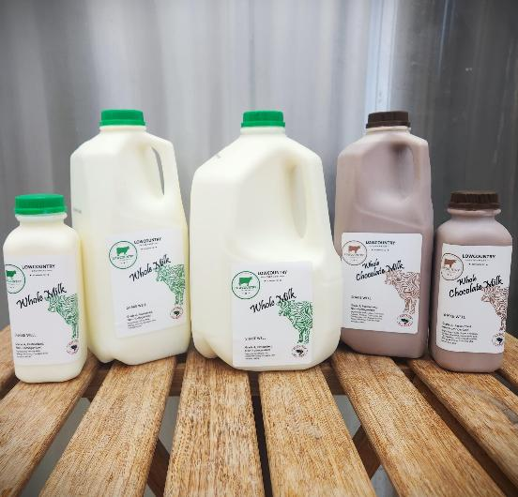

Keeping Milk Fresh
HOMOGENIZATION
Homogenization breaks up the fat globules in milk so they cannot rise to the top and separate.
Homogenized milk is consistent throughout and tastes the same in every sip.
Milk that has not been homogenized is called “creamline milk” and is just as safe to drink as homogenized milk.

Slide 12
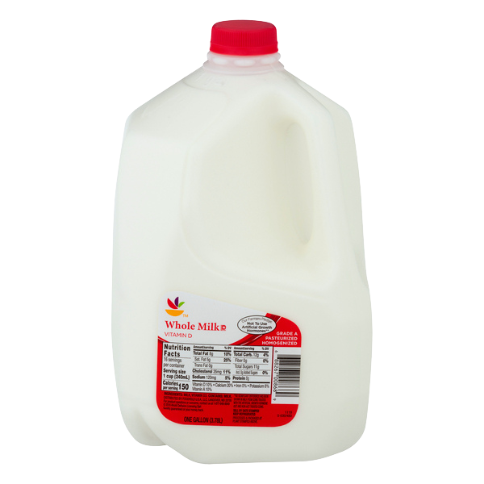

Keeping Milk Fresh
FORTIFICATION
  Fortification is the process of adding vitamins to the milk before bottling.
  Commonly, milk is fortified with Vitamins A and D in the U.S.
  This process is not necessary and is usually done to make milk even more nutritious than it already is.

Slide 13

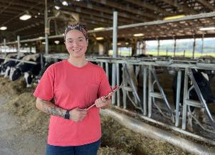
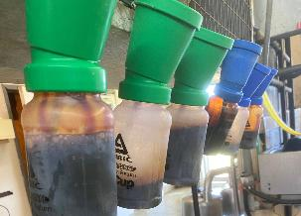
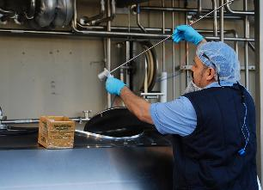
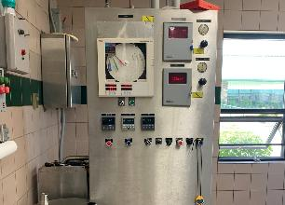
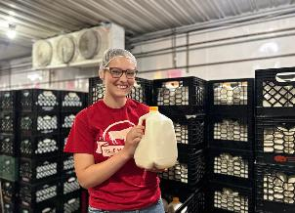
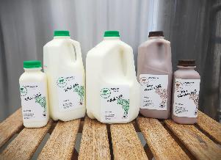
Keeping Milk Fresh
CLOSURE
Explain one of the processes to keeping milk fresh.

Slide 14
Butter Lab
INTRODUCTION
Dairy products are foods made from milk. Examples of dairy products include cheese, yogurt, ice cream, and butter.
Let’s look at milk, its composition and nutritional value, and how dairy products are made. Then in this lab, you will make butter from the cream in milk.

Slide 15
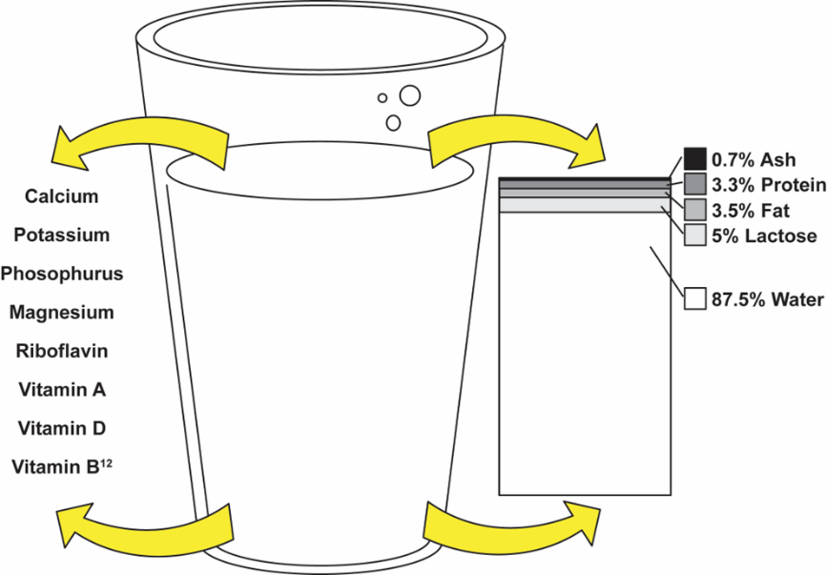
Butter Lab
MILK AND ITS COMPOSITION
  In addition to the eight nutrients listed, milk contains pantothenic acid, niacin, zinc, selenium, and iodine.
  Note: Ash is another name for minerals.

Slide 16


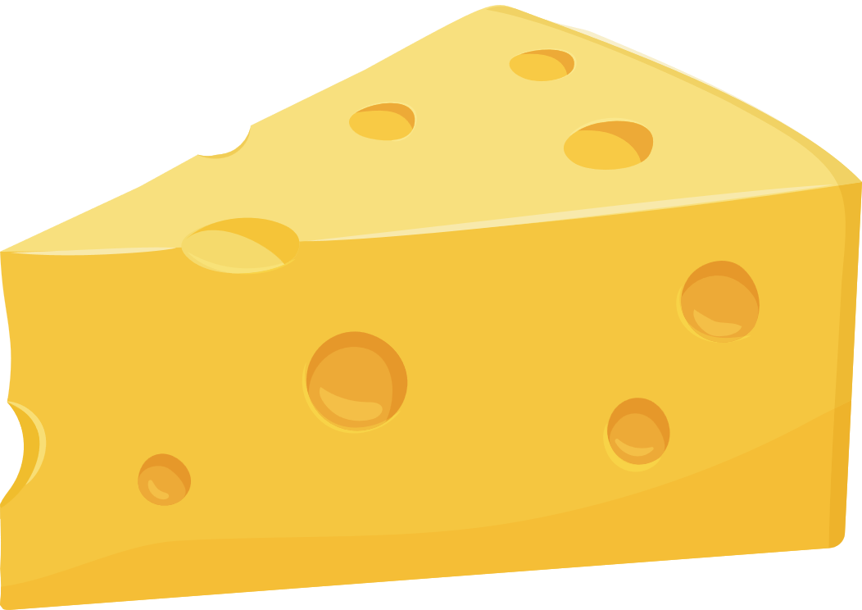

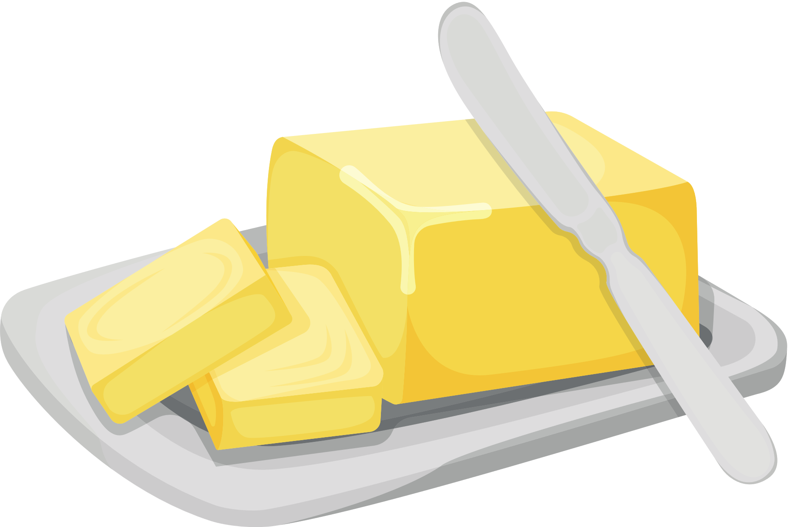
Butter Lab
MAKING DAIRY PRODUCTS FROM MILK
CHEESE is made from the protein and fat in milk.
Lactose is essential in making YOGURT.
ICE CREAM is made from cream found in milk.
BUTTER is made from the cream (fat) in milk.

Slide 17
Butter Lab
CLOSURE
Today you made butter from cream. During the lab, you compiled data to find the experimental ratio of cream to butter.
  What was your experimental ratio of cream to butter?
  What is the theoretical ratio of cream to butter?
  How does your experimental ratio compare to the theoretical ratio?

Slide 18
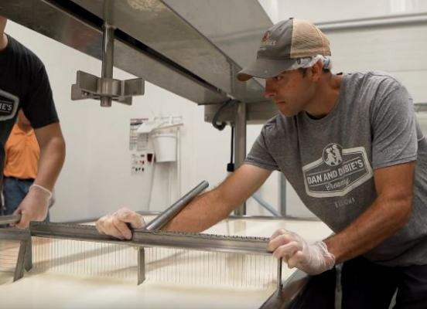
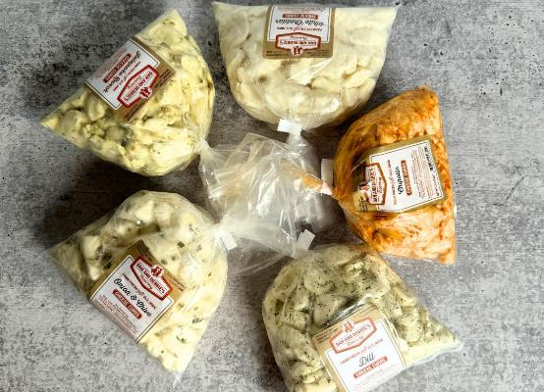
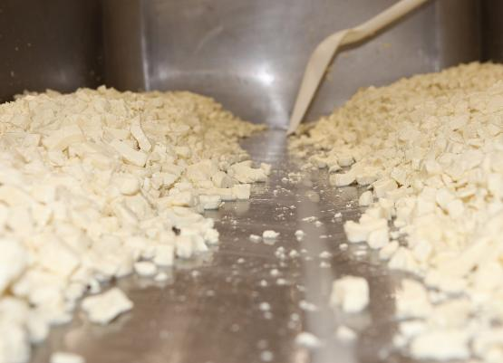
Career Spotlight: Artisan Cheesemaker
INTRODUCTION
Cheesemaking is both a science and an art. Cheesemakers use science to change milk into cheese. With hundreds of different varieties of cheeses available, they also use creativity and other skills to produce high-quality cheese for retail.

Slide 19

Career Spotlight: Artisan Cheesemaker
ACTIVATING STRATEGY
Let’s discover the career of a cheesemaker

Slide 20
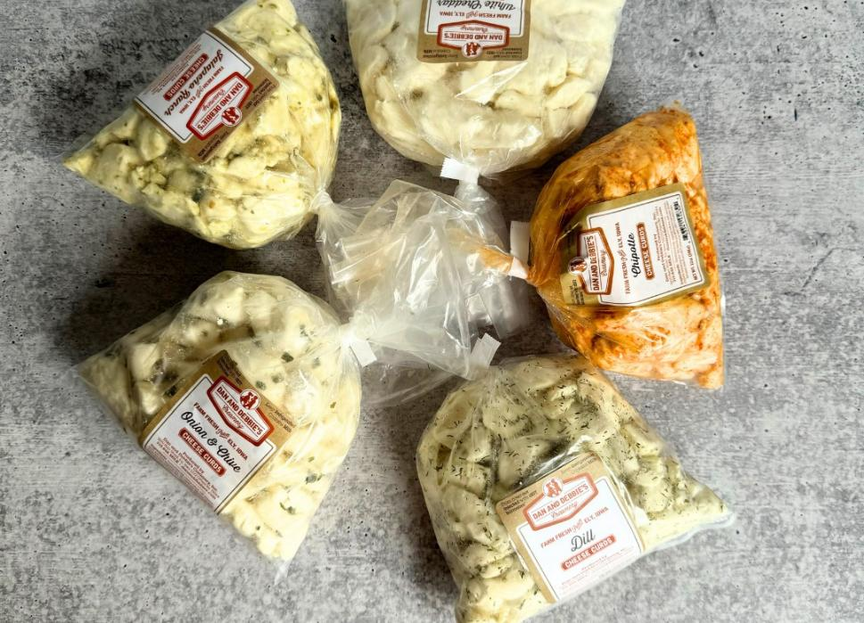
Career Spotlight: Artisan Cheesemaker
CHEESEMAKER RESPONSIBILITIES
1. Set up and operate equipment that mixes ingredients used in the making of cheese
2. Clean and sterilize work areas and equipment used
3. Examine, test, and inspect product during the cheesemaking process
4. Record data and results of measurements and tests completed throughout the cheesemaking process

Slide 21
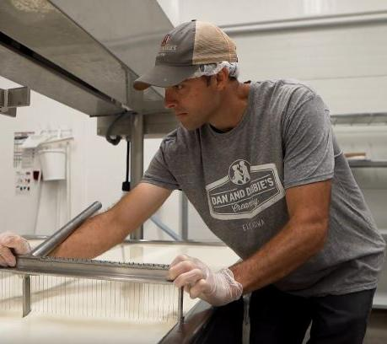
Career Spotlight: Artisan Cheesemaker
WHO IS THE CHEESEMAKER
REQUIRED EDUDATION: Cheesemakers need a high school diploma or equivalent and a
post-secondary certificate or apprenticeship.
Cheesemakers use science and creativity to produce high-quality cheese for retail. They have a passion for the dairy industry and take pride in making a good value-added product to add to the market.

Slide 22
Career Spotlight: Artisan Cheesemaker
CLOSURE
  Tell us one responsibility of being a cheesemaker.
  Are you interested in being a cheesemaker when you grow up?

Slide 23

Kahoot Activity
IT’S TIME TO PLAY
Let’s complete a Kahoot review game to see what you learned about milk quality and safety.
HOW TO PLAY
  Go to Kahoot.It
  Type in the pin number provided for you and click “ENTER”
  Wait for everyone to join the game
  When the game begins, select the answers you think are correct as fast as you can.
  The top three winners will be highlighted on the screen.

Slide 24
Closure
Share one thing you learned today about “Keeping Milk Fresh”.

