Slide 1
Hi, I’m [insert calf name]!
[Insert farm name]
The [insert last name] Family
Notes:
Directions: Use this slide to add a picture or video of the calf and a picture of your family. Replace the text in brackets for what it says inside of them. Don’t forget to remove the brackets from the final sentence! Click on the picture or media icons to add a picture or video to the slide!

Slide 2
[Give a background on your farm’s history. When it was established, how many cows you have, etc.]
Notes:
Directions: Use this slide to introduce your farm. Add a picture or video of yourself, the farmer and add your name to the slide. In the white text box, give a background on your farm’s history. Add a picture or video of your farm, using the icons, below your description.

Slide 3
Name:
Birthdate:
Sire:
Dam:
Height:
Weight:
Breed:
Notes:
Directions: Use this slide to introduce the calf. Add a picture or video of your calf using the icons. Fill out the calf’s information in the white text box, don’t forget to add the calves name at the top! (If you don’t know an answer, feel free to delete that question)

Slide 4
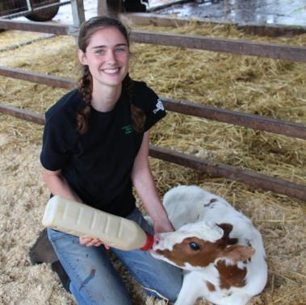
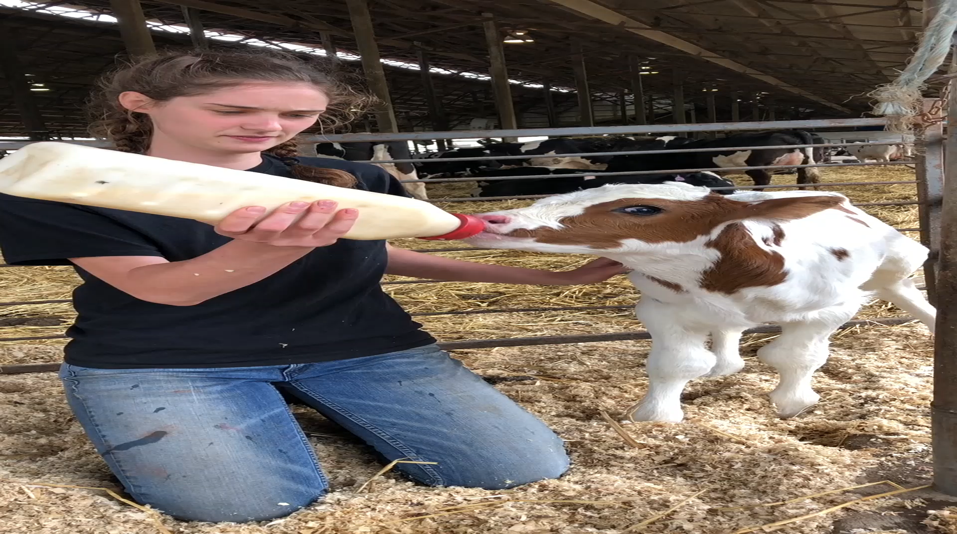
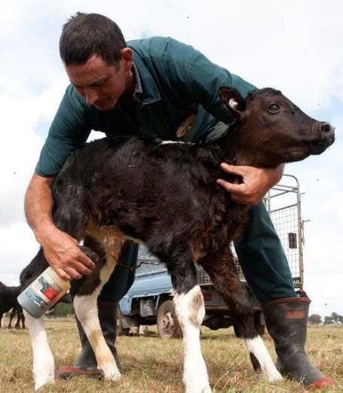
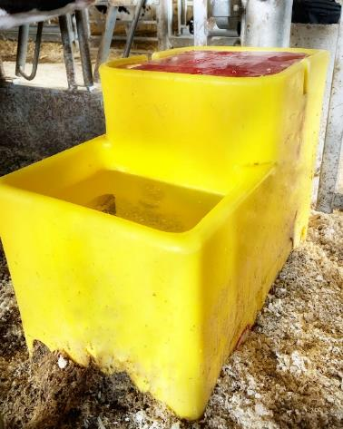
1
2
3
[Insert calf name] also always has fresh water to drink.
Within a few hours after birth, [insert calf name] drinks colostrum and takes her first few steps in life. Colostrum is vital to jump starting [insert calf name]’s immune system.
Naval Dip
[Insert calf name]’s naval is dipped with iodine to protect her from getting an infection.
Automatic Waterer
Notes:
Directions: Use this slide to show the first moments of the calf’s life. Do you feed colostrum and have an automatic waterer? If so, keep this slide and delete other “Her First Moments” slides.

Slide 5
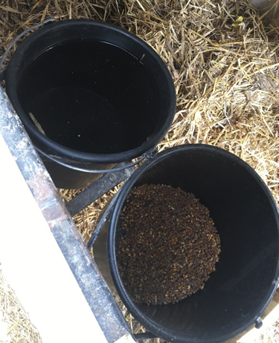
1
2
3
Water Bucket
[Insert calf name] also always has fresh water to drink.
Within a few hours after birth, [insert calf name] drinks colostrum and takes her first few steps in life. Colostrum is vital to jump starting [insert calf name]’s immune system.
Naval Dip
[Insert calf name]’s naval is dipped with iodine to protect her from getting an infection.
Notes:
Directions: Use this slide to show the first moments of the calf’s life. Do you feed colostrum and use water buckets? If so, keep this slide and delete other “Her First Moments” slides.

Slide 6
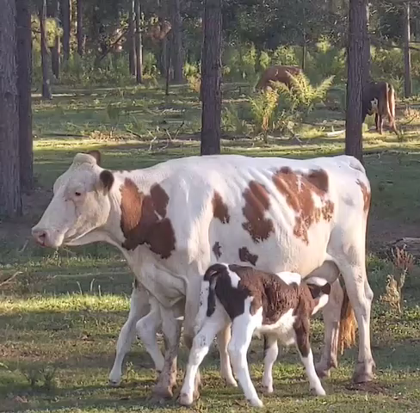
1
2
Within a few hours after birth, [insert calf name] drinks colostrum from her mother, which is the first bit of milk that a mother cow produces after giving birth. She will also take her first few steps in life just an hour after birth.
Naval Dip
[Insert calf name]’s naval is dipped with iodine to protect her from getting an infection.
Notes:
Directions: Use this slide to show the first moments of the calf’s life. Does the calf get colostrum from the dam? If so, keep this slide and delete other “Her First Moments” slides.

Slide 7
1
2
3
Notes:
Directions: Use this slide if you want to include your own photos. If so, keep this slide and delete other “Her First Moments” slides.

Slide 8
[Insert calf name] lives with other calves her age in group housing where she gets to meet her new herdmates.
[Insert calf name]’s bed gets fresh shavings weekly. Shavings keep [insert calf name] clean and warm.
Notes:
Directions: Use this slide for calf group housing facilities. Delete other “Animal Care-Housing” slides.

Slide 9
[Insert calf name] lives in her own calf hutch for the first 12 weeks after birth. This allows her to build a strong immune system before joining the herd.
[Insert calf name]’s bed gets fresh straw bedding weekly. Straw keeps [insert calf name] clean and warm.
Notes:
Directions: Use this slide for calf hutch facilities. Delete other “Animal Care-Housing” slides.

Slide 10
[Insert calf name] lives with her dam and other herdmates on pasture. Here they have a barn they can sleep in for shelter and have access to water and hay for hydration and nutrition.
[Insert calf name]’s bed gets straw weekly. Straw keeps [insert calf name] clean and warm.
Notes:
Directions: Use this slide for grazing facilities. Delete other “Animal Care-Housing” slides.

Slide 11
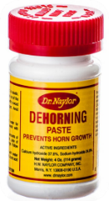
[Farm name] uses dehorning paste that is rubbed on at the buds of the horn to prevent horn growth for the safety of the other animals and humans.
[Insert calf name] is given an Ear Tag at birth for identification, just like this one. Her herd number is ___ . This is just like humans getting their ears pierced.
[Insert calf name] loves being happy and healthy!
Notes:
Directions: Use this slide for dehorning paste farms. Delete other “Animal Care – Maintenance” slides. Add a picture of the calf’s ear tag.

Slide 12
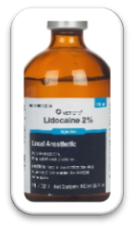
[Farm name] disbuds horns using lidocaine (a pain reliever) and an iron to prevent horn growth for the safety of the other animals and humans.
[Insert calf name] is given an Ear Tag at birth for identification, just like this one. Her herd number is ___ . This is just like humans getting their ears pierced.
[Insert calf name] loves being happy and healthy!
Notes:
Directions: Use this slide for disbudding farms. Delete other “Animal Care – Maintenance” slides. Add a picture of the calf’s ear tag.

Slide 13
At [Farm name], most of their cows are polled. Polled means the calves are born without horns. This is something they can breed for so they don’t have to go through the dehorning process.
[Insert calf name] is given an Ear Tag at birth for identification, just like this one. Her herd number is ___ . This is just like humans getting their ears pierced.
[Insert calf name] loves being happy and healthy!
Notes:
Directions: Use this slide for polled farms. Delete other “Animal Care – Maintenance” slides. Add a picture of the calf’s ear tag.

Slide 14
Mother’s Name:
Age:
Height:
Weight:
[Dam name] produces 80 pounds or 10 gallons of milk everyday!
[Dam’s name]’s job on the farm is to produce high quality milk for the [your last name] family to sell so it can be made into fluid milk and other dairy products for you to consume.
What are your favorite dairy products?
Hi, I’m [dam’s name]. I’m [insert calf name]’s mother!
Meet [insert calf name]’s Mom
Notes:
Directions: Use this slide to introduce the calf’s dam. Insert a picture of the dam and fill out her information above.

Slide 15
[Dam’s name] has a comfy bed that are filled with soft sand. The milking cows are fed TMR or a Total Mixed Ration, which is like a balanced cow salad!
The barn has giant fans that keep the cows cool in the summertime. It also has a cool rotating brush that turns on when cows walk under it! The best way to scratch an itch!
This is the Free Stall Barn where [Dam’s name] and her herdmates live.
Notes:
Directions: Use this slide for free stall barn farms. Delete other “Cow Comfort” slides. Edit information to match your farm.

Slide 16
In addition to grazing the fields, [dam name] and her herdmates are fed hay, which provides additional fiber and nutrition in their diets.
[Dam name] and her herdmates live outside all day. Throughout the day, they enjoy finding the perfect forages to munch on and graze.
[Dam name] and her herdmates live outside all day. Throughout the day, they enjoy finding the perfect forages to munch on and graze.
Notes:
Directions: Use this slide for grazing farms. Delete other “Cow Comfort” slides. Edit information to match your farm.

Slide 17
[Dam name] has everything she needs in her barn including fresh food, fresh water, tunnel ventilation (fresh air) and a comfy bed!
[Dam name]’s sleeps on shavings in her individual stall. This keeps her space very comfy and clean to lay in.
This is the Tie Stall Barn where [Dam name] and her herdmates live.
Notes:
Directions: Use this slide for tie stall barns. Delete other “Cow Comfort” slides. Edit information to match your farm.

Slide 18
The barn is connected to the wide-open fields of [Farm Name] where [Dam Name] can graze all day and enjoy the sun.
The milking cows are fed TMR or a Total Mixed Ration, which is like a balanced cow salad!
This is the Pack Barn where [Dam Name] and her herdmates can go for shelter and shade.
Notes:
Directions: Use this slide for Pack Barn Farms. Delete other “Cow Comfort” slides. Edit information to match your farm.

Slide 19
Hi, I’m [Insert Calf Name]!
[Insert Farm Name]
The [Insert Last Name] Family
97% of dairy farms across the country are family owned and operated just like [Farm name]. Dairy farming is a family affair, with a lot of love, hard work and perseverance put in to take good care of their cows. [Insert calf name] is well loved by them all!
Notes:
Directions: Add a picture or video using the icons of the calf and your family.

Slide 20
Notes:
Directions: Use the icons to insert a picture or video of your farm that will fill the entire background. Then type your farm name and you are all done!

