Slide 1
I have missed you all so much!
It’s Our Last Check Up with
[Calf name]
Notes:
Directions: Use this slide to add a picture or video of the calf. Replace the text in brackets for what it says inside of them. Don’t forget to remove the brackets from the final sentence! Click on the picture or media icons to add a picture or video to the slide!

Slide 2
Name:
Birthdate:
Updated Information
Age:
Height:
Weight:
Notes:
Directions: Add the Calf’s name and birthdate at the top of the slide. Then add the updated information. Add a picture or video of the calf to show how much she has grown!

Slide 3
[Calf name]’s Health and Protection Is Key
Farmer [your name] has done everything she can to protect and provide for [calf name] since birth. Can you remember 5 things [your name] did for [calf name] to keep her healthy and strong?
Let’s Compare
How do your parents or guardians protect you from getting hurt or sick? Compare what Farmer [your name] does for [calf name] to what humans do for their children.
Notes:
Directions: Add a picture or video of your calf showing that she is happy and healthy. Don’t forget to add your own name in the paragraph!

Slide 4
Diet
Though her grain looks the same, [calf name] now eats a new pellet grain that continues to help develop her four stomach compartments.
[Calf name] still eats hay everyday – 10 to 12 pounds per day!
Housing
[Calf name] now lives with many herdmates in a dry lot with shelter. She will live here until she is a prefresh cow.
Notes:
Directions: Use this slide if your calf lives in a dry lot with shelter and is fed heifer grain. Add a pictures or video of the calf’s housing on the left. Add a picture or video on the right of the calf’s feed.

Slide 5
[Calf name] eats heifer grain, which continues to help develop her four stomach compartments.
[Calf name] still eats hay everyday – 10 to 12 pounds per day! She also gets to munch on all the grass she wants!
Housing
[Calf name] now lives with many herdmates on pasture. She will live here until she is a prefresh cow.
Notes:
Directions: Use this slide if your calf lives on pasture and eats heifer grain. Add a pictures or video of the calf’s housing on the left. Add a picture or video on the right of the calf’s feed.

Slide 6
[Calf name] now eats heifer TMR, this is made of corn silage, haylage, and custom mineral mix that continues to help develop her four stomach compartments.
[Calf name] still eats hay everyday – 10 to 12 pounds per day!
Housing
[Calf name] now lives with many herdmates in the heifer barn. She will live here until she is a prefresh cow.
Notes:
Directions: Use this slide if your calf lives in the heifer barn and eats heifer TMR. Add a pictures or video of the calf’s housing on the left. Add a picture or video on the right of the calf’s feed.

Slide 7
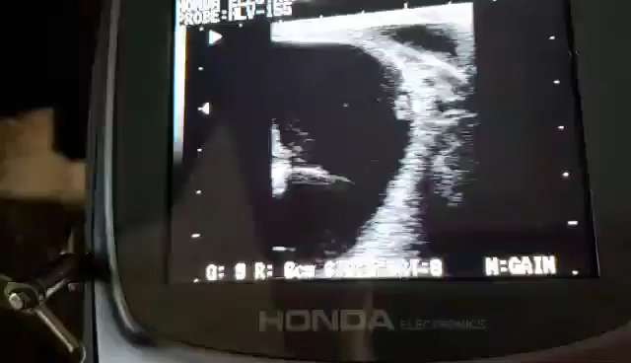
[Dam’s Name]
[Dam’s name] is due to have her next baby in the fall!
Click on the ultrasound video below to see how veterinarians “preg. check” the cows!
Great to see you again kids!
[Dam name]’s Update
Notes:
Directions: Add a picture or video of the calf’s dam. Add a video of your own ultrasound if you have one.

Slide 8
Having A Baby
Once [calf name] is 2 weeks away from her due date, she is moved again to a private pen so Farmer [your name] can keep a close eye on her, preparing for her to have her calf.
After she gives birth, the cycle of life starts all over again for her calf, and [calf name] finally joins the milking herd to become a productive member of [farm name]!
Pre-Fresh Pen
About 1 month before [calf name] is due to have her baby (around 2 years old), she will be moved inside to a freshly bedded pen with a new TMR ration formulated perfectly for her diet needs.
[Calf’s name]’s Future
Notes:
Directions: Add a picture or video of your farm’s pre-fresh pen on the left and a picture of a cow with a calf on the right. Don’t forget to replace the brackets with your name, your farm name, and the calf’s name in the designated areas.

Slide 9
From Cow to You
After [calf name] is milked, the milk travels through clean pipes and is stored in the bulk tank to be kept cold until the milk truck picks up the milk.
The milk truck will take the milk to the processing plant to be pasteurized and get it ready to drink! From the plant, the milk will get sent to grocery stores, schools, restaurants, and more where people can enjoy it!
Life As A Milking Cow
In “adulthood” as a milking cow, [calf name] will be milked twice a day in the milking parlor. The milking processes only takes 5 to 10 minutes.
[Calf’s name]’s Future
Notes:
Directions: Use this slide if you milk in a parlor. Feel free to specify what type of parlor you have. Add a picture of the cow being milked on the left and of your bulk tank or a milk truck on the right.

Slide 10
From Cow to You
After [calf name] is milked, the milk travels through clean pipes and is stored in the bulk tank to be kept cold until the milk truck picks up the milk.
The milk truck will take the milk to the processing plant to be pasteurized and get it ready to drink! From the plant, the milk will get sent to grocery stores, schools, restaurants, and more where people can enjoy it!
Life As A Milking Cow
In “adulthood” as a milking cow, [calf name] will be milked twice a day with stanchion milking units. The milking processes only takes 5 to 10 minutes.
[Calf’s name]’s Future
Notes:
Directions: Use this slide if you milk with stanchion units. Add a picture of the cow being milked on the left and of your bulk tank or a milk truck on the right.

Slide 11
[Farm name] Fun
The [your last name] family is a family just like yours. They have siblings, parents, grandparents, cousins, pets and more! They celebrate holidays together, go to school and eat dinner just like you. Just think, maybe one day, you will be a dairy famer!
Dairy Farmers and their families are important to our community, economy, country and world.
Notes:
Directions: Use this slide to highlight all the fun you have on your farm! Do your grandparents or cousins help on the farm? Do you have any pets or other barnyard friends? Here’s where to include them!

Slide 12
[Calf name] is turning out to be a beautiful young heifer! Thank you for loving her!
Notes:
Directions: Add a picture or video of the calf and change her name in the brackets.

Slide 13
Thanks for letting [calf name] join your class. Let’s do this again next year!
Notes:
Directions: Add the farm and calf’s name. Insert a picture or video of your family!

