Slide 1

Lesson 1 Animal Health
Grades
PreK – 2nd
Making Cows Smile

Slide 2

Introduction
Dairy farming is a way of life for more than 40,000 farm families in the United States. In this lesson, we will learn some words around a dairy farm, see the ways farmers care for their cows every day, and explore the career of being a dairy farmer.

Slide 3
Lesson Objectives
Define important dairy vocabulary terms
List ways that dairy farmers care for their cows
List the skills and responsibilities of being a dairy farmer

Slide 4
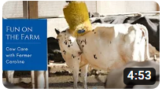
Activating Strategy
Let’s look at how dairy farmers care for their cows by watching the video, Fun on the Farm with Farmer Caroline.

Slide 5
Part
1
Words on a Dairy Farm

Slide 6
Essential Vocabulary
Barn – the place where cows live
Bull – a male or boy calf
Calf – a baby cow
Dairy Cow – a farm animal who is female or a girl, has had a calf, and makes milk for us to drink
Dairy Farmer – a person who takes care of cows that make milk for us to drink
Heifer – a female or girl calf

Slide 7
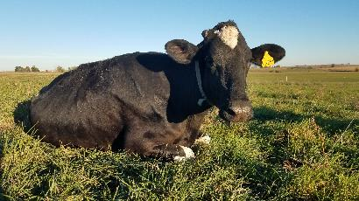
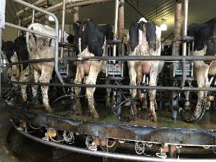
Dairy Cow
Definition: a farm animal who is female or a girl, has had a calf, and makes milk for us to drink

Slide 8
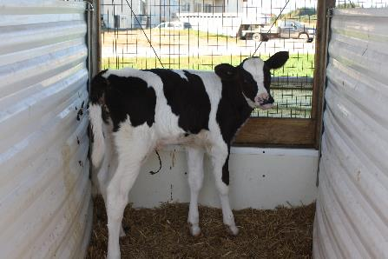
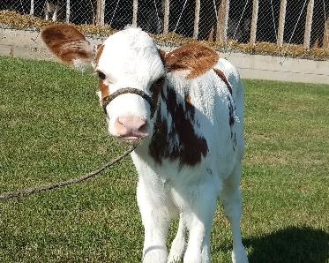
Calf
Definition: a baby cow

Slide 9
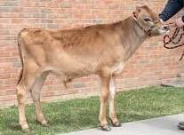
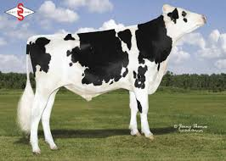
Bull
Definition: a male or boy calf or cow

Slide 10
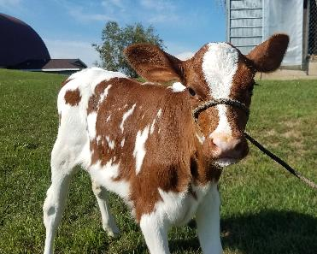
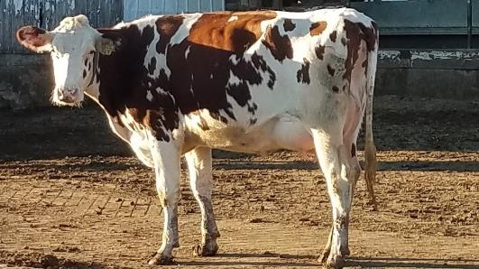
Heifer
Definition: a female or girl calf or cow

Slide 11
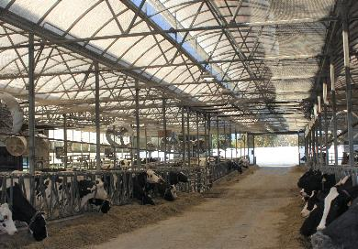
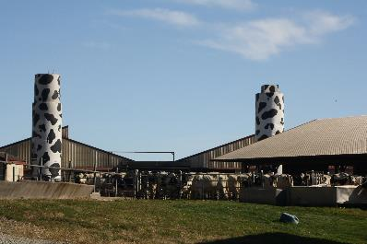
Barn
Definition: the place where cows live

Slide 12
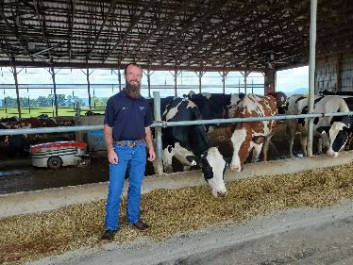
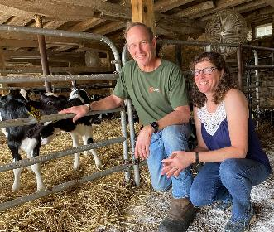
Dairy Farmer
Definition: a person who takes care of cows that make milk for us to drink

Slide 13
Part
2
Dairy Farmers Care for Cows

Slide 14
Introduction
Dairy farmers have a very important job to do. We depend on cows to make milk to keep us healthy.
Just like our parents do many things to take care of us, dairy farmers do many things to take good care of their animals. The health and care of dairy cows is very important to the dairy farmer. The choices a dairy farmer makes—choices like housing and food—are made with the comfort of the cow in mind.

Slide 15

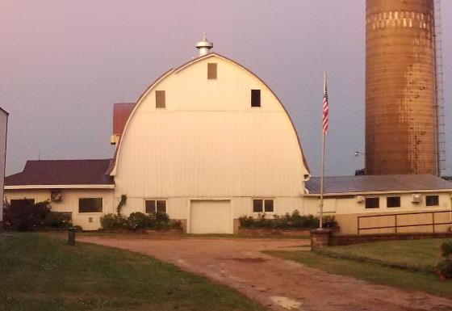
Providing Animals with a Place to Live
Parent – House
Dairy Farmer – Barn

Slide 16

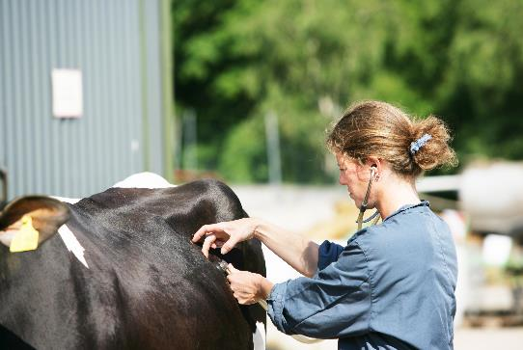
Keeping Animals Healthy
Parent – Doctor
Dairy Farmer – Veterinarian

Slide 17
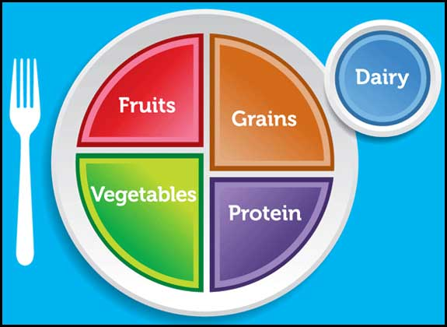
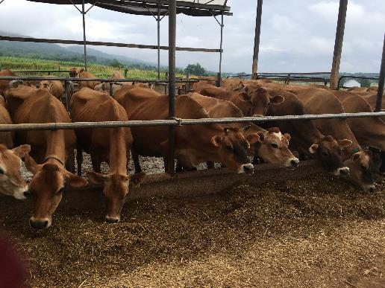
Providing Animals with a Nutritious Diet
Parent – Choose My Plate
Dairy Farmer – Total Mixed Ration

Slide 18

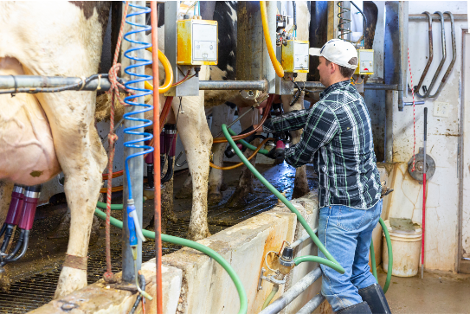
Providing Safe, Quality Milk
Parent – Milk to Drink
Dairy Farmer – Milking Cows

Slide 19
A Dairy Farmer’s Responsibilities
Providing their animals with a place to live
Keeping their animals healthy
Providing their animals with a nutritious diet
Providing safe milk and dairy products for us

Slide 20
Part
3
Career Spotlight: Dairy Farmer

Slide 21
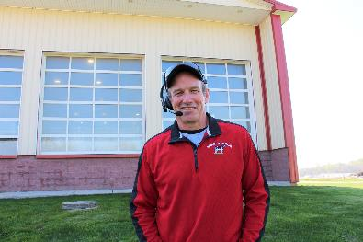
Dairy Farmer Walt
Let’s discover the career of a dairy farmer by watching the video, Interview with Dairy Farmer, Walt Moore .

Slide 22
Other Responsibilities of a Dairy Farmer
Grow crops on the field for the cows to eat
Work with machines and fixing them when they break
Take care of the money and finances
Manage people who work on the dairy farm

Slide 23

Closure
Dairy farmers have a lot of responsibilities other than just taking care of the cows.
Tell us one responsibility that dairy farmers have.
Are you interested in being a dairy farmer when you grow up?

Slide 24
Part
4
Activity

Slide 25
Introduction
Today we discussed the important job dairy farmers do everyday to take care of their cows, so we have milk to keep us healthy. Let’s do a fun activity to see what you learned.

Slide 26
Activity
Take some time to complete this activity.

Slide 27
Lesson Closure
Today you learned about what dairy farmers do every day to take care of their cows, so we have milk to keep us healthy. Tell us one way that dairy farmers take care of their cows.

Slide 28
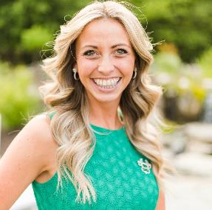
Brittany Snyder
Text/Call: 717-788-0297
Email: bsnyder@centerfordairyexcellence.org
Notes:
You can feel free to follow me, but I highly encourage you to go and follow: Discover Dairy, Dairy Leaders of Tomorrow, Dairy Excellence Foundation and Center for Dairy Excellence
-following will help you see important information to share.
Before I wrap up, I dropping a few different links in the chat box one more time for you. A link to this presentation, a link to the key messages discussed earlier, the link to the quiz you need to complete and a link to a schedule with links and details about joining me throughout the week for the other programs.
And again, if you have questions or comments you want to share either about this webinar or about the dairy industry after this webinar is over, please feel free to text or call 717-585-0875 and we will get back to you as soon as possible with answers.
Thank you everyone for joining me today and I look forward to seeing you again tomorrow!

