Slide 1
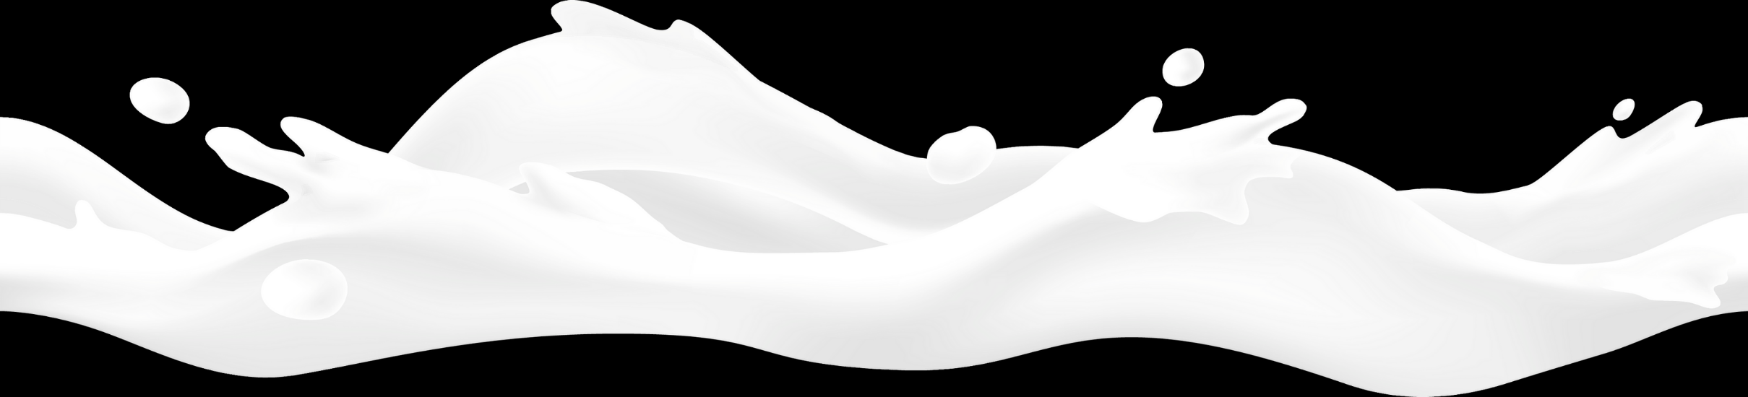

LESSON 2
Milk Quality and Safety
Keeping Milk Fresh

Slide 2


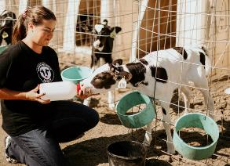
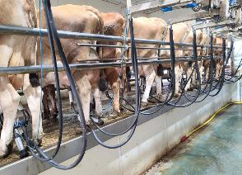
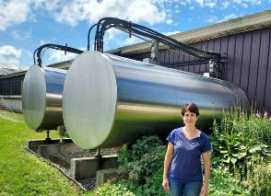
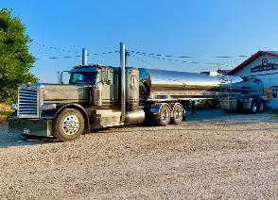
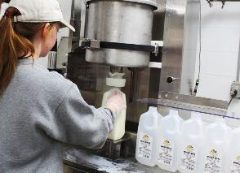
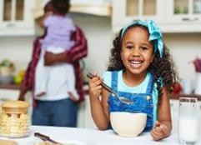
Introduction
HOW DOES MILK GET FROM MOO TO YOU?
We will learn how the milk you drink gets from the cow on a dairy farm to you at home and school.

Slide 3
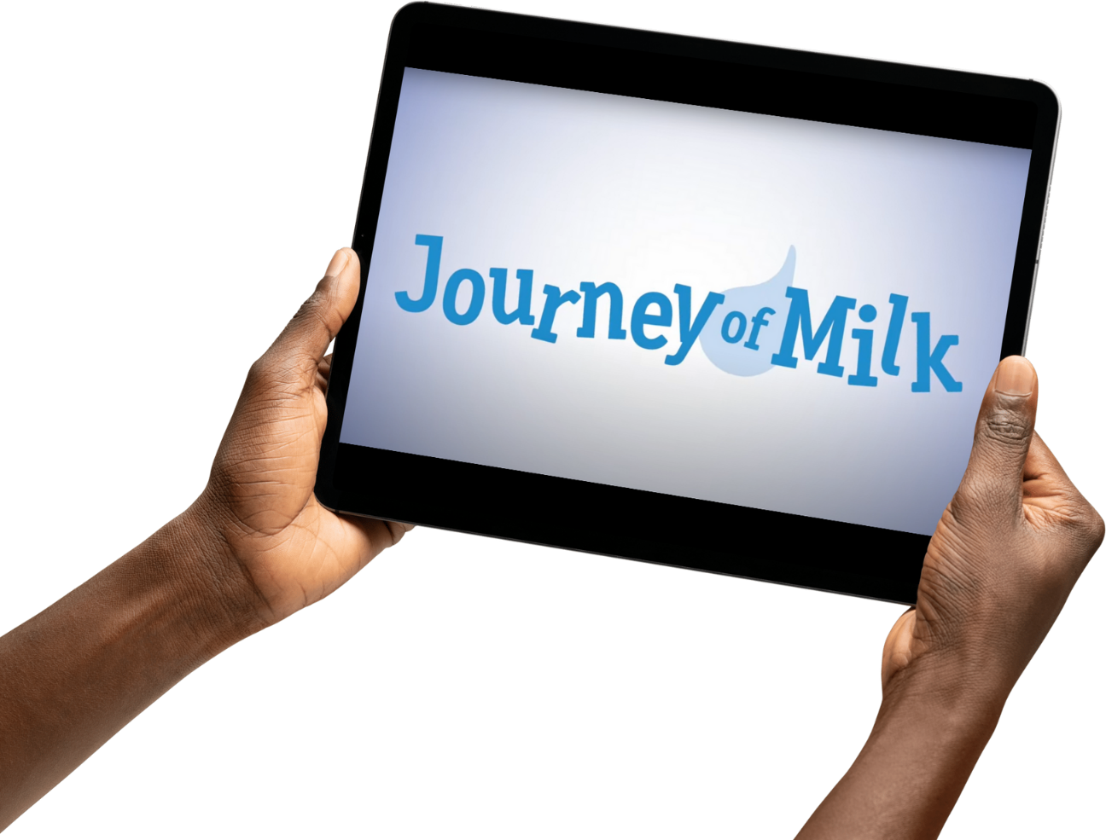

Activating Strategy
JOURNEY OF MILK
Let’s look at how milk gets from Moo to You

Slide 4
Words on the Milk Journey
DAIRY DEFINITIONS
Barn: the place where cows live
Dairy Cow: a female that has had a calf at least once time
Dairy Foods: foods made from milk
Milk Plant: a place that takes milk, makes milk safe, and makes other foods from milk
Milk Tank: a special container that holds cold milk for the farmer, also known as a bulk tank
Milk Truck Driver: a person who takes milk from the farm to the milk plant

Slide 5

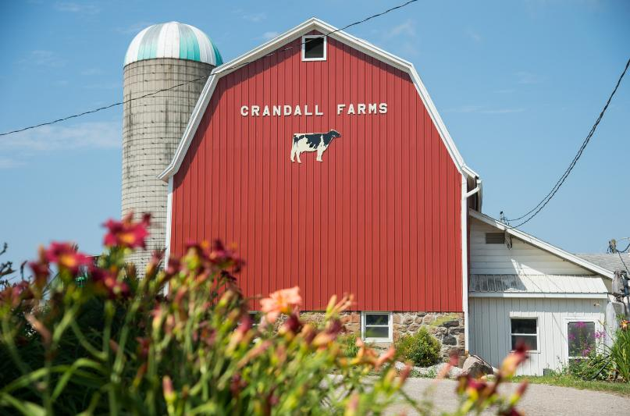
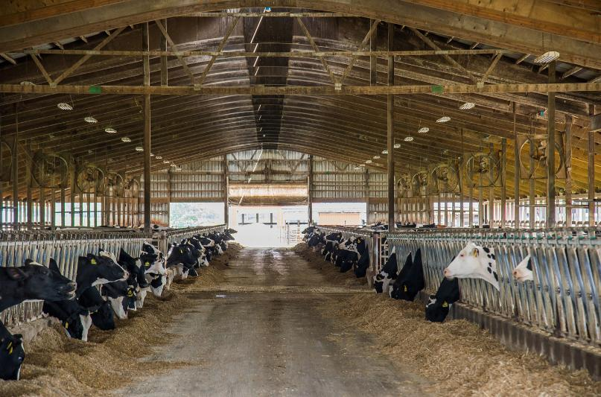
Vocabulary
BARN
Definition: the place where cows live
Outside of a BARN
Inside of a BARN

Slide 6
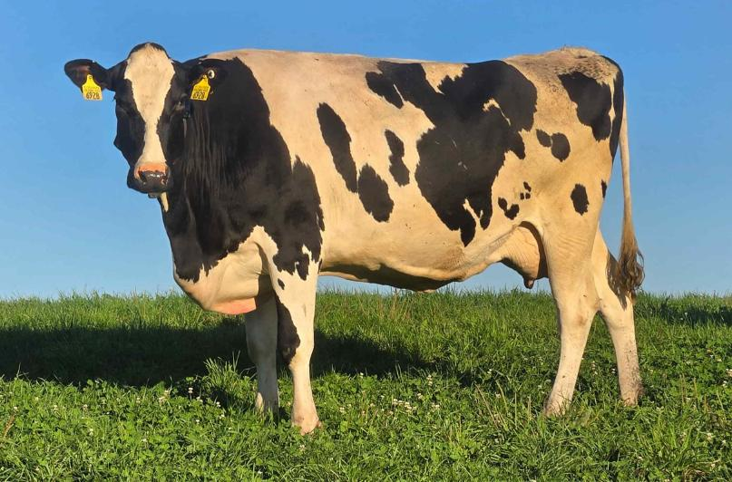
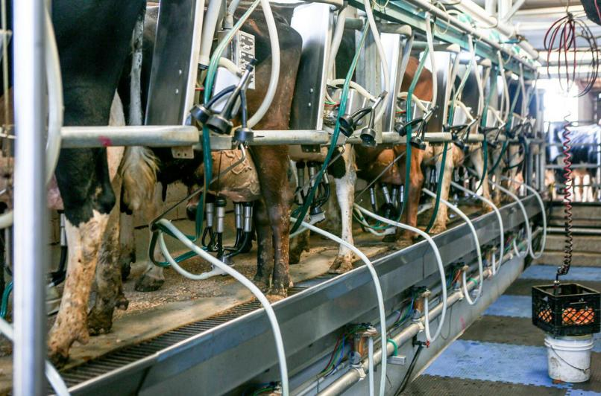
Vocabulary
DAIRY COW
Definition: a female that has had a calf at least one time
Dairy Cow
Dairy Cows Getting Milked

Slide 7
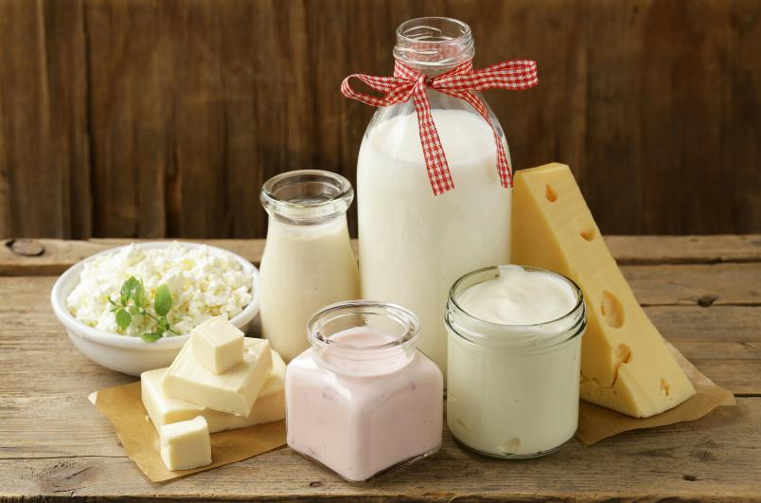
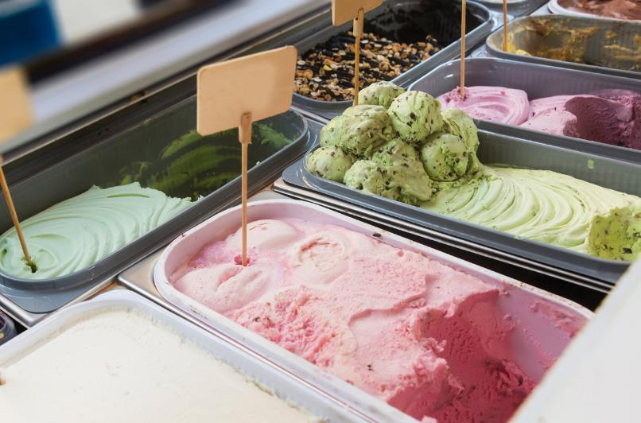
Vocabulary
DAIRY FOODS
Definition: foods made from milk
Milk, Cheese, Yogurt, Butter, Cottage Cheese, and Sour Cream
Ice Cream and Frozen Yogurt

Slide 8
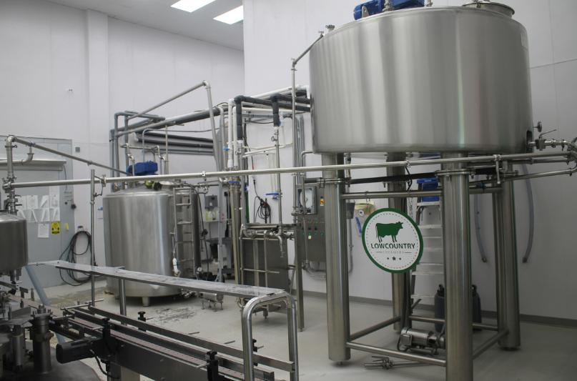
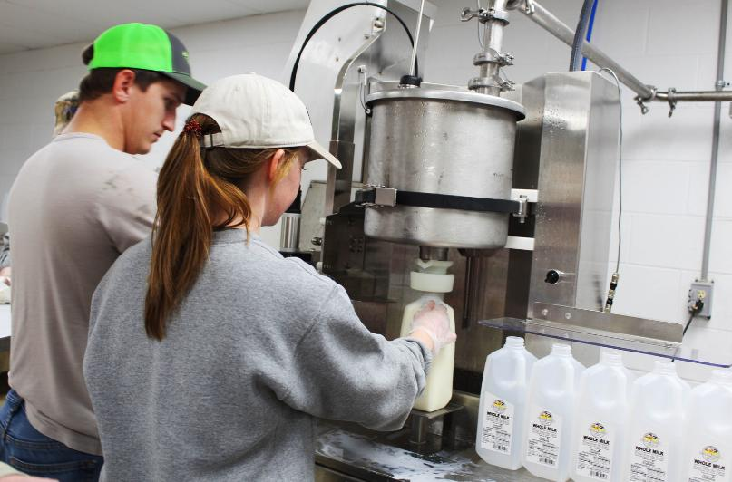
Vocabulary
MILK PLANT
Definition: a place that takes milk, makes milk safe, and makes other foods from milk
Milk Processing Plant Machines
Bottling Milk

Slide 9
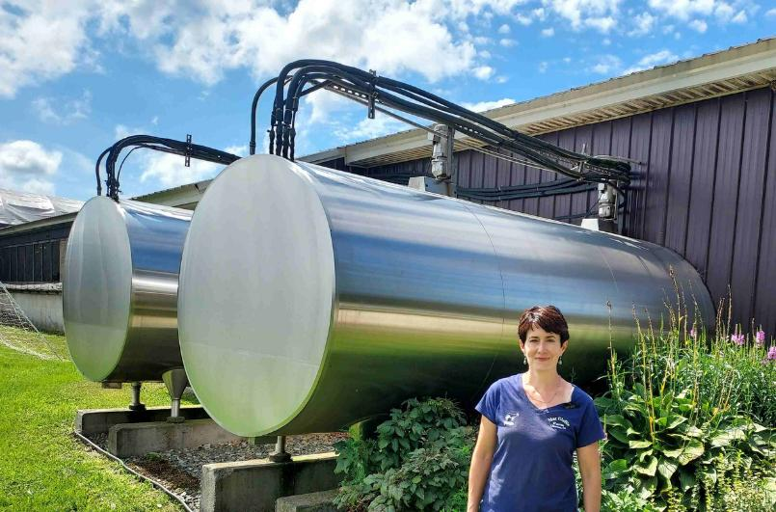
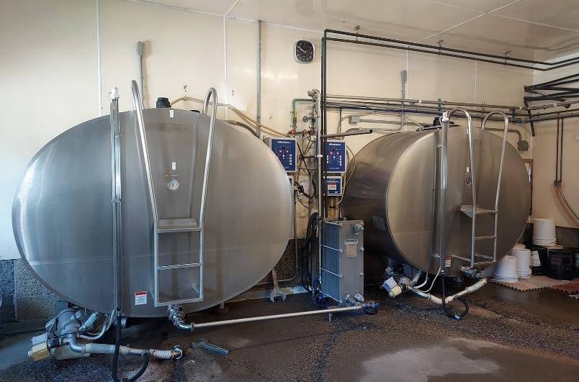
Vocabulary
MILK TANK
Definition: a special container that holds cold milk for the farmer, also called a bulk tank
Milk Tanks Outside
Milk Tanks In a Milk House

Slide 10
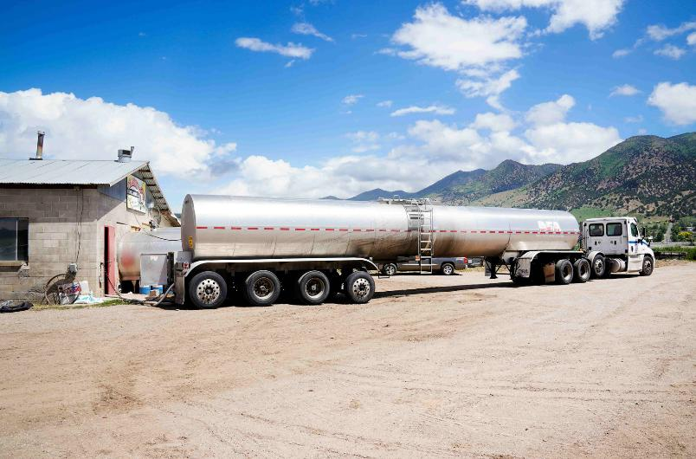
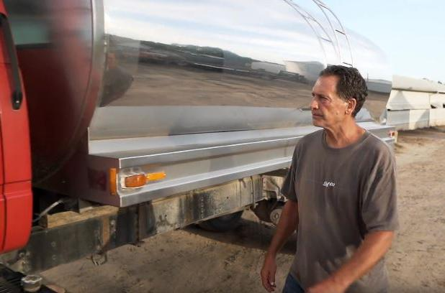
Vocabulary
MILK TRUCK DRIVER
Definition: a person who takes the milk from the farm to the milk plant
Milk Truck Picking Up Milk
Dan the Milk Truck Driver

Slide 11
From Moo to You: The Journey of Milk
INTRODUCTION
How does milk get from moo to you?
Let’s explore six important steps to the journey of milk from cow to you.

Slide 12
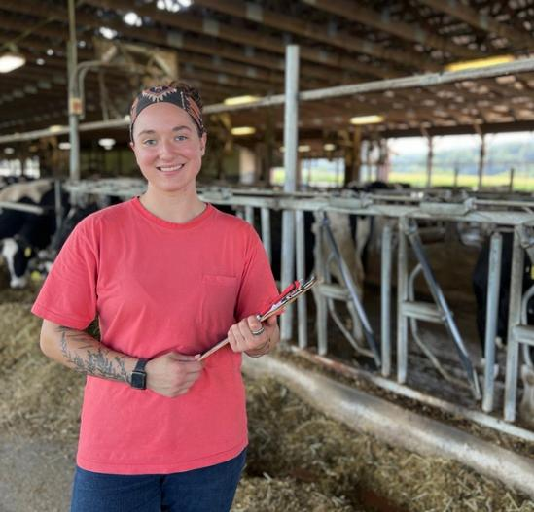
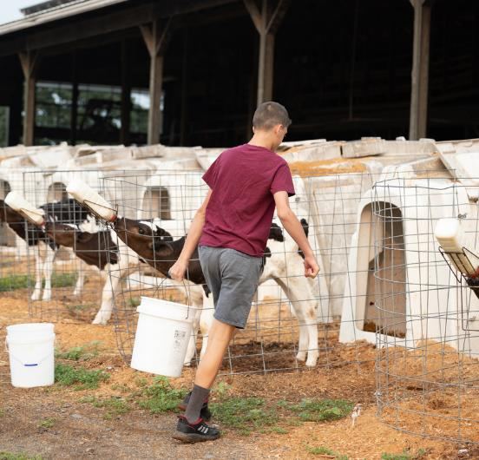
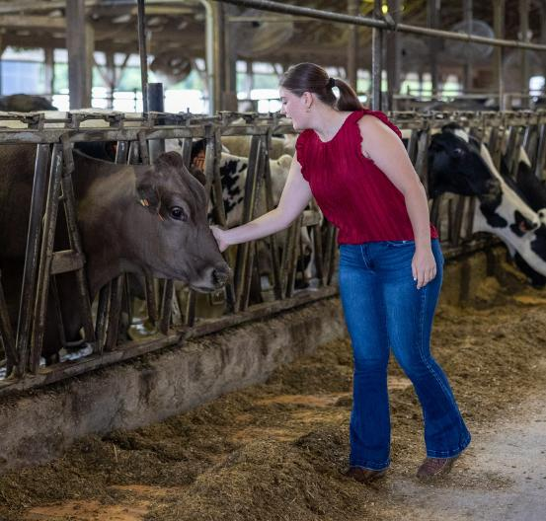
From Moo to You: The Journey of Milk
STEP 1: THE FARMER
Farmers make sure the barn is clean and safe.
Farmers feed and water cows all day.
Farmers take care of cows when they are sick.

Slide 13
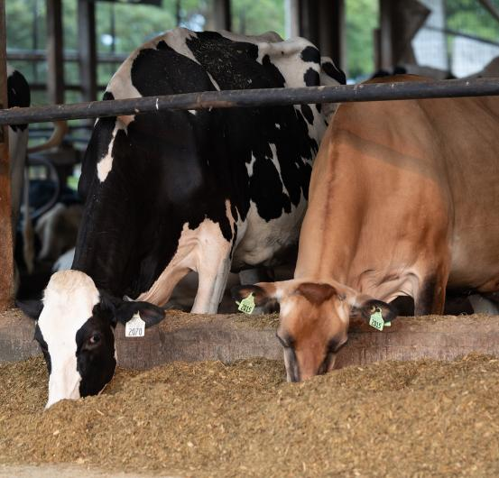
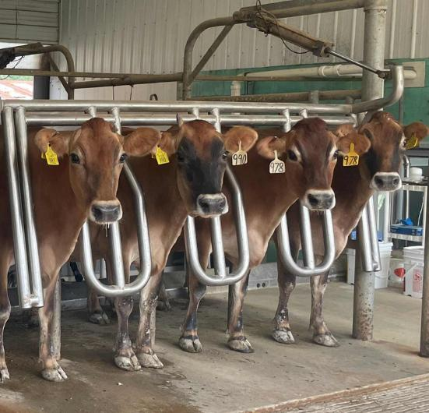
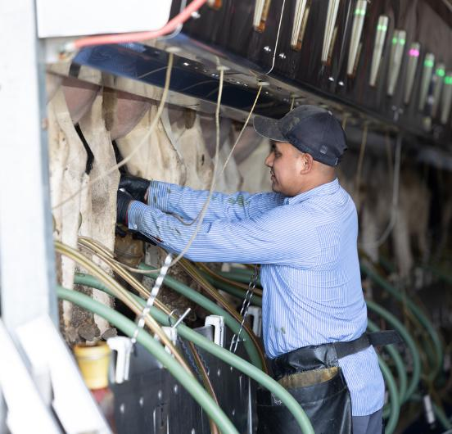
From Moo to You: The Journey of Milk
STEP 2: THE COWS
Cows eat about 100 pounds of feed and drink a bathtub full of water.
Cows are milked two or three times every day.
Cows like to be milked.

Slide 14
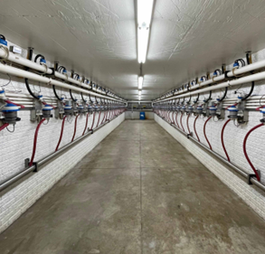
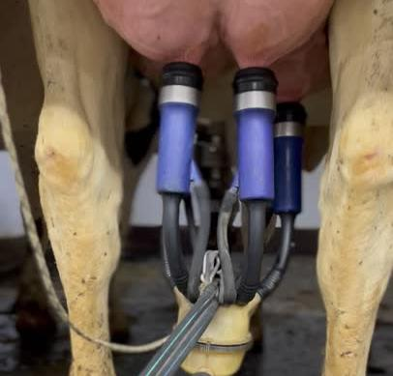
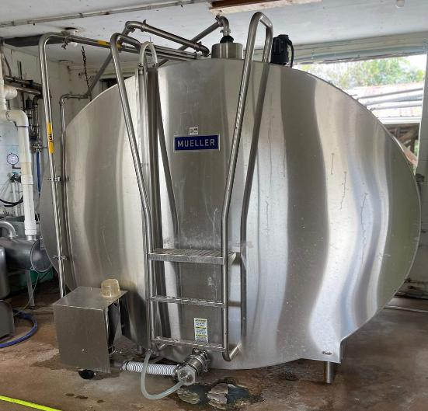
From Moo to You: The Journey of Milk
STEP 3: THE MILK TANK
Milk goes from the cow to the milk tank in hoses and pipes.
Milk is never touched by human hands.
Milk is cooled and put in the milk tank.

Slide 15
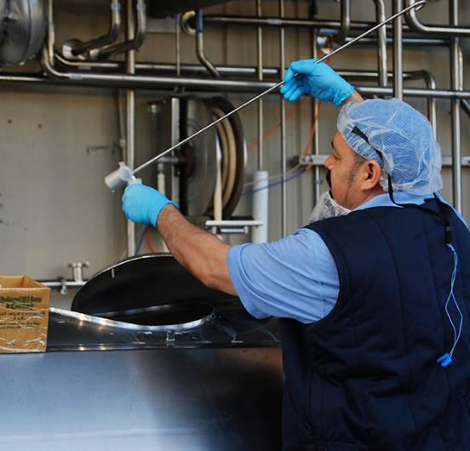
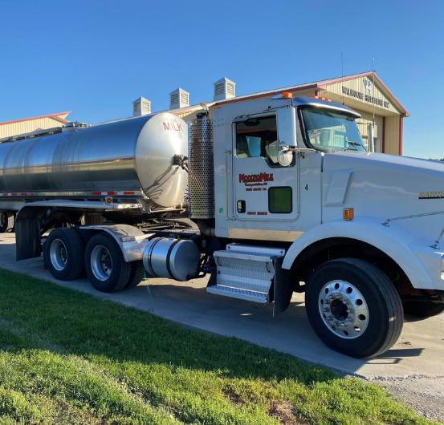
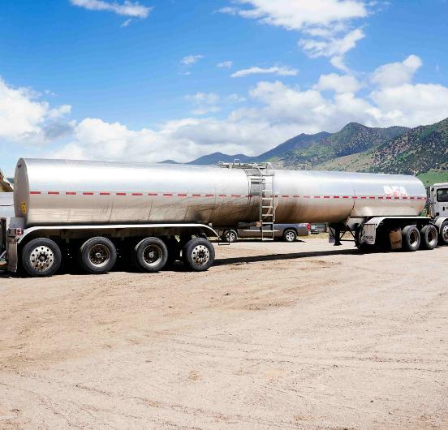
From Moo to You: The Journey of Milk
STEP 4: THE MILK TRUCK
Milk trucks take the milk from the farm to the milk processing plant.
Milk is tested before it goes on the milk truck.
The milk stays cold in the milk truck.

Slide 16
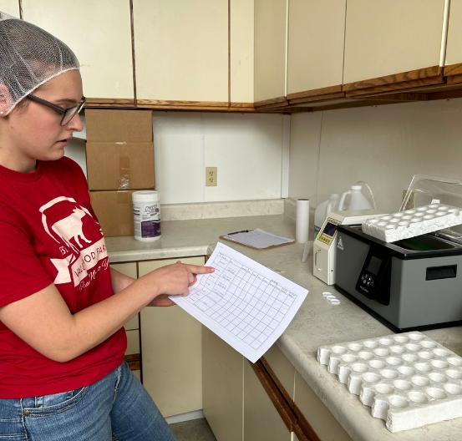
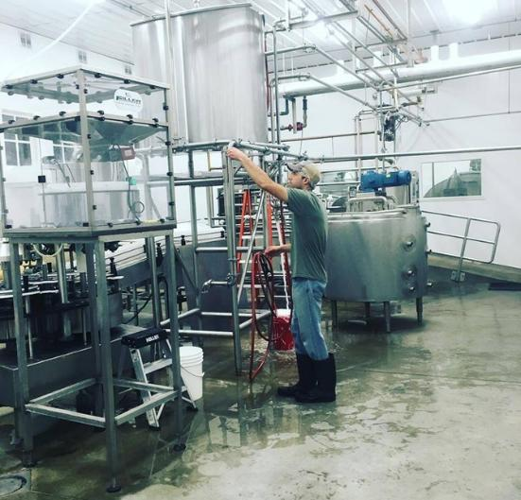
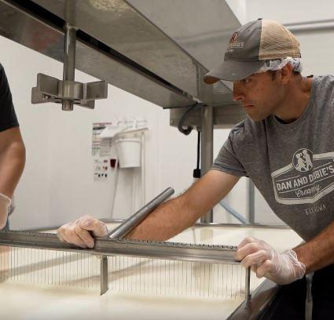
From Moo to You: The Journey of Milk
STEP 5: THE MILK PROCESSING PLANT
Milk is made into different types of milk and other dairy foods.
Milk is tested many times at the plant.
Milk is pasteurized to kill any germs.

Slide 17
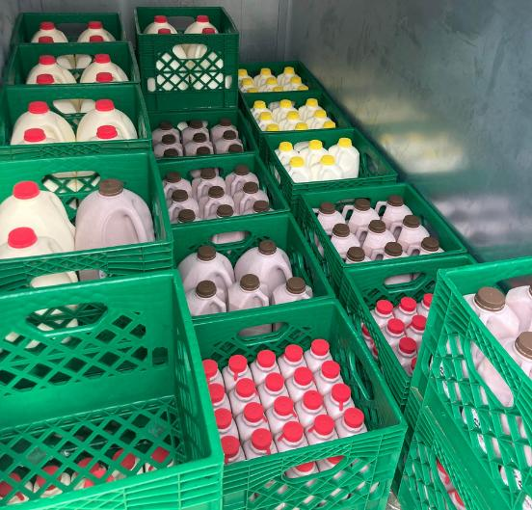
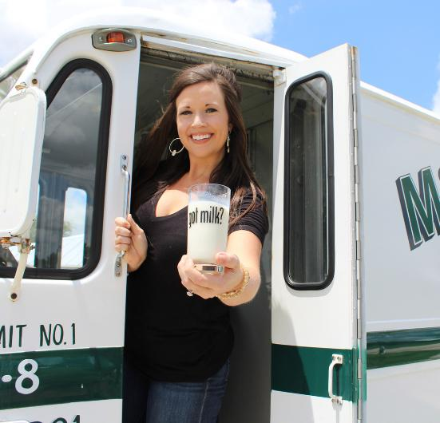
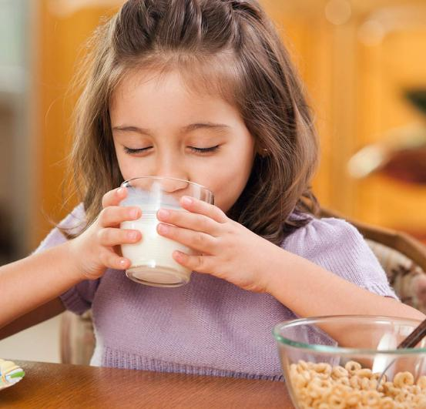
From Moo to You: The Journey of Milk
STEP 6: THE STORE AND YOU
It takes less than two days for the milk to travel from farm to you.
You should keep your milk and dairy foods cold, covered, and clean.
Milk is shipped cold to stores.

Slide 18
From Moo to You: The Journey of Milk
CLOSURE
Share one step you remember from our exploration

Slide 19

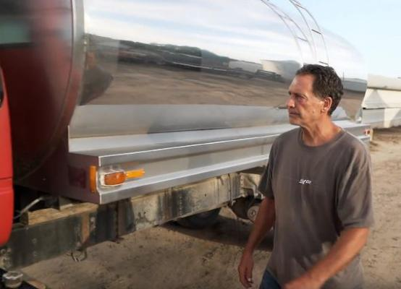
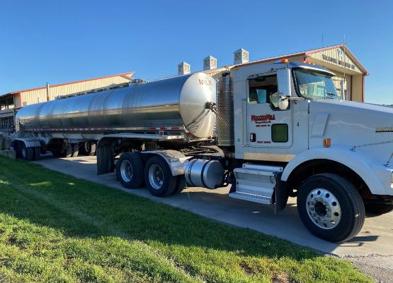
Career Spotlight: Milk Truck Driver
INTRODUCTION
Milk truck drivers are an important part of the journey of milk. Without them, milk could not get from moo to you.

Slide 20
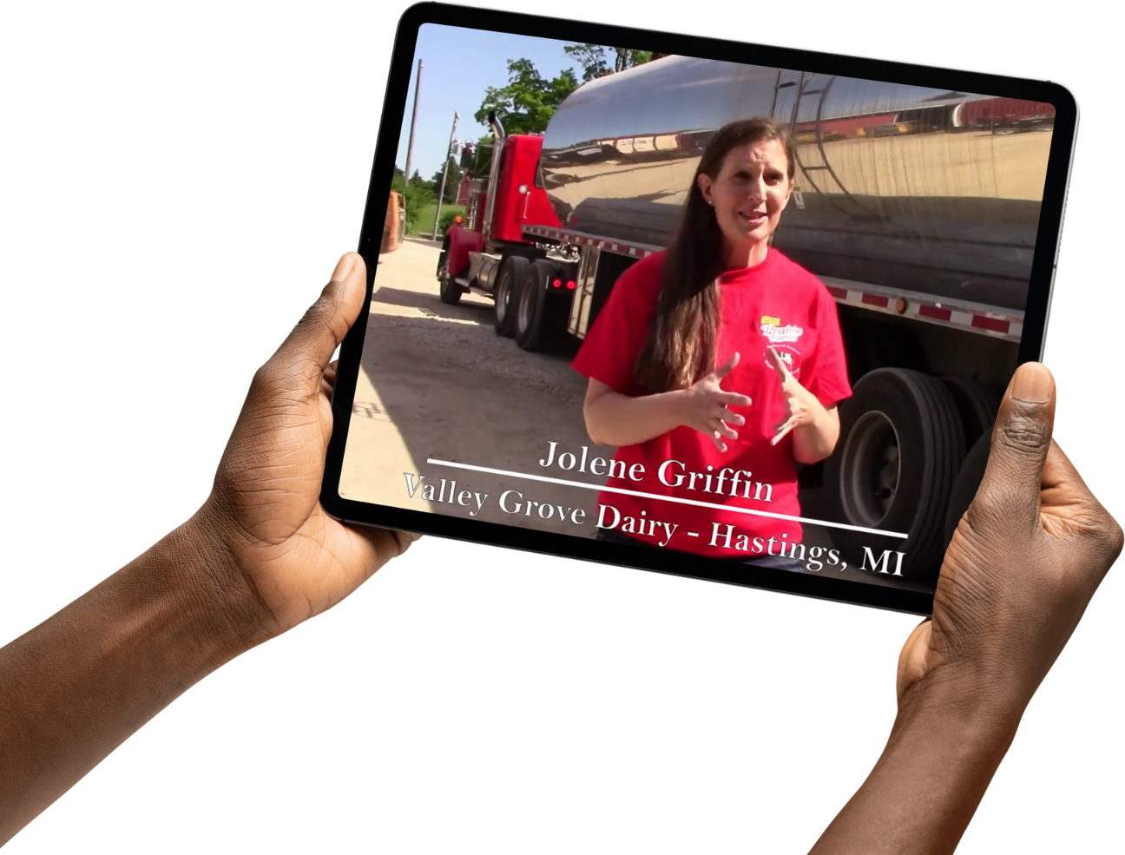
Career Spotlight: Milk Truck Driver
ACTIVATING STRATEGY
Let’s discover the career of a milk truck driver.

Slide 21

Career Spotlight: Milk Truck Driver
WHO IS THE MILK TRUCK DRIVER
The milk truck driver is the person who takes milk from the farm to the milk processing plant.

Slide 22
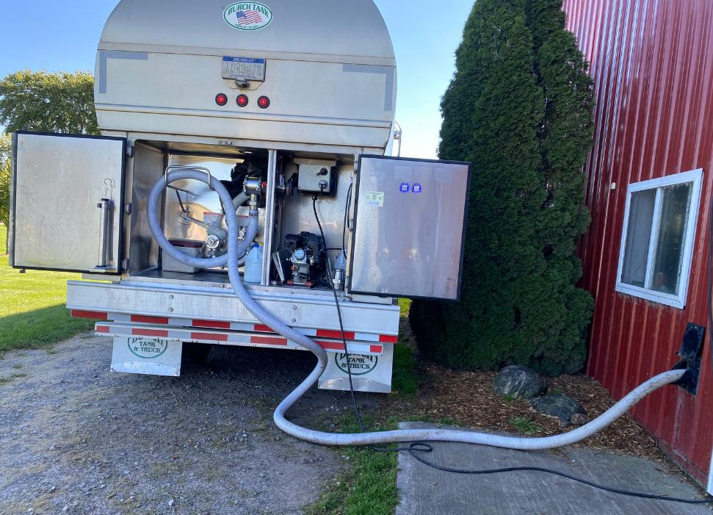
Career Spotlight: Milk Truck Driver
MILK TRUCK DRIVER RESPONSIBILITIES
1. Test the milk to make sure it is safe.
2. Pump the milk from the milk tank to the milk truck.
3. Drive the milk from the farm to the milk processing plant.

Slide 23
Career Spotlight: Milk Truck Driver
CLOSURE
  Tell us one responsibility of a milk truck driver.
  Are you interested in being a milk truck driver when you grow up?

Slide 24
Closure
Share one thing you need to do to keep milk safe

