Slide 1


LESSON 3
Dairy in Our Environment
Going Round and Round
Grades PreK-2nd

Slide 2


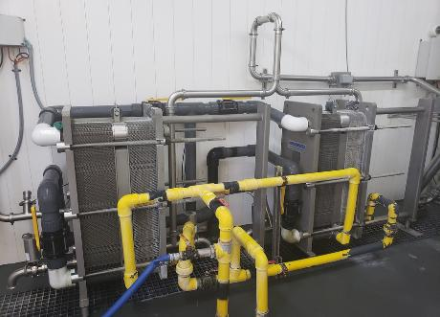
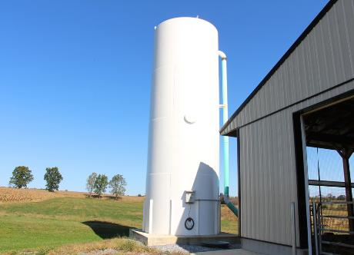
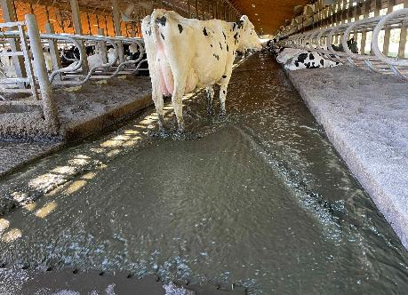
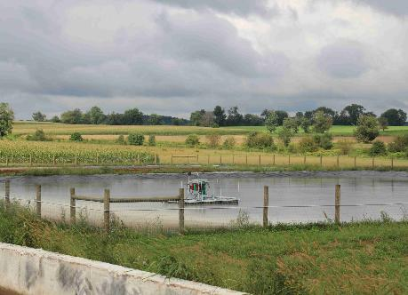
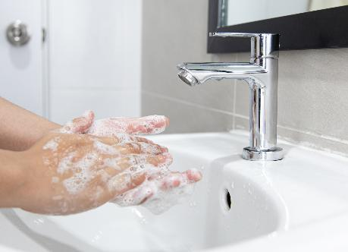
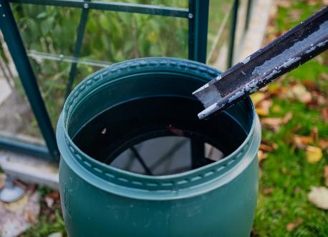
Introduction
HOW DO FARMERS RECYCLE AND CONSERVE?
We will learn the importance of farmers and consumers recycling and conserving water on farms and in homes to help protect our environment.

Slide 3
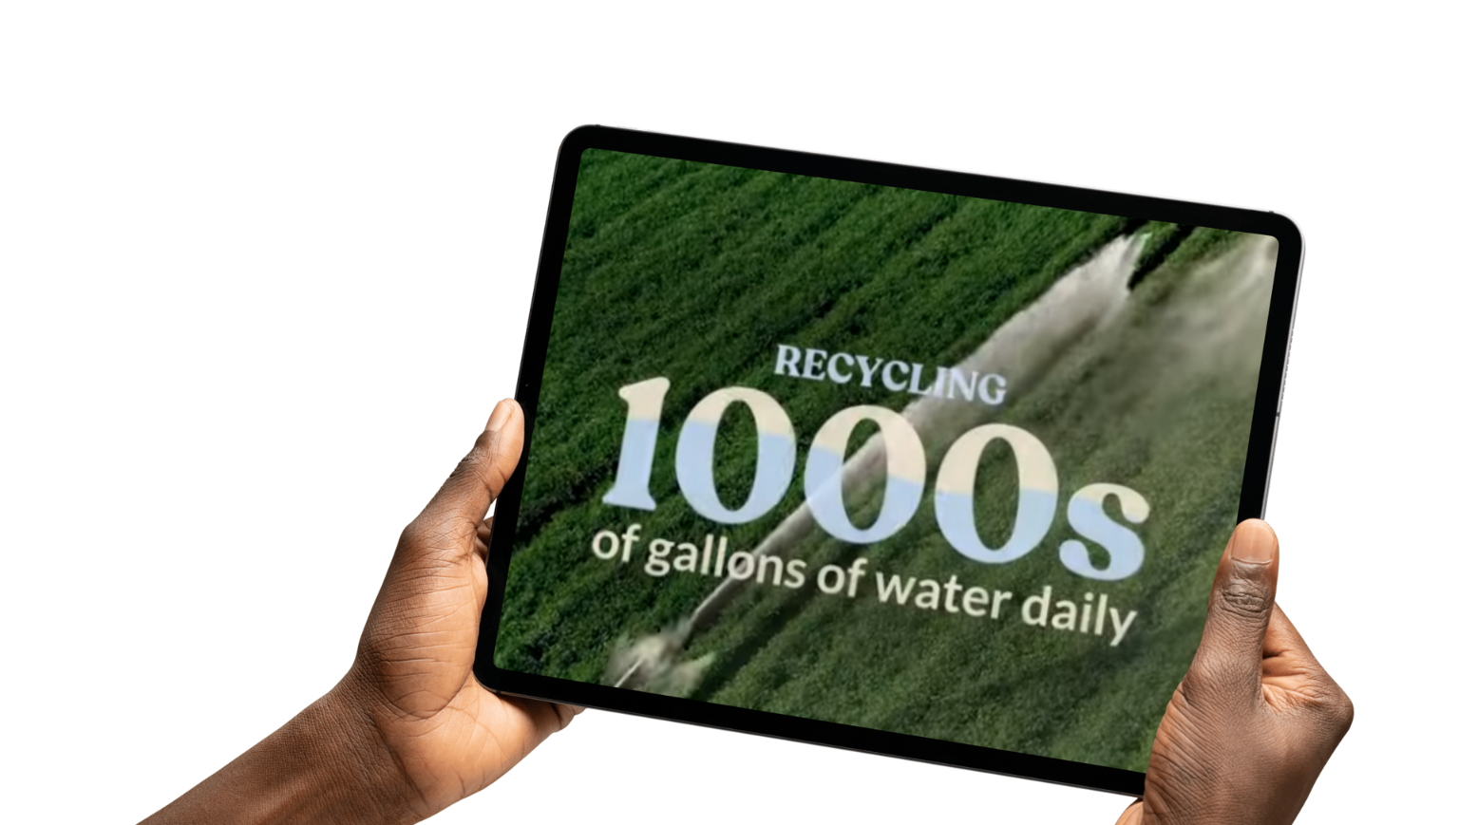

Activating Strategy
DAIRY: GOOD FOR YOU, GOOD FOR THE PLANET
Let’s look at how dairy is good for you and the planet

Slide 4
Words to Learn
DAIRY DEFINITIONS
Conserve: To use less of something
Crops: What a farmer plants in a field and grows into food for people and
feed for the animals
Environment: The surroundings in which a person, plant or animal lives
Field: A piece of land where a farmer plants crops
Milker: A person who guides cows through the milking process on a
dairy farm
Recycle: To use something again

Slide 5

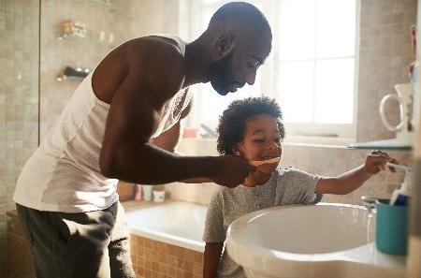
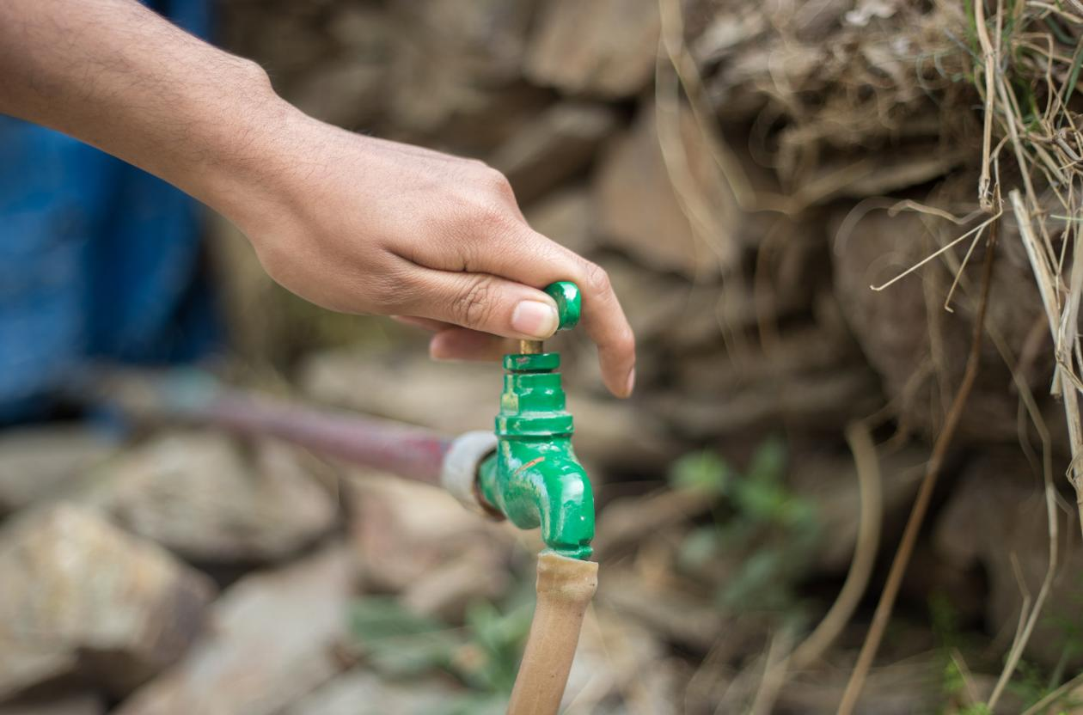
Vocabulary
CONSERVE
Definition: to use less of something
Turn off the faucet when brushing your teeth
Turn the hose off between uses

Slide 6
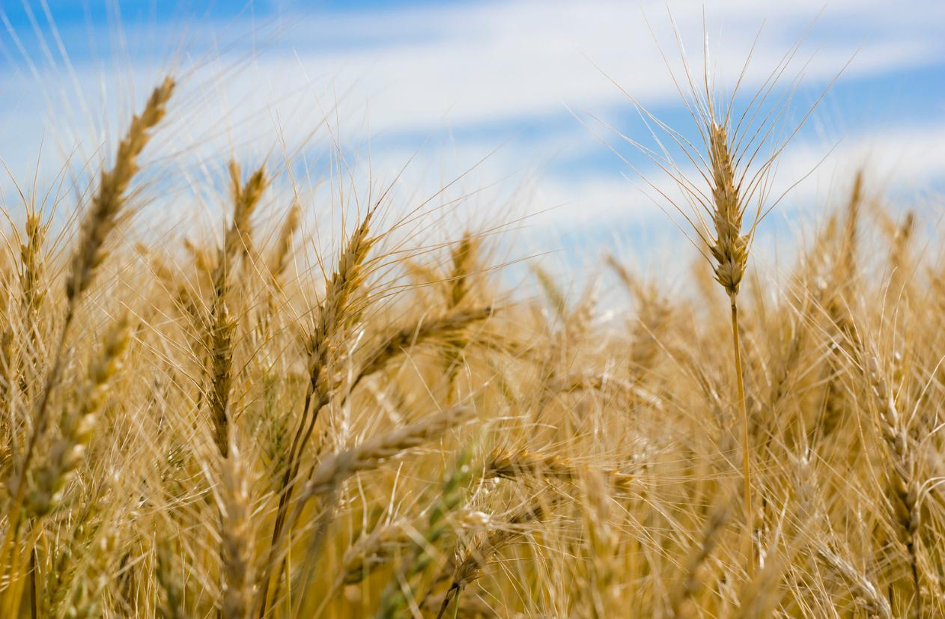
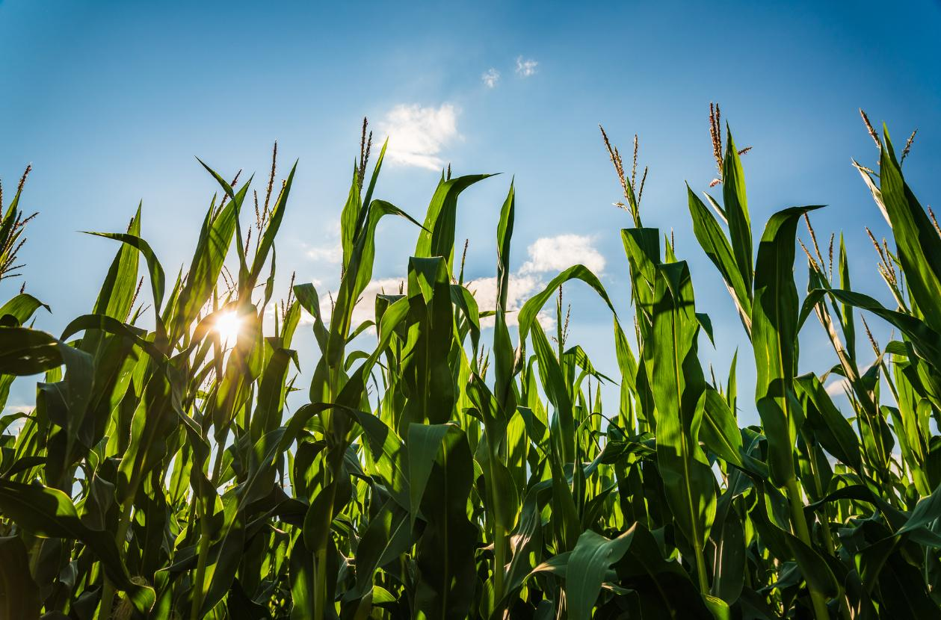
Vocabulary
CROPS
Definition: What a farmer plants in a field and grows into food for people and feed for the animals
Wheat
Corn

Slide 7
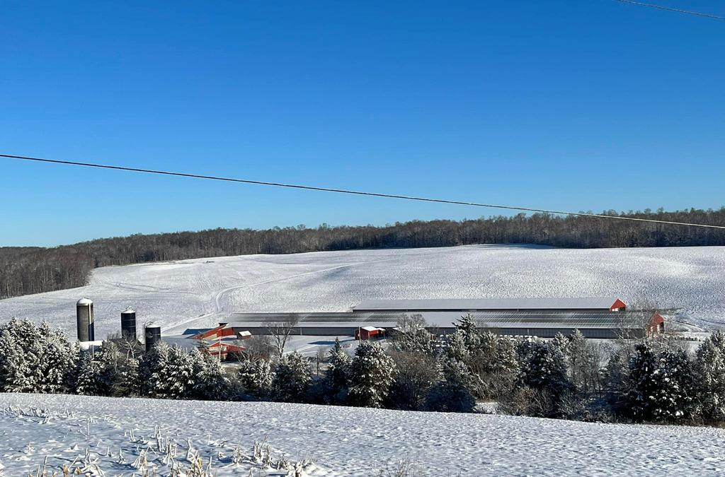
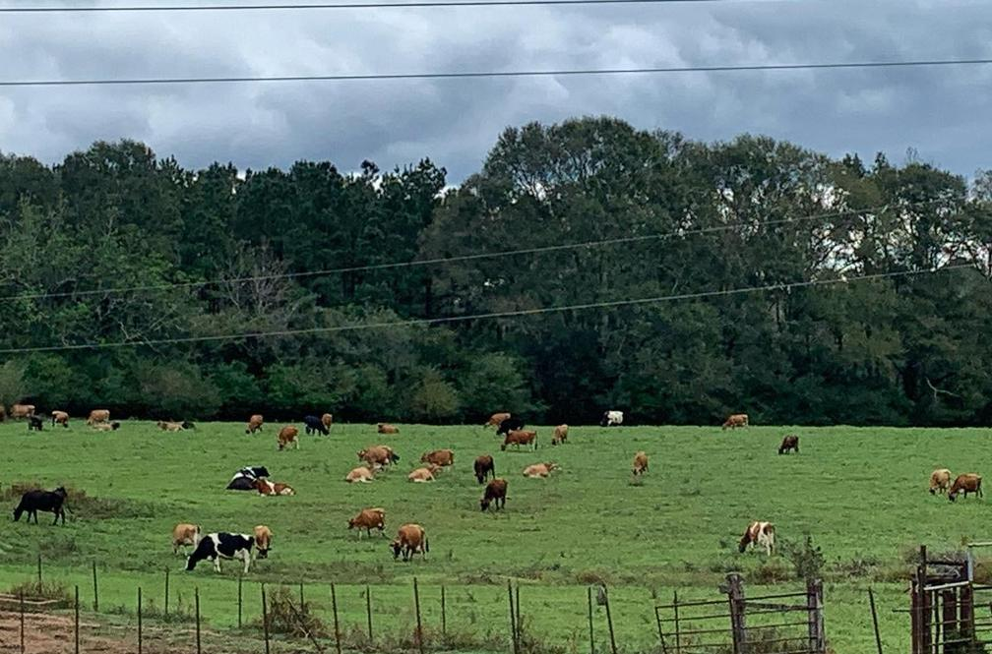
Vocabulary
ENVIRONMENT
Definition: the surroundings in which a person, plant or animal lives
Winter Barn
Summer Pasture

Slide 8
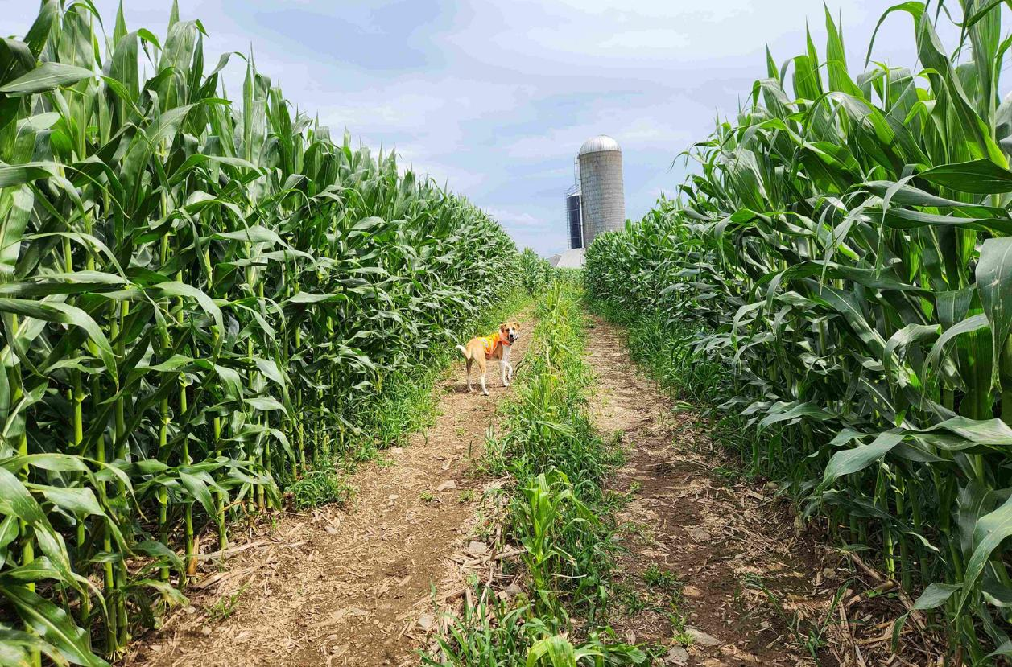
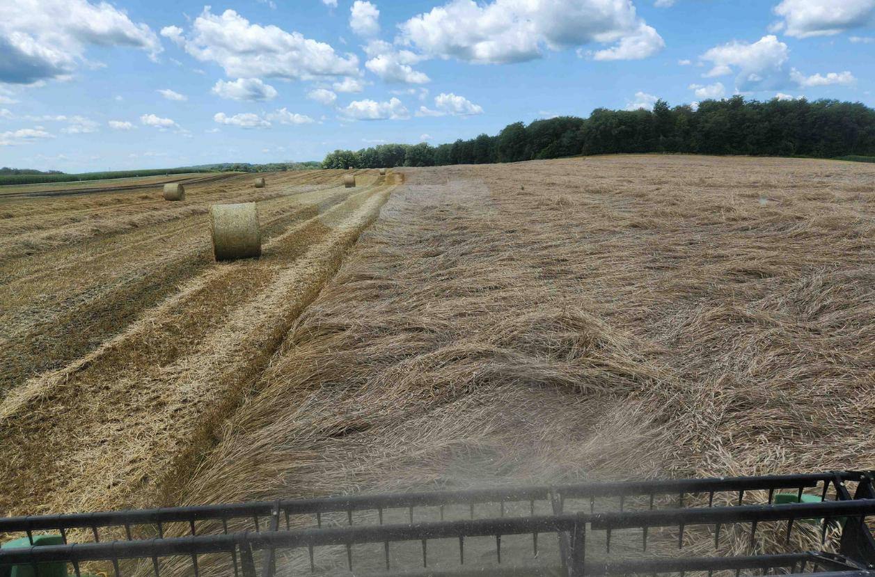
Vocabulary
FIELD
Definition: a piece of land where a farmer plants crops
Corn Field
Rye Field

Slide 9
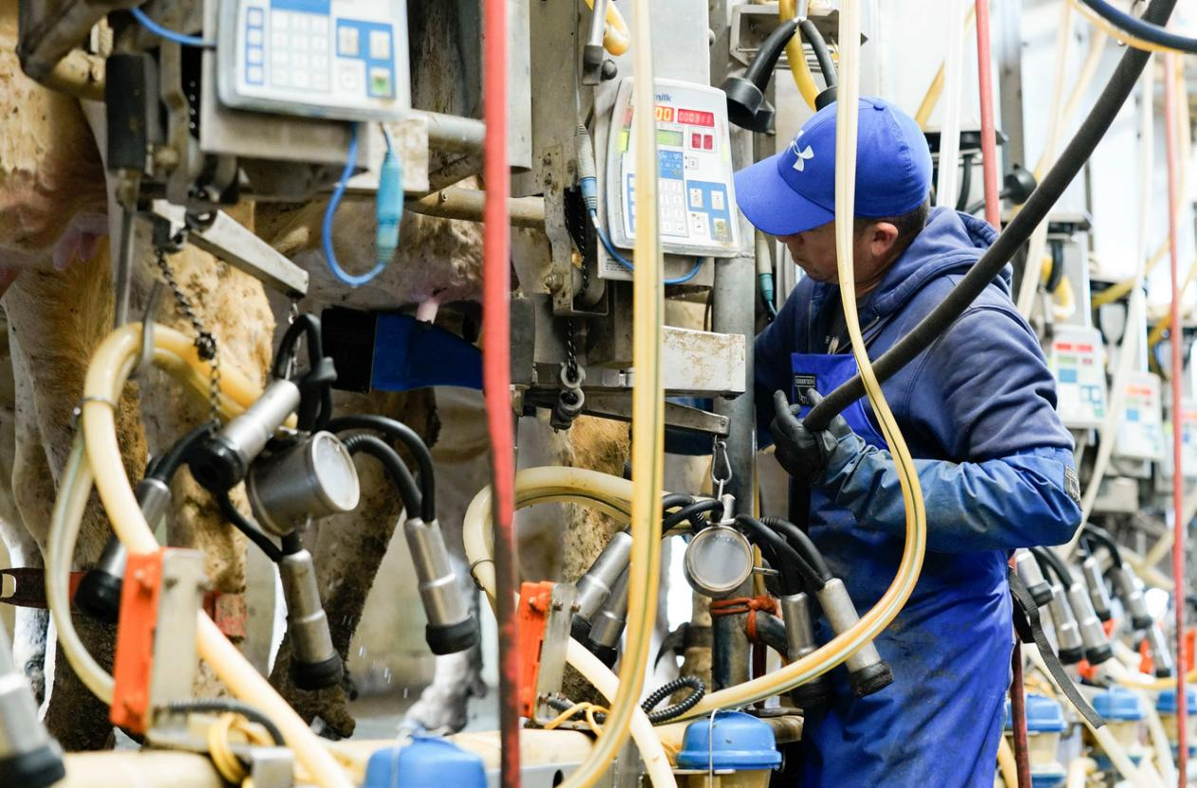
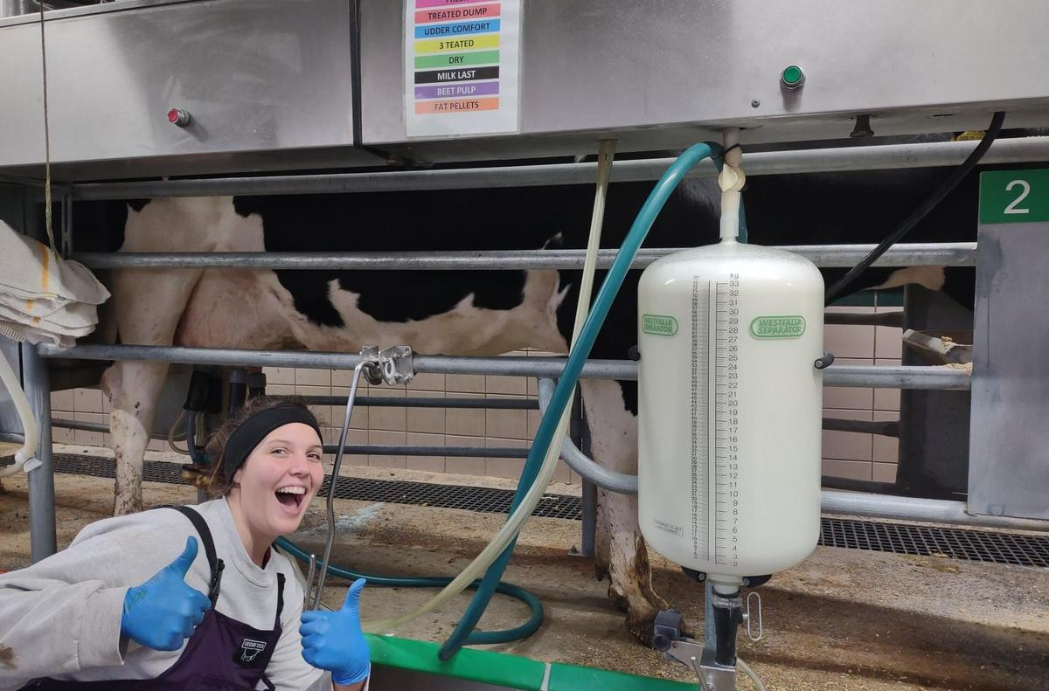
Vocabulary
MILKER
Definition: a person who guides cows through the milking process on a dairy farm
Full-Time Milker
Student Milker

Slide 10
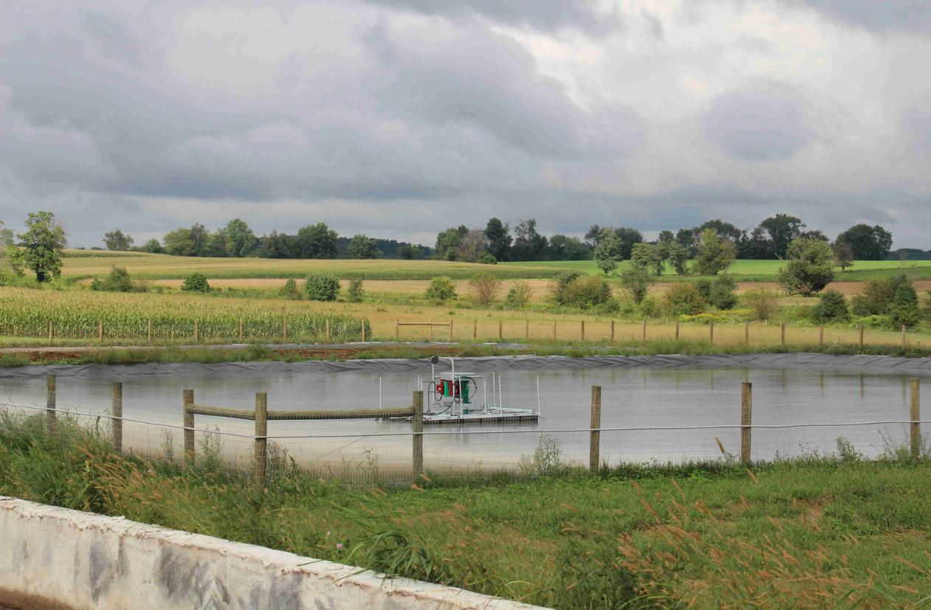
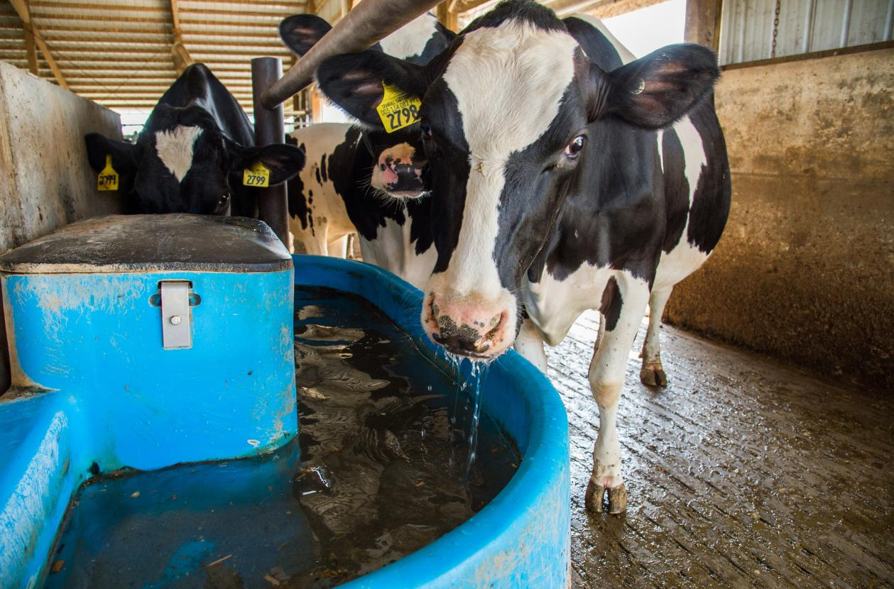
Vocabulary
RECYCLE
Definition: to use again
Water used to cool down milk is then drinking water for the cows
Capturing rain water to fertilize

Slide 11

Recycling and Conserving Water
INTRODUCTION
How do dairy farmers recycle water?
Let’s explore how farmers conserve and recycle one of the most precious resources on a farm: water.

Slide 12
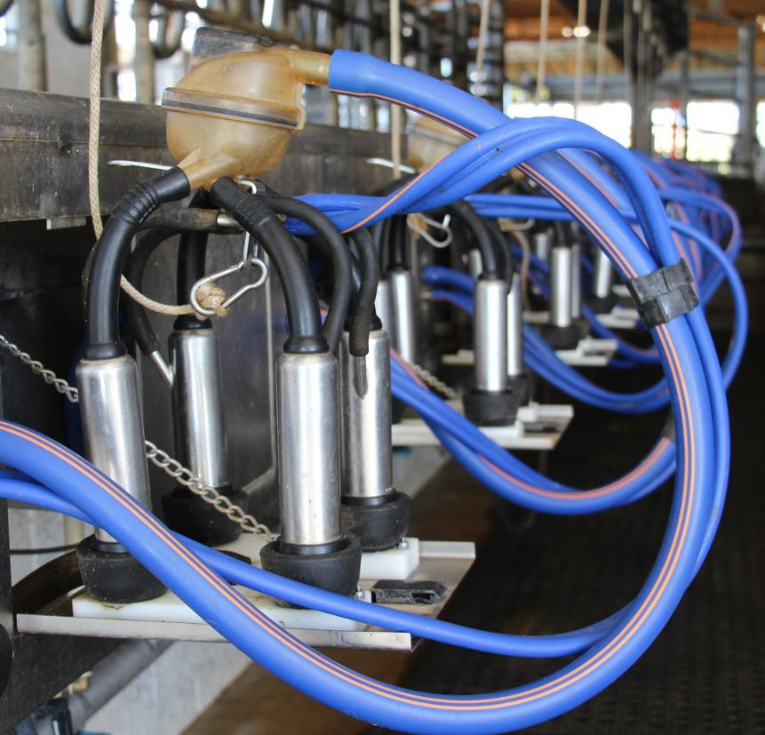
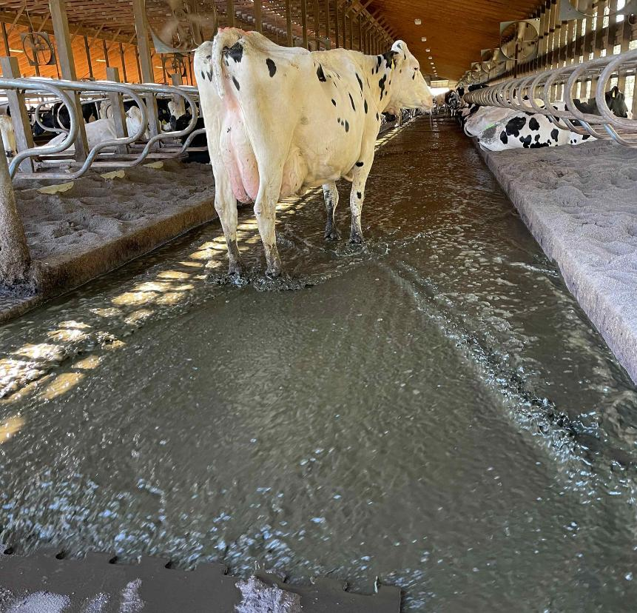
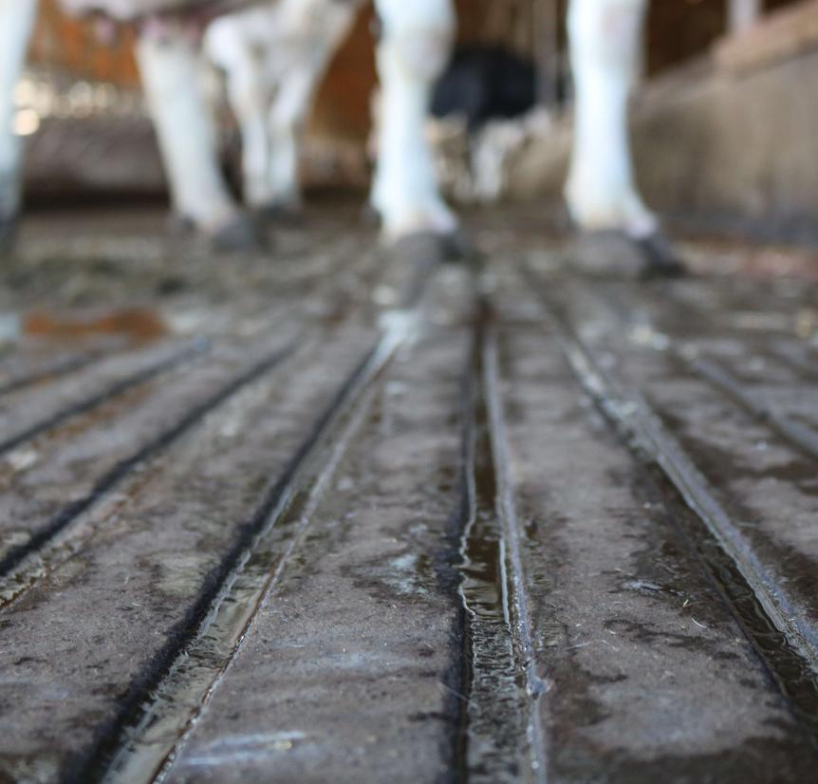
Farmers Recycle and Conserve Water
CLEAN BARNS
Water runs through the milk lines to clean and sanitize.
That water is used again to flush and clean the barn floors.
All clean!

Slide 13
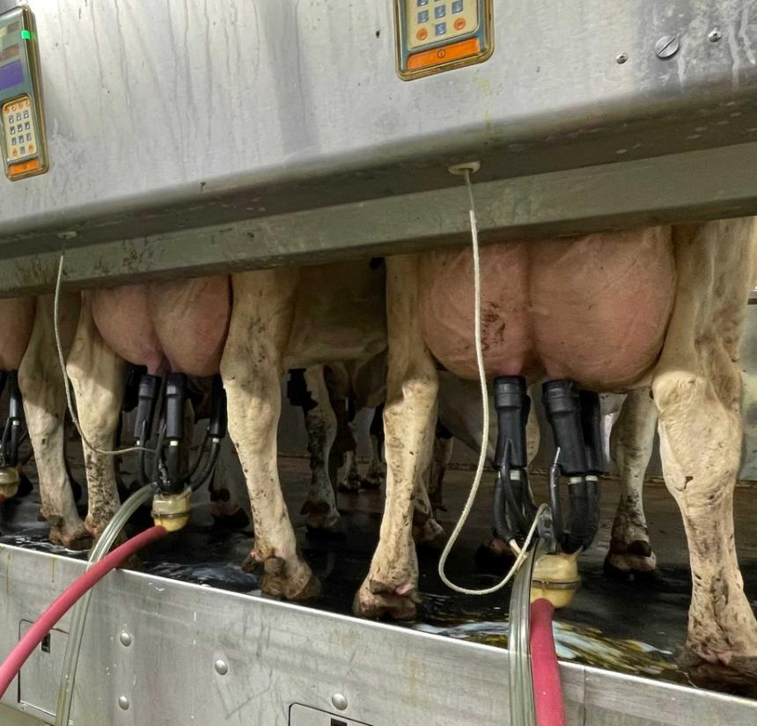
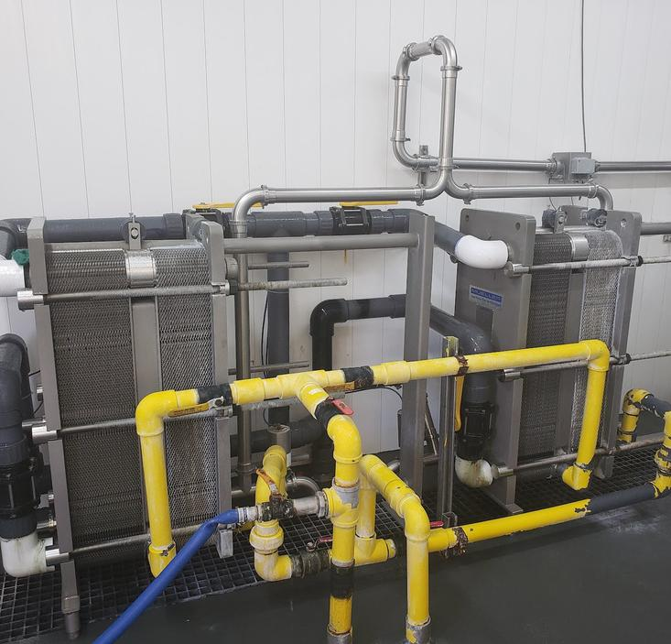
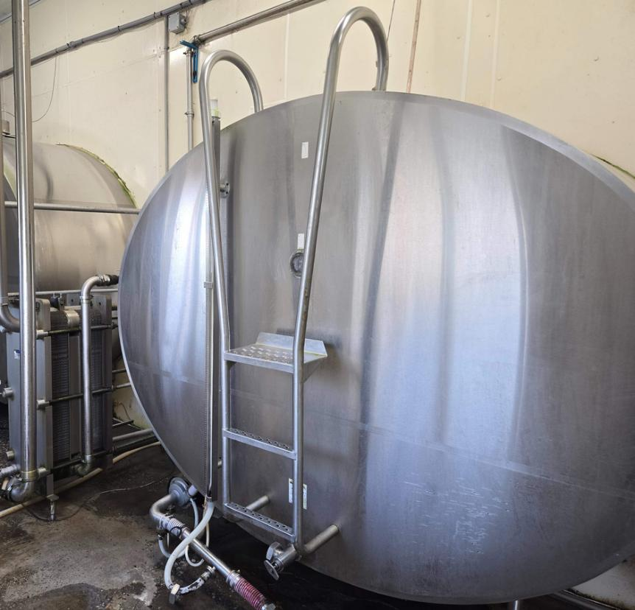
Farmers Recycle and Conserve Water
COOL DOWN MILK
Milk comes out of the udder at 101.5°F and travels through the pipes.
The plate cooler cools the milk down to about 60°F with cold water.
Now it will take less energy to cool the milk to 34°F for storage.

Slide 14
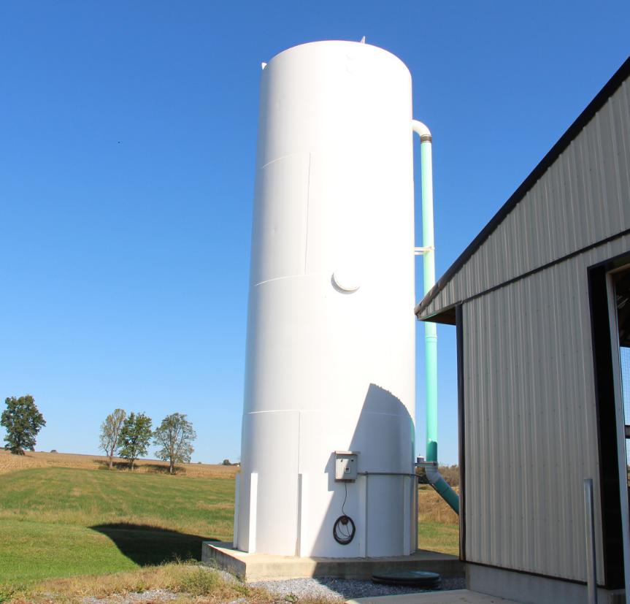
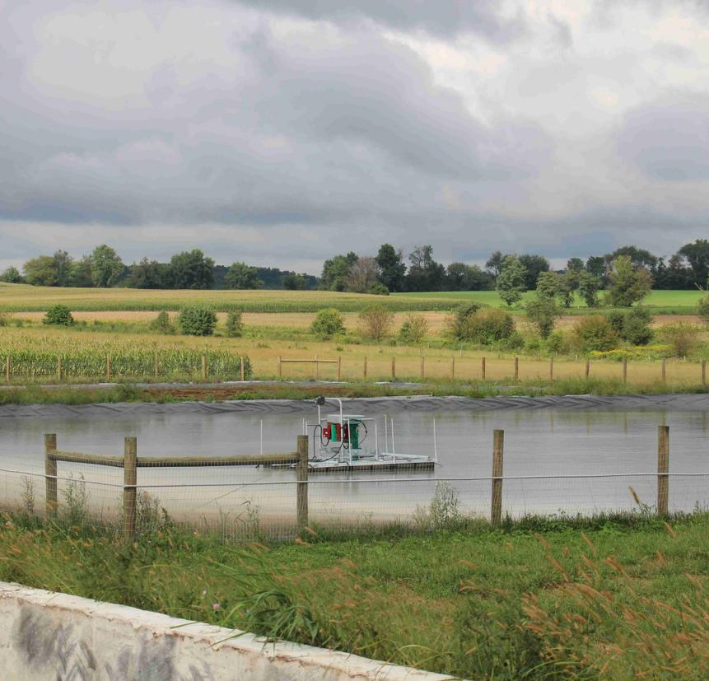
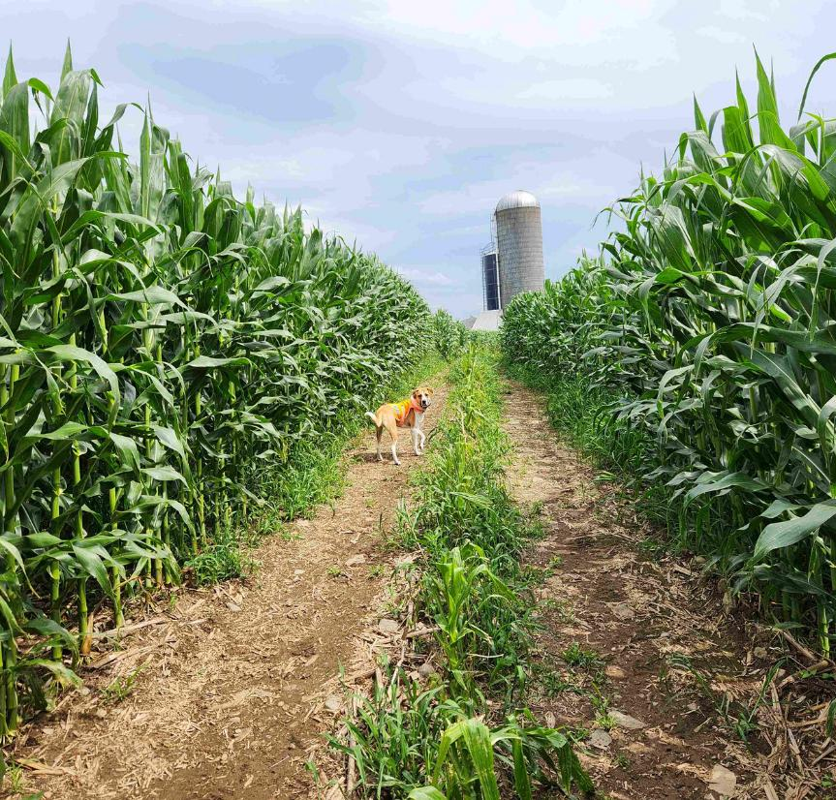
Farmers Recycle and Conserve Water
WATER THE CROPS
Recycled water is stored in the water towers and used to wash the barns.
The waste water is stored in a lagoon until it can be spread on a field.
The crops grow thanks to the nutrient-rich, recycled water!

Slide 15
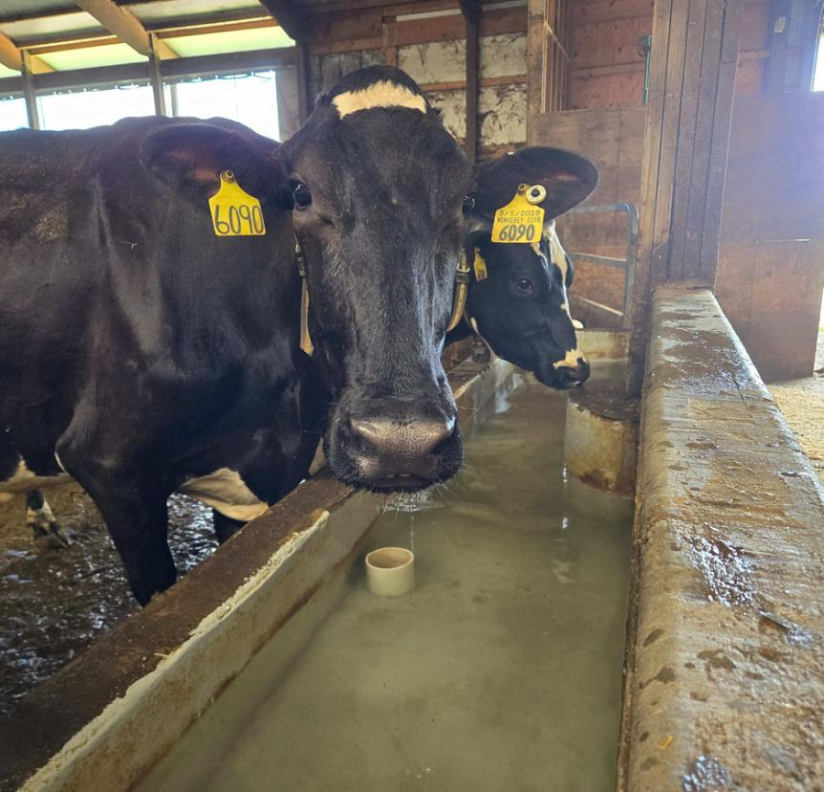
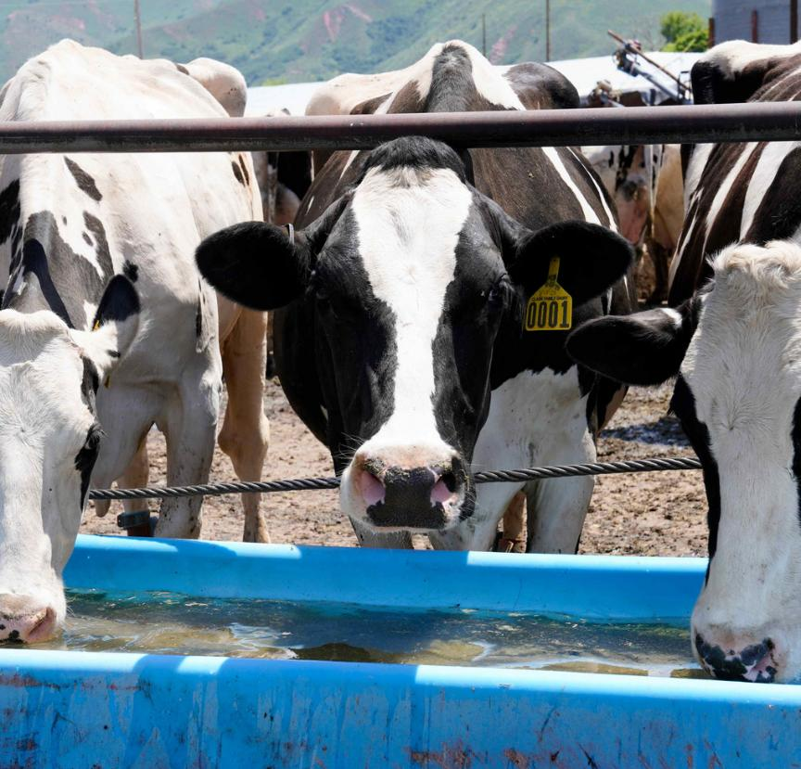
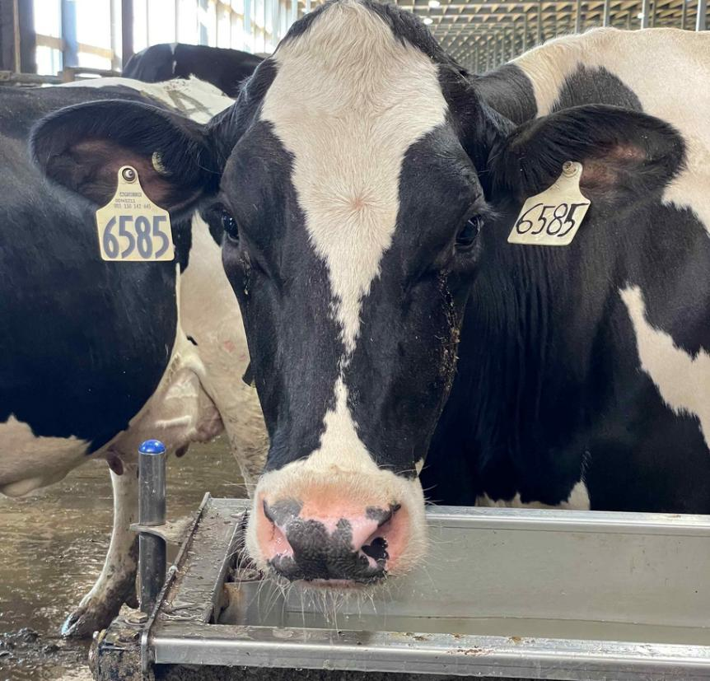
Farmers Recycle and Conserve Water
GIVE WATER TO COWS TO DRINK
Water first cools down the milk in the plate cooler.
Then the clean water is used to fill the water tubs for the cows.
Cows drink 40 gallons of water every day!

Slide 16
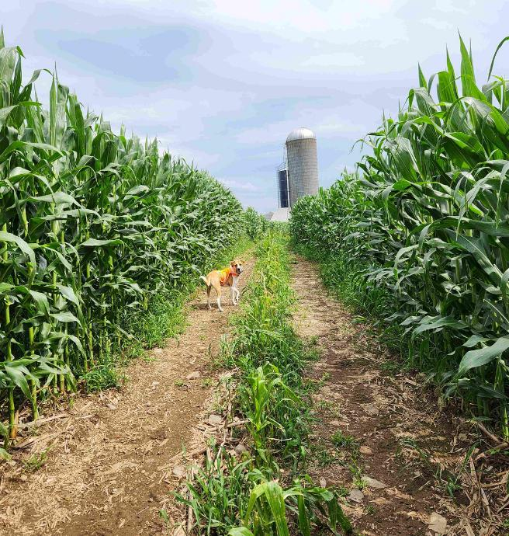
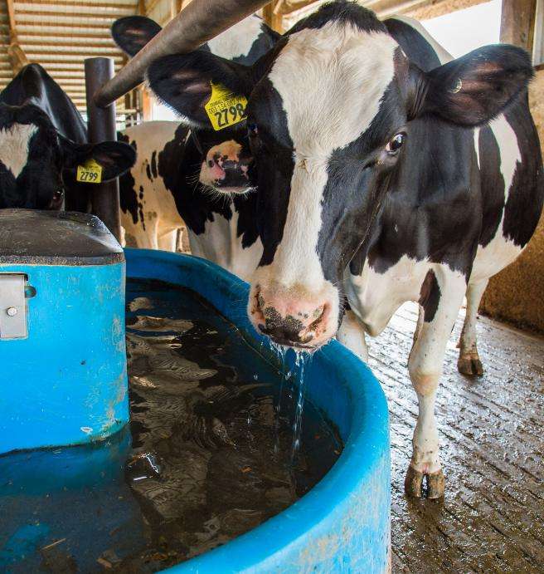
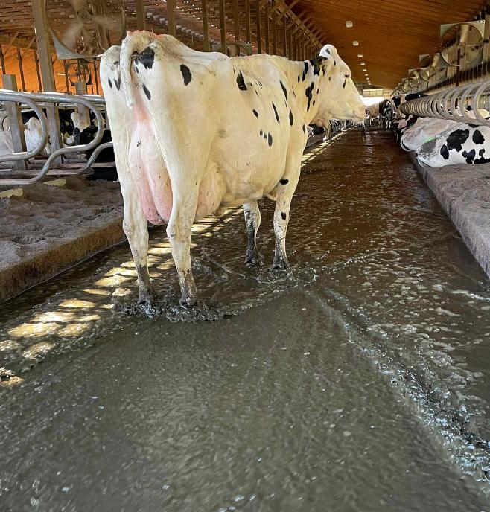
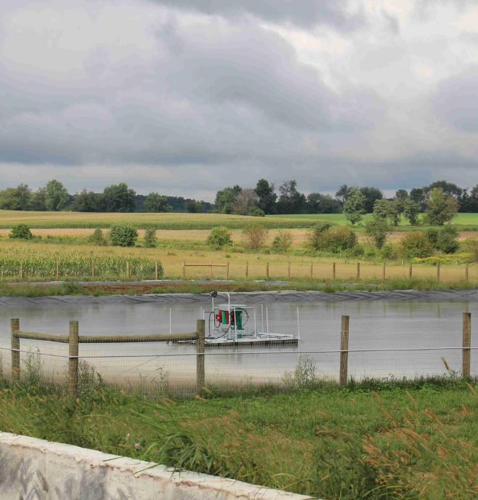
Farmers Recycle and Conserve Water
REVIEW
Recycle rainwater to water crops, wash cows, and keep cows cool (sprinklers).
Recycle the cold water that cools down the milk into drinking water for cows.
Recycle the water used when milking the cows to clean the barn and alleys with a flush system.
Recycle the water used to clean the alleys to water the crops with nutrient-rich water.

Slide 17
Recycling and Conserving Water
CONSUMERS RECYCLE
How can you recycle and conserve water?
Let’s explore how you can help recycle water in your home.

Slide 18
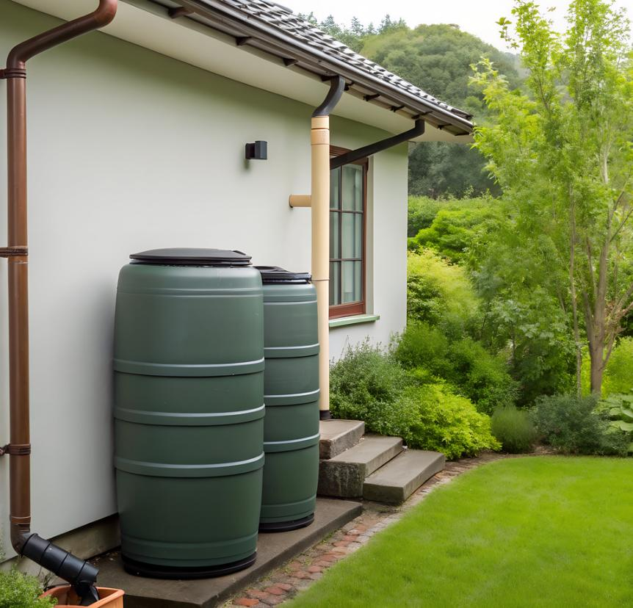
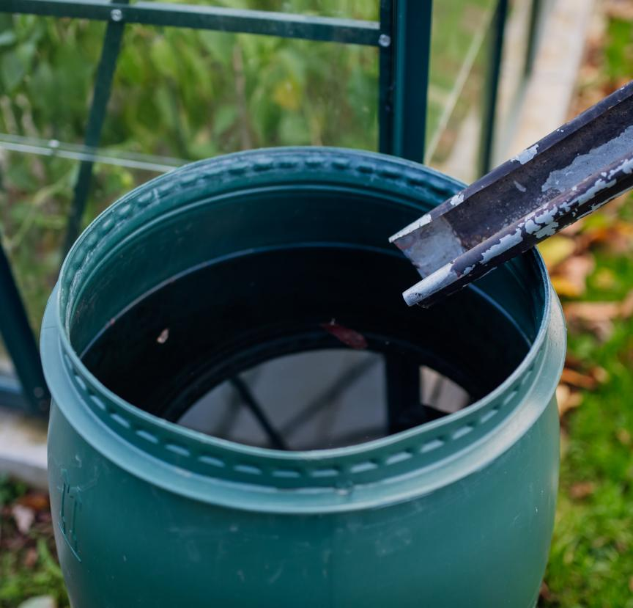
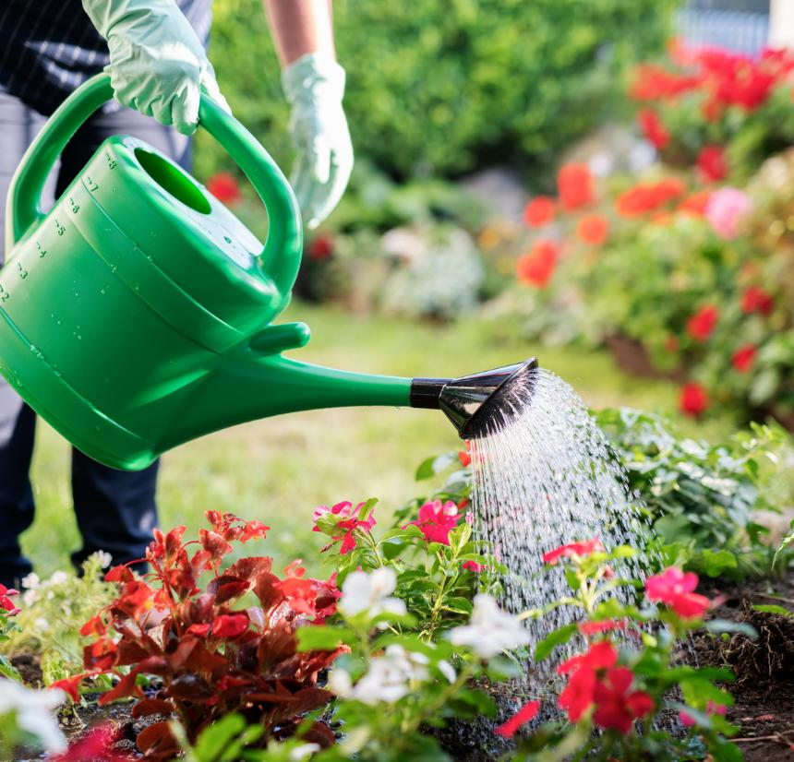
Consumers Recycle and Conserve Water
RECYCLE RAINWATER
Recycle rainwater by using a drain system connected to the roof.
Use the recycled water to water your flowers and garden.
Collect the water in a barrel.

Slide 19
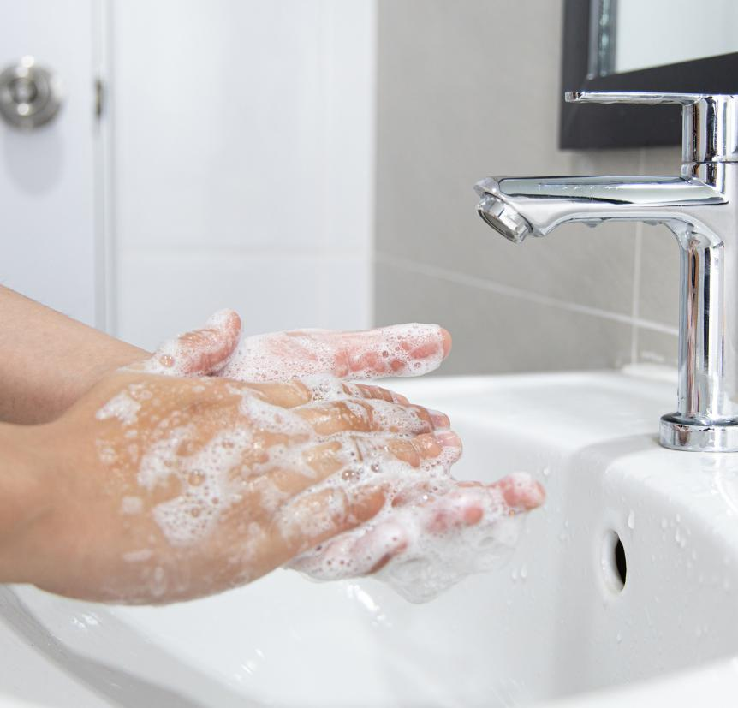
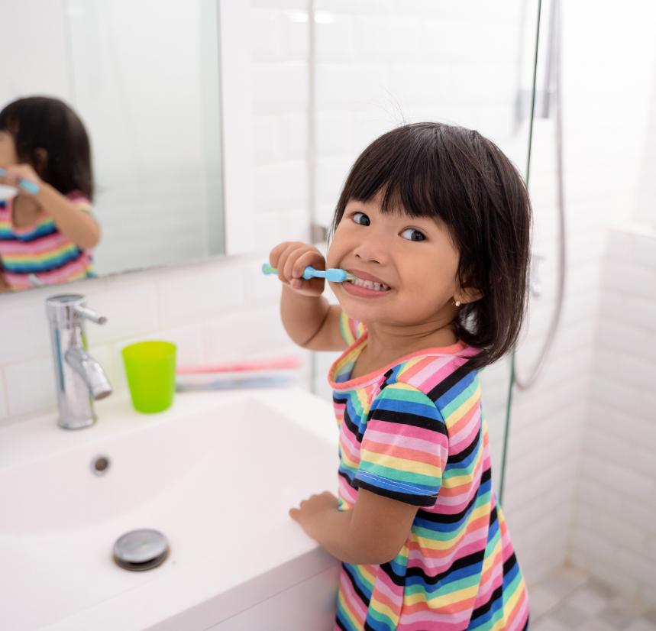
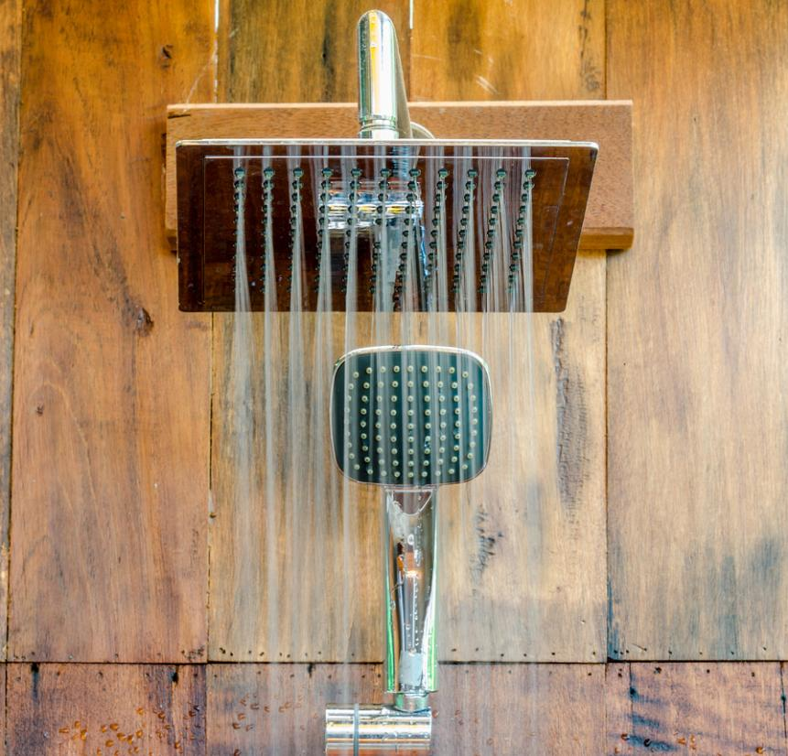
Consumers Recycle and Conserve Water
CONSERVE WATER
Turn off the faucet while scrubbing your hands.
Turn off the water while brushing your teeth
Try taking shorter showers.

Slide 20
Recycle and Conserve Water
CLOSURE
Share one way you know how to recycle and conserve water.

Slide 21
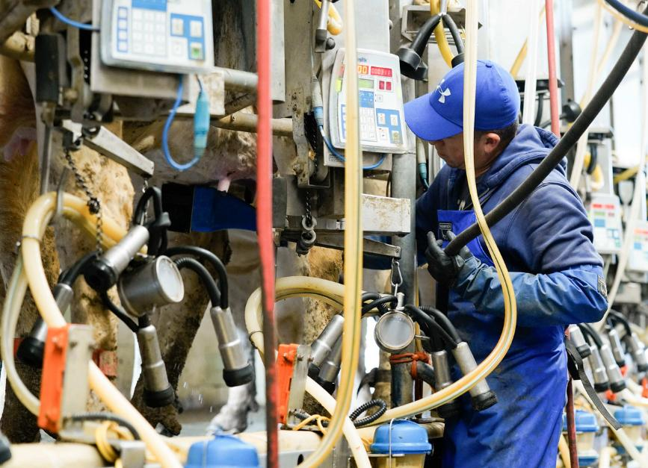
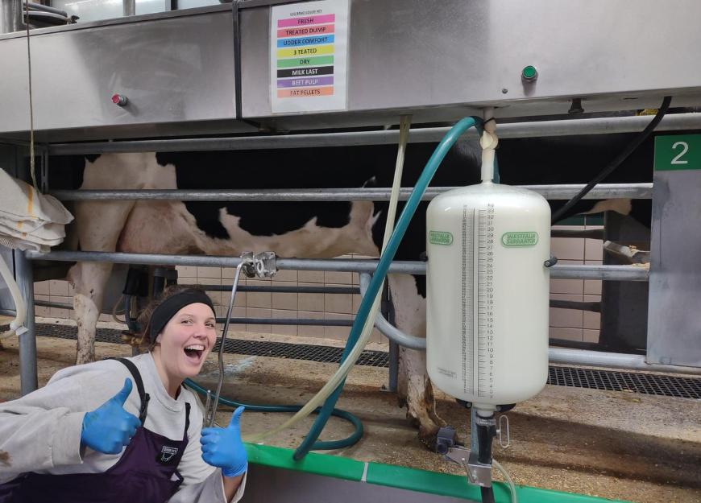
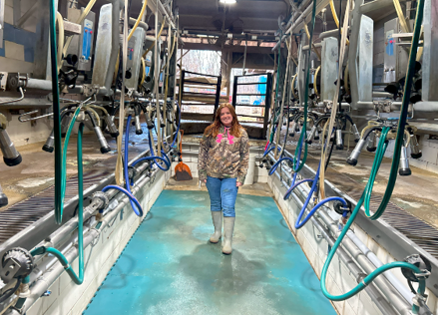
Career Spotlight: Milker
INTRODUCTION
Milkers have an important job on the farm to make sure we get milk and dairy products at the store.

Slide 22
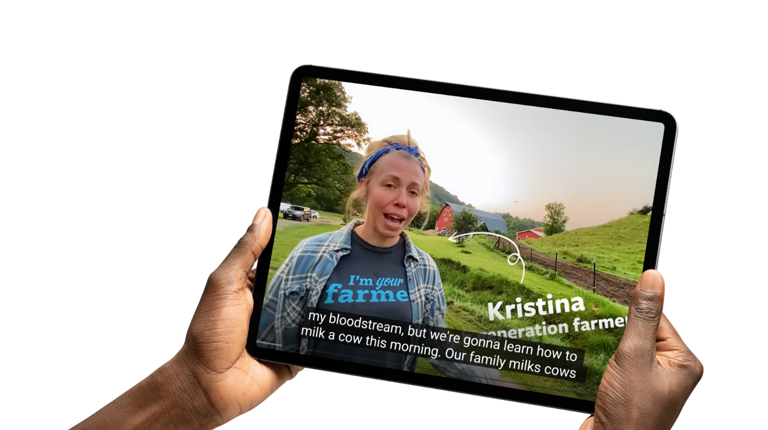
Career Spotlight: Milker
ACTIVATING STRATEGY
Let’s discover the career of a milker

Slide 23
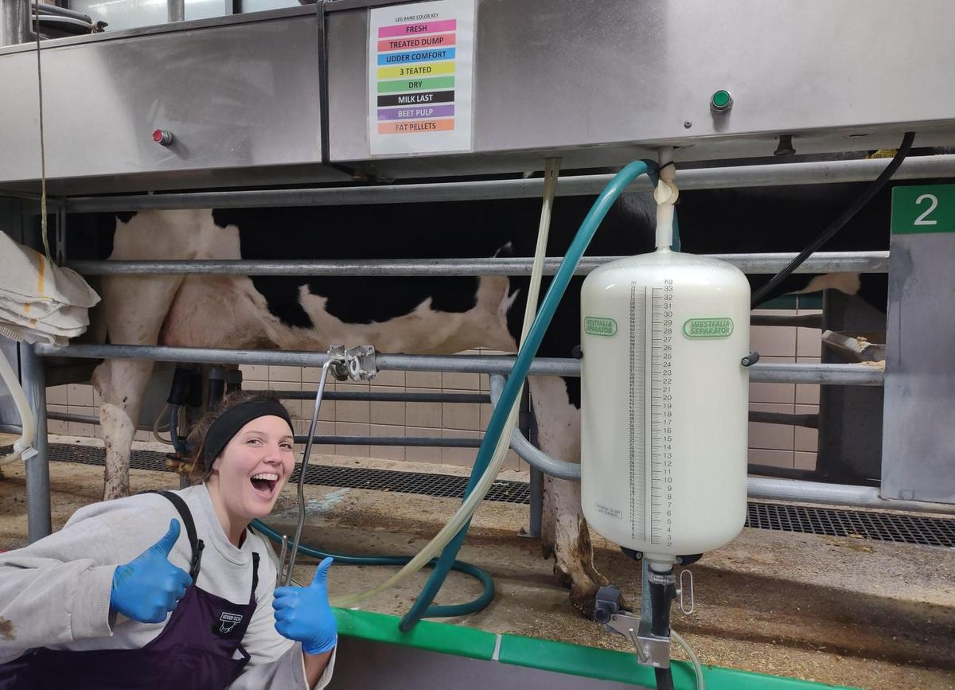
Career Spotlight: Milker
WHO IS THE MILKER?
The milkers guide the cows through the milking process. They get milk from the cows to the milk tank two to three times each day.

Slide 24
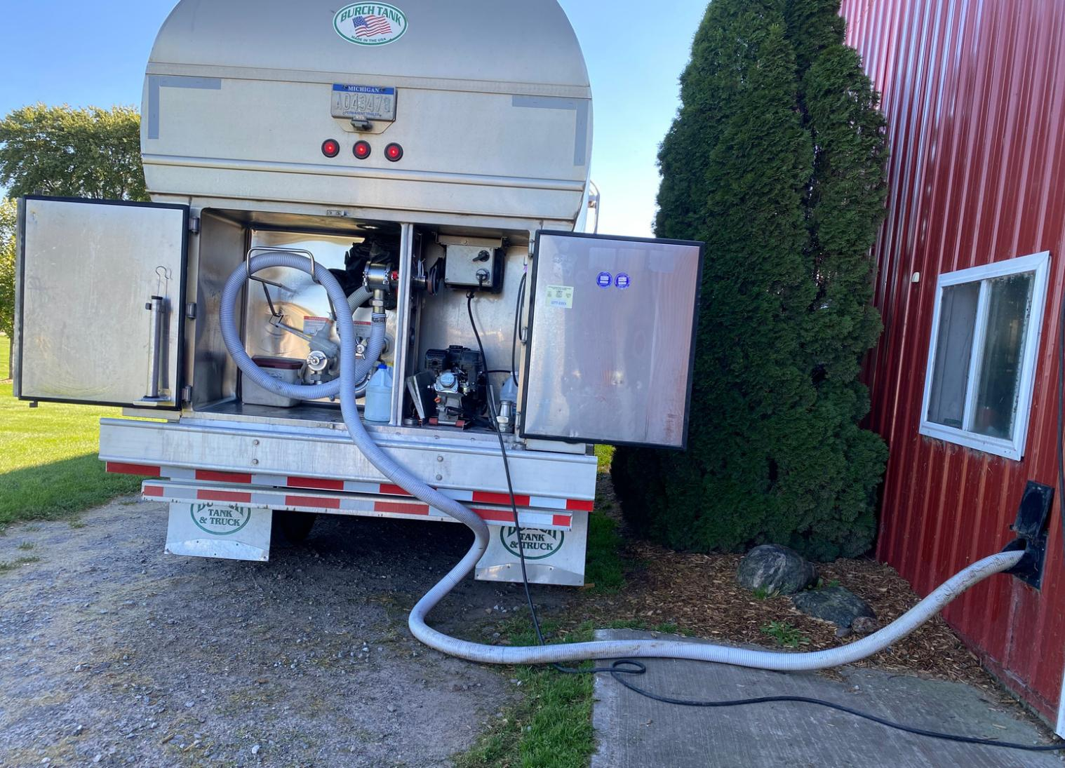
Career Spotlight: Milker
MILKER RESPONSIBILITIES
1. Move the cows into the milking parlor.
2. Prepare the cows to be milked while checking the cow’s health.
3. Milk the cows with a milking unit.
4. Clean the milking parlor and equipment.

Slide 25

Career Spotlight: Milker
CLOSURE
  Tell us one responsibility of the milker.
  Are you interested in being a dairy cow milker when you grow up?

Slide 26
Closure
Share one way that dairy farmers recycle water on their farms.

