Slide 1
Hi kids, it’s good to see you again!
Time to Check in on [insert calf name]!
Notes:
Directions: Use this slide to add a picture or video of the calf. Replace the text in brackets for what it says inside of them. Don’t forget to remove the brackets from the final sentence! Click on the picture or media icons to add a picture or video to the slide!

Slide 2
Name:
Birthdate:
Updated Information
Age:
3 Month Height:
3 Month Weight:
Notes:
Directions: Add the Calf’s name and birthdate at the top of the slide. Then add the updated information. Add 2 pictures or videos of the calf to show how much she has grown!

Slide 3
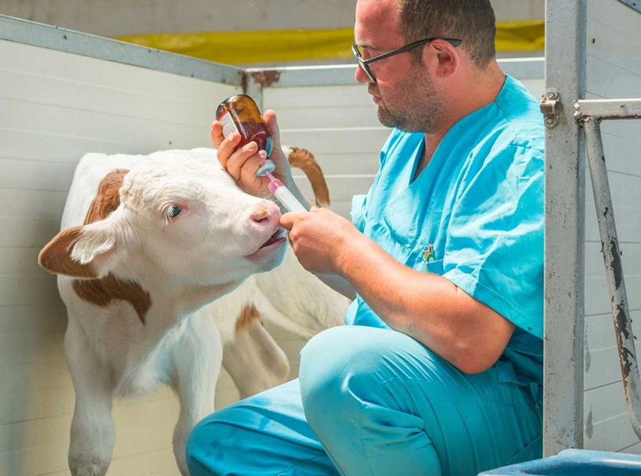
[Insert calf name]’s Health is Important
Proactive daily care is key to keeping Adele and her herd mates happy and healthy!
Vaccinations
[Insert calf name] was vaccinated at 3 months old to protect her from getting harmful diseases.
Notes:
Directions: Add a picture of your calf and insert her name in the brackets. If she wasn’t vaccinated at 3 months, change it to when she was.

Slide 4
[Calf name] enjoys a sweet grain pellet mix which gives her a lot of energy and helps her digestive system develop.
Hay is added to [calf name]’s diet because it is a high fiber food which is perfect for her growth and diet. She gets to eat as much hay and drink as much water as she wants!
[Insert calf name]’s New Diet
Now that [calf name] is older, she gets to eat foods that have more fiber to help develop the different compartments in her stomach.
Notes:
Directions: Use this slide if your farm feeds sweet grain pellet mix and hay to 3-month-old calves. Delete the other two diet slides.

Slide 5
[Calf name] enjoys a calf starter grain which gives her a lot of energy and helps her digestive system develop.
Hay is added to [calf name]’s diet because it is a high fiber food which is perfect for her growth and diet. Her and her friends eat as much hay and drink as much water as they want!
[Insert calf name]’s New Diet
Now that [calf name] is older, she gets to eat foods that have more fiber to help develop the different compartments in her stomach.
Notes:
Directions: Use this slide if your farm feeds calf starter corn mix and hay to 3-month-old calves. Delete the other two diet slides.

Slide 6
[Calf name] enjoys a corn and soybean mix with vitamins and minerals which gives her energy and helps her digestive system develop.
Hay is added to [calf name]’s diet because it is a high fiber food which is perfect for her growth and diet. She gets to eat as much hay and drink as much water as she wants!
[Insert calf name]’s New Diet
Now that [calf name] is older, she gets to eat foods that have more fiber to help develop the different compartments in her stomach.
Notes:
Directions: Use this slide if your farm feeds corn and soybean mix and hay to 3-month-old calves. Delete the other two diet slides.

Slide 7
[Calf name] sleeps on straw bedding which helps to keep her clean, dry, and very warm!
[Calf name] and her friends live together because it is easier to monitor growth, feed intake, and see signs of sickness.
Group Housing
[Calf name] now lives with a few of her herd mates in a new group pen. She loves hanging out with her new buddies!
Notes:
Directions: Use this slide if your calf lives in group housing at 3 months old. Delete the other housing slides.

Slide 8
[Calf name]’s hutch is bedded with cozy straw. Straw is an excellent insulator and helps keep her warm and clean.
[Calf name] loves her cozy hutch. Each hutch has plenty of protection from the weather and room to play!
Hutches
[Calf name] is finishing up her time in her individual hutch and will be moving to group housing soon!
Notes:
Directions: Use this slide if your calf lives in a hutch at 3 months old. Delete the other housing slides.

Slide 9
[Calf name]’s pen is very soft! It has straw that is very comfy to lay on and keeps her warm and dry.
[Calf name] is very excited to live with her friends soon but for now she likes having her own room!
Individual Pens
[Calf name] still lives in her pen but soon she will move into a larger pen with 4-5 of her friends!
Notes:
Directions: Use this slide if your calf lives in an individual pen at 3 months old. Delete the other housing slides.

Slide 10
Living on the pasture provides plenty of soft places for [calf name] to sleep and play all day.
In the summer, there are trees that provide shade and fresh green grass to nibble on.
Pasture Living
[Calf name] lives with her other herd mates in an open pasture. For protection, she has a sheltered area that she can go to if she wants.
Notes:
Directions: Use this slide if your calves live on pasture at 3 months old. Delete the other housing slides.

Slide 11
[Dam name]
[Dam name] produced more than 20,000 pounds of milk last year! Go [dam name]!
[Dam] was bred artificially to become pregnant and have another calf. Once confirmed pregnant at 60 days, she will be milked for 5 more months and then go on vacation for 2 months. [Calf name] is going to have a little brother or sister soon!
Do you have siblings?
What are their names?
Hey Kids! Thanks for adopting my calf [calf name]!
[Dam name] Update
Notes:
Directions: This is the dam’s update slide. Add a picture or video of the dam and fill out any information in the brackets.

Slide 12
Look how BIG [calf name] has grown! At just 3 months old, she is as tall as a 2nd grader!
Notes:
Directions: Add a picture or video of your calf.

Slide 13
Notes:
Directions: (Same as update 1) Use the icons to insert an arial picture or video of your farm that will fill the entire background. Add your farm name and you are all done!

